Slide 1
Managing Anxiety
During periods of chaos and change
Total Health 3Q Webinar
September 29, 2022
John C. Pompe, Psy.D., SPHR
Global Manager, EAP and Employee Health Programs
Caterpillar Inc.

Slide 3
Introduction
Peoria, IL, USA
Masters and Doctorate in Clinical Psychology. Senior Professional in Human Resources (SPHR).
Caterpillar since 2002
Areas of work: EAP, Wellness, Occupational Health, absence management, mobility and relocation support, workplace violence prevention, HR/performance management
Current: Global Manager of EAP and Employee Health Programs

Slide 4
Agenda
What is anxiety?
Early warning signs
Taking control
Resources for support
1-2 things you can start/stop/continue doing to better manage anxiety

Slide 5
Make mental health & well-being for all a global priority.
October 10, 2022
September 8, 2022

Slide 6
What is Anxiety?
Notes:
Think about these questions as they relate to you – do not type in the chat

Slide 7
Anxiety
/aNGˈzīədē/
noun
Anxiety can be normal in stressful situations. It becomes problematic when these feelings happen too often, go on too long or are severe enough to interfere with daily life.
An umbrella term for feelings of tension, worried thoughts and physical changes often related to an event or something with an uncertain outcome.
Anxiety disorders involve recurring intrusive thoughts, avoidance behaviors, and more severe physical symptoms.
Notes:
Source: https://www.apa.org/topics/anxiety
Anxiety is an emotion characterized by feelings of tension, worried thoughts, and physical changes like increased blood pressure.
People with anxiety disorders usually have recurring intrusive thoughts or concerns. They may avoid certain situations out of worry. They may also have physical symptoms such as sweating, trembling, dizziness, or a rapid heartbeat.
Anxiety is not the same as fear, but they are often used interchangeably. Anxiety is considered a future-oriented, long-acting response broadly focused on a diffuse threat, whereas fear is an appropriate, present-oriented, and short-lived response to a clearly identifiable and specific threat.
Intense, excessive, and persistent worry and fear about everyday situations. Fast heart rate, rapid breathing, sweating, and feeling tired may occur.

Slide 8
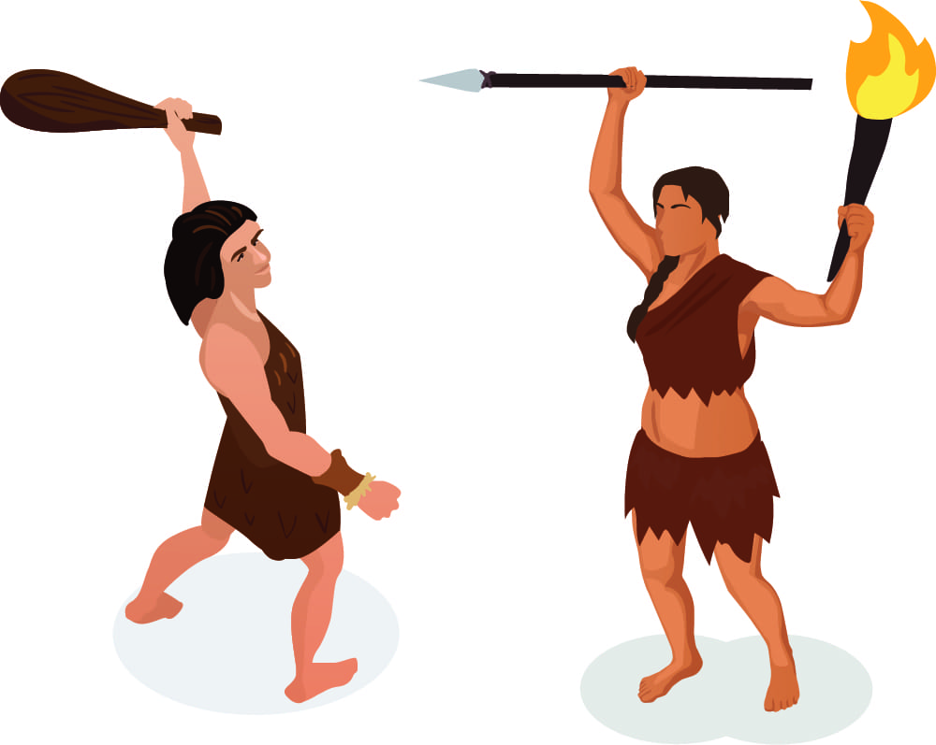
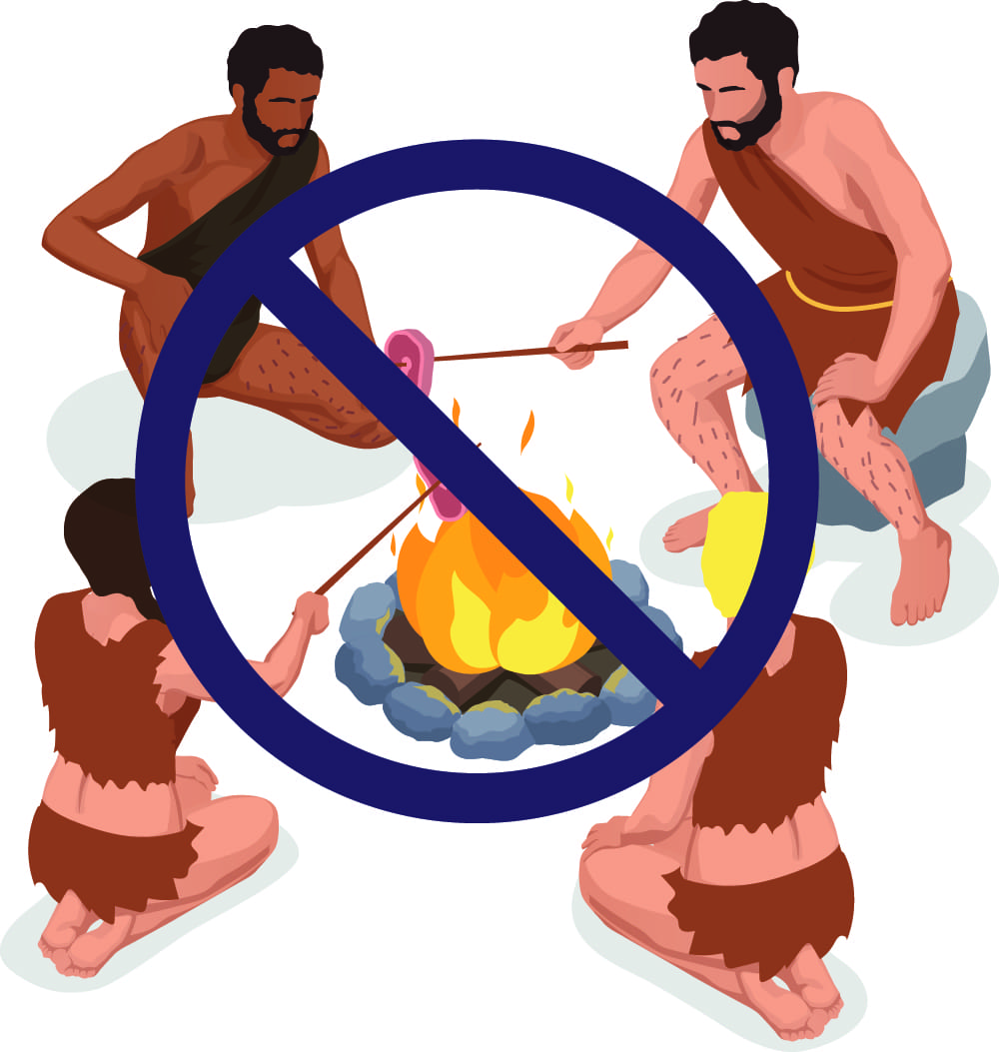
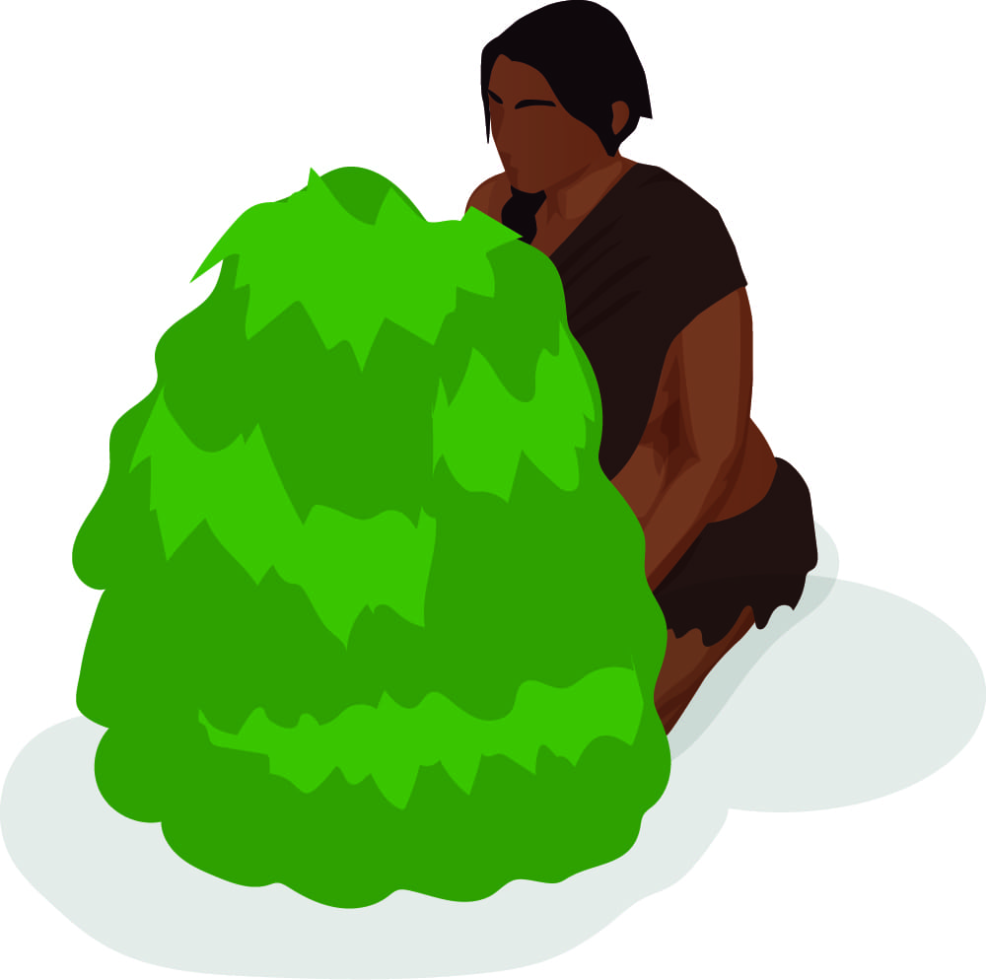
Evolution of Anxiety
Better safe than sorry.
Our brain would rather set off ‘false alarms’ than miss one real danger. We are prone to suddenly feeling afraid when there is no danger.
Reality vs. imagination.
Our brain isn’t very good at telling the difference between real threats in the world vs. imagined threats.
Impulsivity.
We are growing “emotionally hyperactive.” We feel first and think second. Thoughts are often irrational.
Cold
Hunger
Other people
Dangerous
animals
Being excluded
from your group
Freezing, hiding,
or ‘playing dead’
Running away
Fighting or acting
aggressively

Slide 9
Anxiety Disorders
When our evolutinary wiring no longer fits in the modern world.
Separation Anxiety
Selective Mutism
Specific Phobia
Social Anxiety Disorder (Social Phobia)
Panic Disorder
Agoraphobia
Generalized Anxiety Disorder (GAD)
Substance/Medical Induced Anxiety Disorder
Others where Anxiety is a prominent feature- OCD, PTSD, Health Anxiety, Avoidant PD
Primary treatments include psychotherapy (counseling) and medication.
Notes:
When our evolutionary wiring no longer align in the modern world
Fear- related to a real or past experienced threat
Anxiety- is future focused and less severe

Slide 10
CDC Household Pulse Survey: Presence of Anxiety Disorder
Pre-pandemic
U.S. 8.1%
Global 7.3%
Post-pandemic
U.S. increase 255%
Global increase 25.6%
Changes correlated with infection rate and mobility (or lack of)
2019
Apr. 20
Oct. 20
Jan. 21
July 21
Jan. 22
July 22
Notes:
Increases in the prevalence of major depressive disorder and anxiety disorders during 2020 were both associated with increasing SARS-CoV-2 infection rates and decreasing human mobility. Source: https://www.thelancet.com/action/showPdf?pii=S0140-6736%2821%2902143-7
2013: The global current prevalence of anxiety disorders adjusted for methodological differences was 7.3% (4.8-10.9%) and ranged from 5.3% (3.5-8.1%) in African cultures to 10.4% (7.0-15.5%) in Euro/Anglo cultures. https://pubmed.ncbi.nlm.nih.gov/22781489/
Global pandemic increase: https://www.sciencedirect.com/science/article/pii/S0140673621021437&originRegion=us-east-1&originCreation=20220918201924

Slide 11
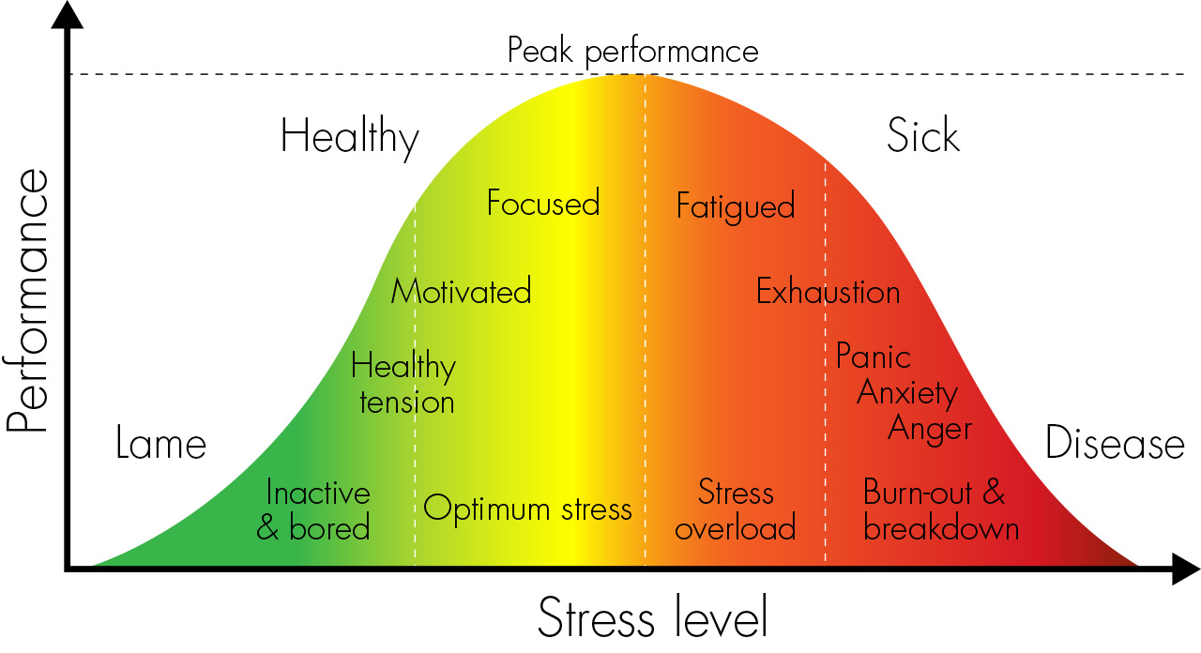
Identification and action
Resilience
Yerkes Dodson Law (1908)

Slide 12
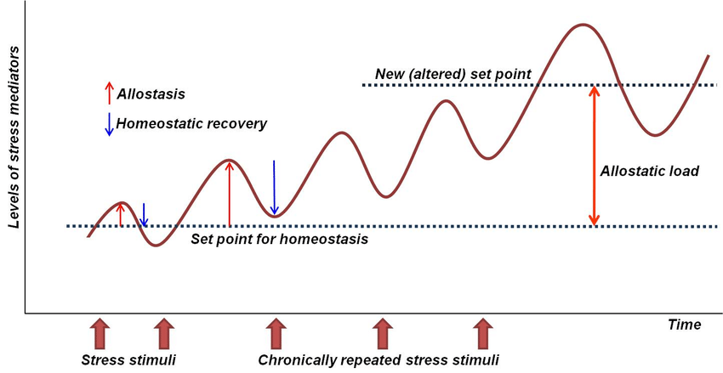
During chaotic times, we often experience repeated, unpredictable stressful events that we can’t control, resulting in an “Allostatic Load.” This leads to burnout and health problems.
Notes:
https://www.researchgate.net/figure/Stress-allostasis-and-allostatic-load-Stress-is-any-stimulus-inducing-either-adaptive_fig3_270652069
Stress, allostasis, and allostatic load. Stress is any stimulus inducing either adaptive or maladaptive allostasis (changes in homeostasis) of stress mediators, which constitute the autonomic nervous system (blood pressure, catecholamines), metabolic hormones (cortisol, insulin), and pro-& anti-inflammatory cytokines. If stress stimuli are excessive and repetitive, recovery to the original homeostatic levels may be incomplete (indicated by the second blue arrow). As a result, chronic stress can make a body system to anticipate, as if such a new (stressful) environment would persist, demanding a newly defined set point for future adaptation. Thus, the difference between the new and old set points can be understood as a 'cumulative burden of adaptation to stress'-i.e., allostatic load. Examples of allostatic load may be found in the primary mediators (hypercortisolemia, increased inflammatory cytokines), secondary outcomes (elevated blood pressure, overweight, insulin resistance), or tertiary outcomes (hypertension, diabetes, obesity, coronary heart disease, neurodegenerative disorders). For more details, see reference # 6.

Slide 13
Anxiety signals
Feelings of unease, worry, negativity, doom-and-gloom
Thoughts racing
Difficulty concentrating
Distractable
Irritable
Fear
Dizzy or lightheaded
Headaches
Avoidance
Fear
Changes to vision
Breathing becomes quicker and shallower
Dry mouth
Heart beats faster
Feeling restless
Problems sleeping
Adrenaline, norepinephrine and cortisol are released
Nausea, cramping and ‘butterflies’ in the stomach
Bladder urgency
Hands get cold and sweaty
Muscles tense
Unexplained pains

Slide 14
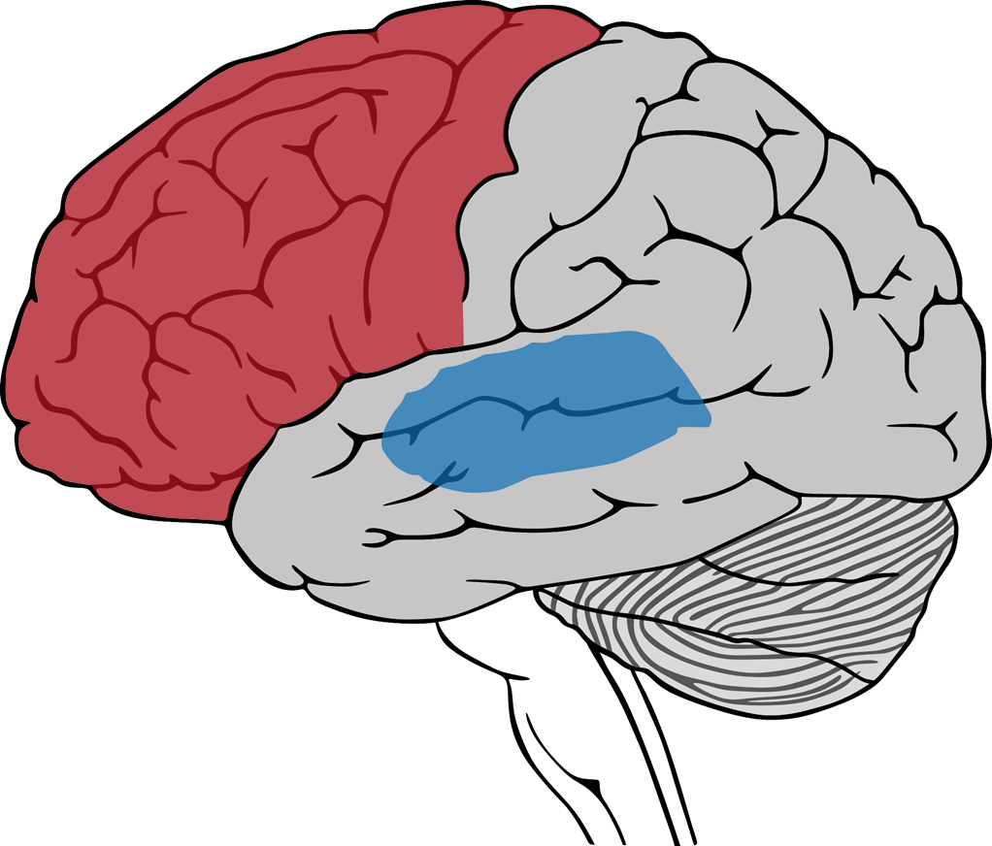
Prefrontal cortex
Physical sensations trigger thoughts
Thoughts can trigger physical sensations
Limbic System
In order to manage anxiety, we must break the cycle and address both the mind and body.
Notes:
This becomes very important as we start to discuss ways to manage anxiety

Slide 15
“
You don’t have to be a passenger.
”
Fred Rio, Product Manager, Construction Industries Digital and Technology (CD&T)

Slide 16
Strategies to manage anxiety
Immediate and long-term
Notes:
Some will be immediate, short-term strategies. Some are longer term lifestyle behaviors.

Slide 17
The fundamentals of individual resilience
Healthy Behaviors
Healthy Body
Stay Connected
Practice Mindfulness
Mindset
AKA: Positive Outlook
…like time management, work-life balance, hobbies, volunteering and taking on new challenges.
Healthy diet, physical activity, good sleep habits, limiting substance use and regular wellness check-ups.
Right-size social interactions: at least 1-2 people who offer regular support. Avoid isolation and withdrawal during stressful times.
Understand your motivation and purpose for work. Slow your body down by practicing relaxation and mindfulness.
Healthy, rationale interpretations of the world around us. Avoid rigid, inflexible thinking. Embracing growth and change

Slide 18
1. Build self-awareness
What external events (people, places, things, times, events) are anxiety provoking for you?

Slide 19
1. Build self-awareness
What is your primary signal that you are anxious?
Notes:
Identify physiologically what your body experiences as you ratchet up into what you label as an “anxiety” resource state
Usually there is a sequential escalation of physiological experiences – identifying the earlier “tells” gives you more time to employ your anxiety reduction strategies

Slide 20
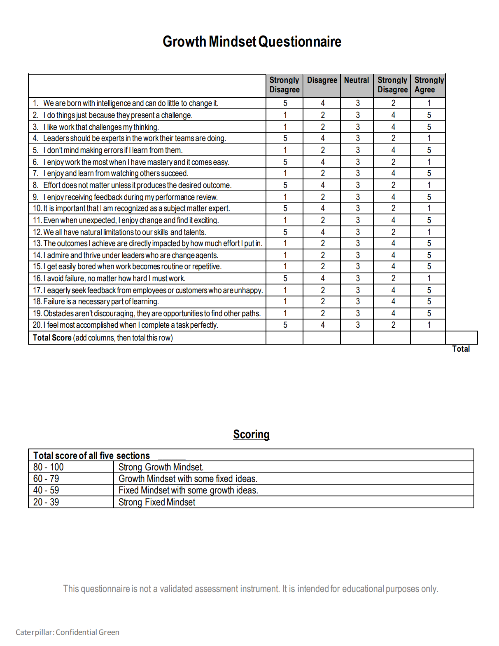
2. Embrace uncertainty and a Growth Mindset
Build awareness of your mindset. Those with a fixed mindset tend to be anxious.
Create some chaos.
Set personal (not just work) goals.
Expose yourself to new, challenging ideas.
Get out of your routine.
Find the heaviest thing you can carry and pick it up.
Get comfortable falling short, including the appearance of failing. It’s also OK to laugh at yourself.
See “Growth Mindset” in the Total Health A-Z Library

Slide 21
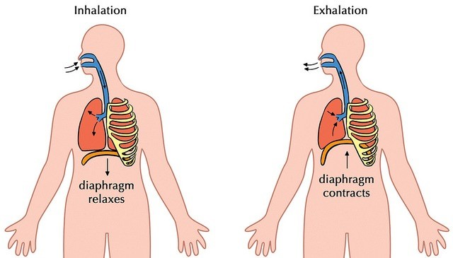
3. Control your heart
Full deep (belly) breathing. Avoid “chest breathing.”
Leverage technology (e.g. pulse oximeter or smart watch).
Practice. Desensitize yourself.
Elevate your heart rate through exercise or swizzle stick breathing.
Bring it down using 4-7-8 or 4-4-4 breathing.
Inhale- HR goes up
Exhale- HR goes down

Slide 22
4. Manage your body
At least 7 hours of sleep
Healthy, whole foods. Processed and carb-heavy foods impact glucose (energy and mood).
Beware of the impact of other factors
Stimulants (including technology)
Medications and other health problems
Hormones
Fatigue
Social stressors
Practice mindful relaxation and progressive muscle relaxation.
Instructions
For each group of muscle group, you should:
Focus your attention on that muscle group
Tense those muscles for 5 to 7 seconds. The relax.
Repeat, but lighter and softer tension this time.
Stay focused on that muscle group for about 20 to 30 seconds before moving on, noticing feelings of relaxation.

Slide 23
5. Sit with it
Anxiety is not fatal, even though it might feel like it.
Rate your anxiety. Analytical thinking eases the emotion.
Get out of your head. Get grounded.
Go for a walk
Listen to music
Exercise or do something physical
Do “5 things” exercise
Get comfortable being uncomfortable. Anxiety passes. Avoidance will last forever.
Count
5 things you see
4 things you’re touching
3 things you hear
2 things you smell
1 thing you can taste

Slide 24
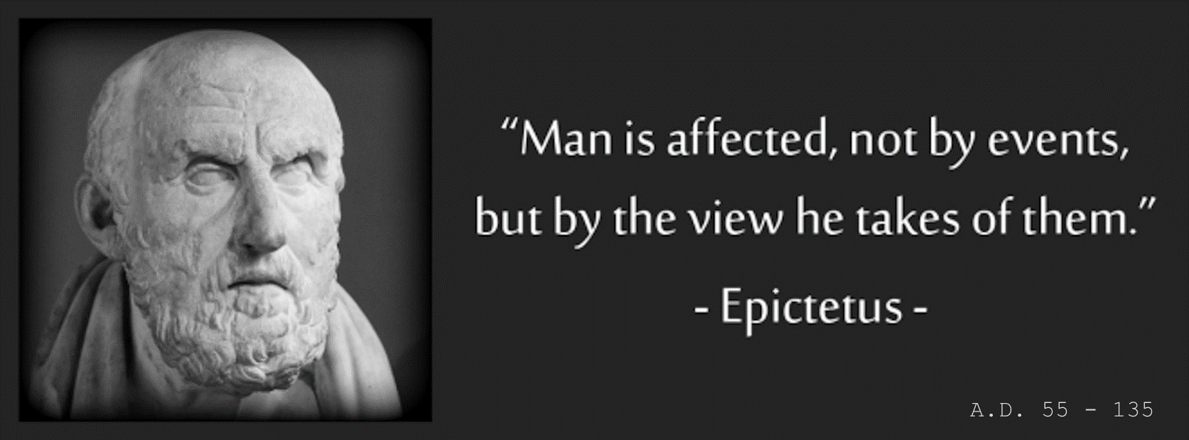
6. Control your thinking
Notes:
Put a little space between what happens and how we choose to feel and behavior

Slide 25
6. Control your thinking
Emotions
Behaviors
Counter our tendency toward a negative, irrational mindset (self-talk).
Focus on things you can control.
Be where your feet are. Stay present-focused.
Avoid making assumptions.
Don’t catastrophize. Be realistic, find pros/cons.
Balance self-reward with self-criticism.
Remember that nothing is perfect.
There is no “must,” “should,” or “have to.”
All or nothing thinking
Catastrophizing
Over-generalization
Disqualifying the positive
Jumping to conclusions
Rigid demands
Low frustration tolerate
Actions
“everything is
always rubbish”
“nothing good
ever happens”
Relationships
Events
News
Career
2 + 2 = 5
MUST
“I can’t stand it”
The more we practice using our lens (filter), the more hard-wired our responses become.
25
Notes:
Jumping to conclusions: Settling on a belief when there is little or no evidence to support it.
“If I don’t do well on this project, my leaders will think I’m incompetent.”
Mental filtering: Over focusing on the negative, while ignoring the positive
“I didn’t know the answer to a question today. Maybe I’m not suited for this job.”
All-or-nothing: Exaggerated “black and white” thinking.
“If I don’t get selected for the open position, my career is over.”
Perfectionism: Very high expectations that something can only be a certain way.
“The hotel isn’t as good as the reviews said. Our vacation is ruined.”
Rigid, inflexible thinking: Leaving no room for a realistic, alternative outcome.
“People shouldn’t act that way.” “I must get a high rating every year.” Or, “Society should be just and fair.”
Overgeneralization: Maintaining global beliefs based on one factor or a single situation.
“My coworker just got a new position. Everyone else has gotten promoted but me.”
Personalization: The tendency to automatically blame yourself.
“I wasn’t selected for the open position. I always interview very poorly.”
Externalization: The tendency to automatically blame others.
“I wasn’t selected for the project. The project leader is threatened by my skills.”
Mind Reading: Assuming that you know what others are thinking, or expecting others to know what you are thinking.
“My supervisory hasn’t responded to my email. She must be upset about what I said.”
Catastrophizing: Worst case scenario thinking. Exaggerating the impact of a negative event.
“I was rated “meets” even though I performed better. My boss is looking for an excuse to fire me.”
Future or past orientation: spending too much time focused on the part or future. Assuming you can predict the future or the past is destine to repeat itself.
“This date is not going to go well. First dates never work for me.”
Emotional reasoning: Interpreting our experience, fact, and reality based on how we feeling in the moment
“I feel stressed and over worked. Our leaders don’t know how to manage people.” or “I feel bad when you say that. You must be a horrible person.”

Slide 26
A-B-C exercise
* See handouts: ABC exercise, Outlook exercise and Thought Log
Antecedents / events
Describe what has happened to signal anxiety.
Behaviors / Beliefs
Describe the behavior or belief in response to the event (A).
Emotional Consequences
Describe the emotional response.
The event could be an external occurrence, a though or memory.
Could be your behavioral response to A or a belief about the event (A).
Describe the emotions and physical signals. Include severity and duration.
Dispute the belief. Different behavior.
Change your problematic thinking about the event (A). Insert a healthy, coping behavior to ease anxiety or defuse the event.

Slide 27
Thought Log
Event | Emotion / Behavior | Thought or “self-talk” | Identify the irrational thought | Counterstatement- new healthier thought
Received “constructive” feedback from my supervisor on a project I’ve been working on. | Disappointed. Sad. Anxious about job performance. | “Nothing I do is right. I’m going to job fail. I am not qualified for a job at this level.” | Overgeneralization. Catastrophizing. All-or-nothing thinking. Perfectionism: I must be perfect and always look competent. | “I’m not perfect. I’m still learning. Coaching can be hard to hear, but it will help me improve. It’s all part of the learning process.”

Slide 28
Employee Assistance Program (EAP)
Personal support for a variety of challenges, before they impact your lives at work or at home.
There is no cost to use the EAP
What is EAP?
What is the cost?
Yes. EAP is completely confidential. No one at Caterpillar will ever know you have used the EAP.
Regular full and part time Caterpillar employees and their eligible family members.*
Who is eligible?
Is it private?
Clinical assessment, counseling, referrals
Information, consultation and referrals
Organizational support
Most employees self-refer to EAP. But leaders can play an essential role in helping employees get support by making EAP referrals.
What is provided?
For leaders
* Local eligible of family members will vary. Check with your HR representative.

Slide 29
Accessing EAP
By Phone
Online
LifeWorks App*
Onsite
Access in Switzerland
0800-321-021
+41-44-551-43-88
CaterpillarEAP.com
Local contact numbers.
47 languages.
Or through our benefits portal
EAP.cat.com
For iOS, Android and Blackberry
* Uses CWS single sign on.
EAP counselors are available onsite in many locations. Learn more at EAP.cat.com.
Global access numbers can be found at CaterpillarEAP.com

Slide 30
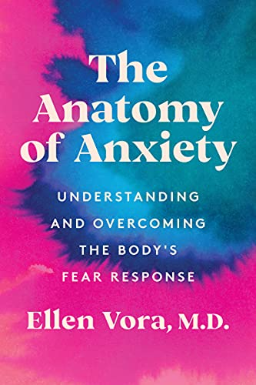
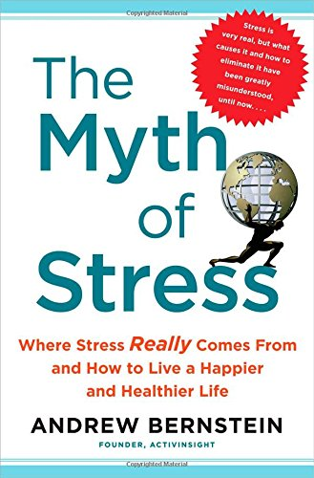
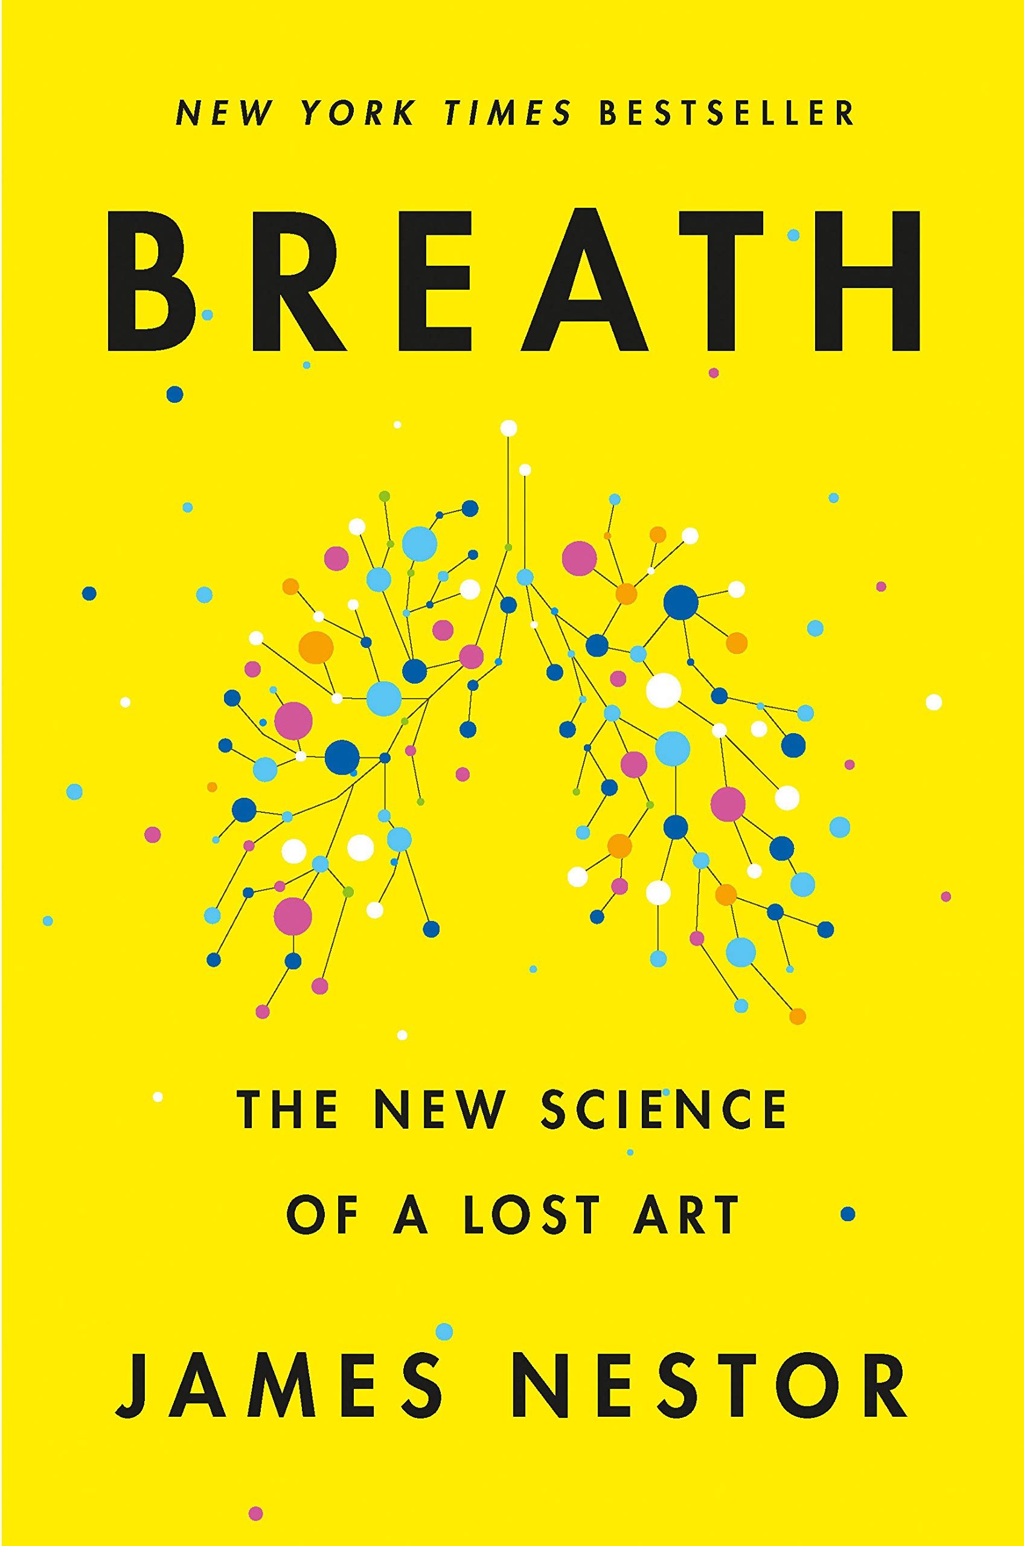
More information is available:
.cat.com

Slide 31
Discussion
John C. Pompe, Psy.D., SPHR
Global Manager, EAP and Employee Health Programs
Caterpillar Inc.

