Slide 1
Understanding Social Security and Medicare

Slide 2
Disclaimer
This presentation is for informational purposes only | This information is provided by Alight Financial Advisors LLC for general informational purposes only and should not be considered an individualized recommendation or personalized advice. The strategies mentioned may not be suitable for everyone. Each investor needs to pursue a particular investment strategy based on his or her own situation. Data contained herein is obtained from what are considered reliable sources; however, its accuracy, completeness, or reliability cannot be guaranteed.
It’s not investment advice | This information does not constitute investment advice or an offer to invest or to provide management services.
It’s not tax advice either | It does not constitute tax advice. Please see your tax advisor to determine how this information may apply to your own situation.

Slide 3
Agenda
History of Social Security & Medicare
Receiving the Retirement Benefit
Other Considerations
Get Started
Medicare

Slide 4
Overview
Origins of Social Security
The Retirement Benefit
Spouse and Survivor Benefits

Slide 5
Origins of Social Security
Social Security Established Under FDR
Medicare Established
COLAs¹ Enacted by Congress
1935
1940
1950
1956
1965
Survivor Benefits Added
Disability Benefits Added
¹ COLA = Cost of Living Adjustment
Source: https://www.ssa.gov/history/briefhistory3.html

Slide 6
The Retirement Benefit
Eligibility
Contributions
Benefits
40 credits to be considered fully insured
1 credit for every $1,410 earned income in 2020 ($1,470 in 2021)
Maximum of 4 credits per year
Employee contributes 6.2% to program
Employer contributes 6.2% to program
Wage capped at $137,700 for 2020 ($142,800 for 2021)
Known as “Old Age, Survivor and Disability Insurance” (OASDI) tax
Earlier payments will reduce benefits
Later payments will increase benefit
May be adjusted annually for COLA
For 2020.

Slide 7
Spouse and Survivor Benefit
50% of working spouse’s benefit
Must be married at least 12 months
Divorced spouse if married at least 10 years and not remarried
Reduction in benefit if not Full Retirement Age
Spouse
Deceased worker must have been fully insured
100% benefit if Full Retirement Age
Could be reduced if taken early
Must be age 60 or older¹
Survivor
¹ May be eligible for a survivor benefit starting at age 50 if disabled, or any age if taking care of a dependent under 16 or disabled.

Slide 8
Receiving the Benefit
How the Benefit is Calculated
Full Retirement Age
Receiving the Benefit
Comparison Chart
Deciding When to Take the Benefit
Planning Tools

Slide 9
How the Benefit is Calculated
Use highest 35 years of earnings
AIME
Average Indexed Monthly Earnings
Average monthly earnings for the highest 35 years, indexed to inflation
Index earnings to inflation to get AIME
PIA
Primary Insurance Amount
Amount the Social Security benefit is based on. If receiving the benefit at Full Retirement Age, the benefit is 100% of the PIA
Three-tiered formula to calculate PIA
90% on first $960
32% over $960 but below $5,785
15% over $5,785
X
Primary Insurance Amount (PIA)¹
¹ PIA numbers shown are for 2020. In 2021 the amount portions are $996, over $996 but below $6,002, and over $6,002.

Slide 10
How the Benefit is Calculated: Example
Arthur is getting ready to retire. His Average Indexed Monthly Earnings
is calculated to be $5,800, and he wants to know what his PIA will be.
$864.00
90% of first $960
$1,544.00
32% over $960 but
below $5,785
₊
$2.25
15% over $5,785
$2,410.25
Primary Insurance Amount
¹ PIA numbers shown are for 2020. In 2021 the amount portions are $996, over $996 but below $6,002, and over $6,002.

Slide 11
Full Retirement Age
Full Retirement age is the age at which you receive 100% of the benefit
Birth Year | Age of Full Benefits | Benefit Reduction at age 62¹ | Benefit Increase at age 70²
1943-1954 | 66 | 25% | 32%
1955 | 66 & 2 Months | 25.8% | 30.7%
1956 | 66 & 4 Months | 26.7% | 29.3%
1957 | 66 & 6 Months | 27.5% | 28%
1958 | 66 & 8 Months | 28.3% | 26.7%
1959 | 66 & 10 Months | 29.2% | 25.3%
1960 & Later | 67 | 30% | 24%
¹Benefit is reduced by 5/9% for each month taken early up to 36 months. Any additional months beyond 36 months, the benefit is reduced by 5/12%, or about 6% per year.
²Benefit is increased by 2/3% for each month the benefit is delayed, or about 8% per year

Slide 12
Comparison Chart
Assumes a PIA of $1,000 at a full retirement age of 66
Reduction of about 6% per year¹
Increase of about 8% per year¹
$1,320
$1,240
$1,160
$1,080
$1,000
$866
$933
$750
$800
Monthly Benefit Amount
Full Retirement Age
Age to Start Receiving Benefits
¹ Actual reduction is 5/9% for each month taken early up to 36 months, 5/12% for each month beyond 36 months. Actual increase is about 2/3% for each month taken late until age 70. Visit www.ssa.gov to learn more.

Slide 13
Deciding When to Take the Benefit
Do you have a current need for income?
Are you currently working?
Would you prefer higher payments?
Do you believe you’ll have an average life expectancy?
Do you have concerns over the health of the program?
How would the benefit affect your taxes?
Remember, if you don’t need the income now, delaying benefits may increase your payment.¹
¹ Until age 70.

Slide 14
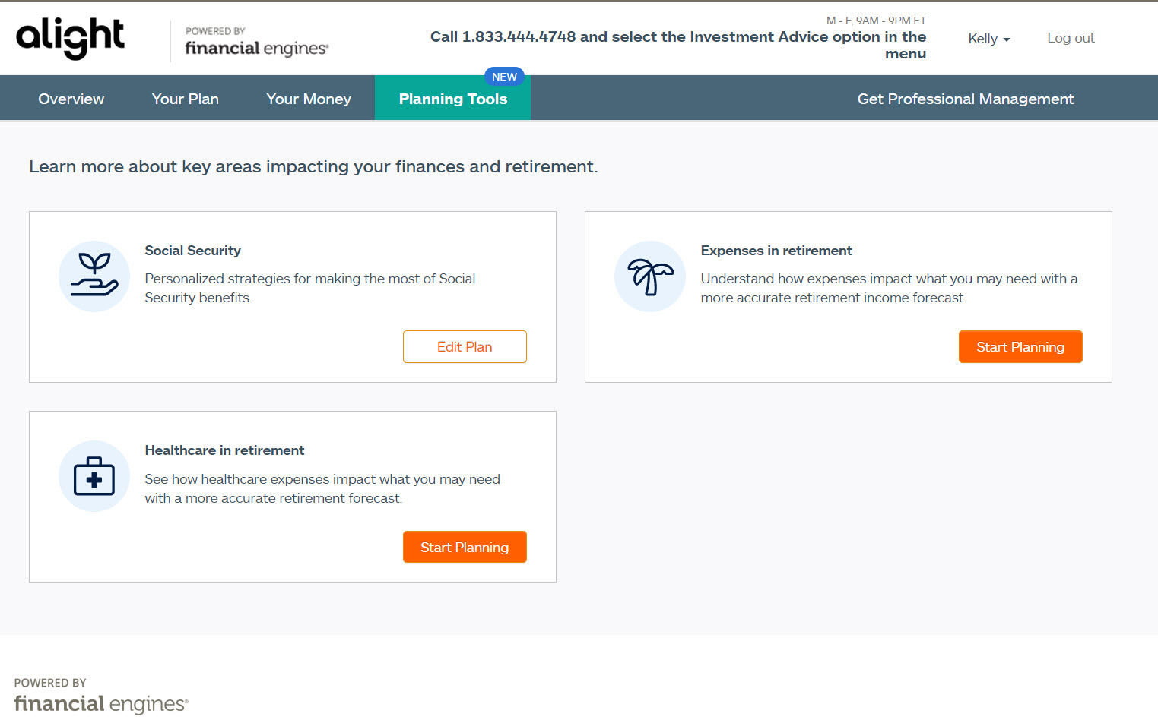
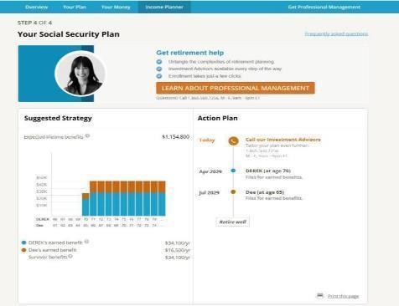
Online Advice – Planning Tools

Slide 15
Other Considerations
How Work Affects the Benefit
Taxation of Benefits

Slide 16
How Work Affects the Benefit
Before Year of FRA
Year of FRA
FRA and After
Benefit reduced $1 for every $2 earned over $18,240 ($18,960 for 2021)
Benefit reduced $1 for every $3 earned over $48,600 ($50,520 for 2021)
No reduction in benefits when at Full Retirement Age
If some of your benefits are withheld because of your earnings, your monthly benefit will increase starting at your full retirement age.¹
¹ https://www.ssa.gov/pubs/EN-05-10069.pdf

Slide 17
How Work Affects the Benefit
James is 62 and works part-time at a golf shop earning $25,000 for the year. He also decides to claim his Social Security benefit which is calculated to be $14,400 annually ($1,200 monthly).
Total earnings over
the limit
1. $25,000 - $18,240 = $6,760
Benefit will be reduced
by this amount
2. $6,760 / 2 = $3,380
Adjusted annual
benefit¹
3. $14,400 - $3,380 = $11,020
¹ The $3,380 would be withheld up front. For example, James’ monthly payment was $1,200. As a result of the reduction, James would receive $0 for his first two payments, and then $220 for his third payment. Beginning with his fourth payment, he would start receiving $1,200 per month.

Slide 18
Taxation of Benefits
Adjusted Gross Income
Non-Taxable Income
50% of Social Security Benefit
Combined Income
 | Single Filers | Joint Filers
Up to 50% Taxable | $25,000-$34,000 | $32,000-$44,000
Up to 85% Taxable | Over $34,000 | Over $44,000

Slide 19
Taxation of Benefits: Example
Eileen is single and has an AGI of $20,000. She also has $1,000 in non-taxable interest, and a Social Security (SS) benefit of $12,000 per year.
$20,000
$1,000
$6,000
$27,000
AGI
Non-taxable Interest
50% of
SS Benefit
Total Combined Income
Since Eileen is single and her combined income is between $25,000 and $34,000, up to 50% of her Social Security benefit would be taxable.

Slide 20
Get Started
Create an Online Account
“my Social Security” Home Page
Apply for Benefits Online
Documents You’ll Need to Apply

Slide 21
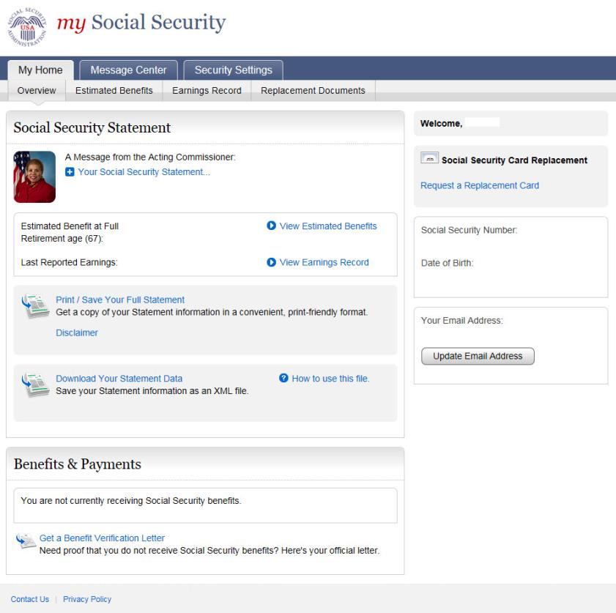
Create an Online Account
John
$1,600.00
XXX – XX – 1111
$72,500.00
January 1st, 1962
John.smith@email.com

Slide 22
What You’ll Need to Apply for Retirement Benefits:
Date and Location of Birth
Marriage and Divorce
Names and Dates of Birth of Children
U.S. Military Service
Employment History for Current Year and Prior 2 Years
Direct Deposit Information

Slide 23
Medicare
Part A
Part B
Part C (Medicare Advantage)
Part D
The “Donut Hole” Coverage Gap

Slide 24
Part A: Hospital Insurance
Funded by Medicare Tax at 2.9%
Compulsory
$1,408 ($1,484 in 2021) deductible for each benefit period¹
Days 1-60: $0
Days 61-90: $352 ($371 in 2021) per day coinsurance
Days 91+: $704 ($742 in 2021) per “lifetime reserve day”²
¹ This is not an annual deductible, but a reoccurring deductible that resets once you have been out of the hospital for 60 days.
² Medicare grants you 60 “lifetime reserve” days. Once these are exhausted, you are 100% responsible for costs beyond the 90 day mark.

Slide 25
Part B: Medical Insurance
$144.60 ($148.50 in 2021) monthly premium¹
$198 ($203 in 2021) deductible per year
After deductible is met, 20% of Medicare approved amount for most doctor services
Supplemental insurance
Funded by premiums and government subsidies
¹ Most people will pay a minimum of $144.60. Some individuals may pay a different amount based on their income. Late enrollment may cause the monthly premium to increase 10%.

Slide 26
Medicare Overview: Part C: Medicare Advantage
“All-in-one” alternative
Includes Parts A, B and usually D
Lower out of pocket expenses
Most plans offer extra benefits (i.e. vision, hearing & dental)

Slide 27
Part D: Prescription Drugs
Voluntary Enrollment although you MUST be enrolled in Part A & Part B
Possibly defer if have existing creditable coverage such as an employer sponsored plan. If creditable coverage dropped for more than 63 consecutive days, may result in a late enrollment penalty
Provided through private insurers and can be either:
Medicare Prescription Drug Plan (Part D) or
Medicare Advantage Prescription Drug Plan (Part C)
Can be enrolled in one or the other
Funded by premiums and government subsidies
Deductibles and coinsurance vary by plan

Slide 28
The “Donut Hole” Coverage Gap¹
1
Coverage begins Jan. 1st
You pay 100% of deductible
$0 - $435
($0 - $445)
2
Initial coverage by your plan
You pay copay or coinsurance
$436 - $4,020
($446 - $4,130)
3
“Donut Hole” coverage gap
You pay 25% of the cost of Brand-name or Generic
$4,021 - $6,350
($4,131-$6,550)
4
Catastrophic coverage until Dec. 31st
You pay a small copay or coinsurance
Over $6,351
(Over $6,550)
Catastrophic coverage begins once you have spent $6,350 out of pocket for the year 25% coinsurance and 70% manufacturer discount count towards out-of-pocket expense²
Only the 37% coinsurance on generic brand
drugs count towards the out of pocket expense
¹2020 amounts shown with 2021 amounts in parentheses. Not everyone will enter the coverage gap.

Slide 29
Enrollment
3 months before month of 65th birthday
Month of 65th birthday
3 months after month
of 65th birthday
Part A: If actively employed and enrolled in employer coverage at age 65, employer coverage is primary and Medicare is secondary:
If receiving Social Security, possible automatic enrollment
If not receiving Social Security, contact Medicare
Part B: Possibly defer if active participant with coverage
Participant or spouse currently working and covered by employer group health plan through employer as result of that work
A special 8-month period that begins the month after employment ends or group health plan coverage ends
May need proof of coverage to avoid penalty
Do not defer if have non active participant coverage
COBRA coverage is not considered coverage based on current work status
Retiree Health Plans are not considered coverage based on current work status

Slide 30
Remember
Check with your employer to see if there are any enrollment rules regarding your plan
Review if you should enroll in Medicare three months before your 65th birthday, even if you don’t intend on claiming Social Security right away
Failure to enroll may result in a late enrollment penalty depending on your situation
Part B penalty is 10% increase in premiums
Part D penalty is 1% multiplied by the “national base beneficiary” premium of $32.74 in 2020 ($33.06 in 2021) for each uncovered month

Slide 31
People Like Me
Lucy
Mark
Tom

Slide 32
People Like Me - Lucy
Lucy is going to be 65 in 3 months but plans to retire at age 67
Lucy’s employer requires her to enroll in Medicare in Parts A & B
Lucy will wait to claim her Social Security benefits
Post retirement, she will make decisions on other Medicare options
Lucy plans to work until age 67.

Slide 33
People Like Me - Mark
Mark retired early and began collecting Social Security at age 62
Mark will automatically be enrolled in Medicare Part A at age 65, since he is already receiving Social Security benefits
Decisions will need to be made about whether he will enroll in the other parts of Medicare
Mark started collecting Social Security at age 62

Slide 34
People Like Me - Tom
Tom will be 65 in 3 months and plans to retire then
Tom will be starting Medicare upon retirement but holding off on collecting his Social Security benefits until he is 70 years old
He will use Medicare as his primary insurance and his retiree health insurance benefits as contingent insurance protection
Tom retires at age 65

Slide 35
Contact Information
Benefits Website
http://CatBenefitsCenter.com
Benefits Center
877-228-4010
8 a.m. – 6 p.m. CT, Monday - Friday
Alight Financial Advisors
877-228-4010, Select “Investment Advice”
8 a.m. – 8 p.m. CT, Monday - Friday
Social Security
www.ssa.gov
1-800-772-1213
Medicare
www.medicare.gov
1-800-633-4227

Slide 36
Workshop Evaluation
Your feedback is
greatly appreciated!

Slide 37
Course Summary
Overview
Origins of Social Security and Medicare
How the Benefit is calculated
Other Considerations
How Work Affects the Benefit
Taxation of Social Security
Getting Started
Parts A, B C & D
Deductibles and Coinsurance
Receiving the Benefit
The Retirement Benefit
Spousal and Survivor Benefits
Primary Insurance Amount
Deciding When to Take the Benefit
Medicare
“my Social Security”
Applying for Benefits Online
Documents You’ll Need to Apply
The “Donut Hole” Coverage Gap

Slide 38
Questions?

