Slide 1
Employee Assistance Programme (EAP)
Employee Orientation
Notes:
Thank you for listening to this orientation video. During this recording, you will obtain information on the various services available through Caterpillar’s Employee Assistance Programme, also known as the E A P. The EAP is provided by Morneau Shepell.

Slide 2
Understanding your Morneau Shepell Employee Assistance Programme
Voluntary
Confidential
Help for work, health, life issues faced by you and your family
No cost to you or your eligible family members
Notes:
It is important for you to know that the EAP is a voluntary and confidential support service. When accessing the EAP there's no cost to you or your eligible family members. The EAP is available 24 hours a day, 7 days a week, 365 days a year in your local language.

Slide 3
Confidentiality
No one will know you have used the EAP unless YOU tell them
Convenient counselling locations – AWAY from the workplace and online
Discreet, non-identifying messages, online services and programmes are firewall and password protected
Confidential records
Immediate and confidential help
Notes:
Confidentiality is THE key feature of our services. We do not disclose any information that would identify you or the reason you are accessing EAP services to anyone including Caterpillar and your family members. There are a number of ways we maintain your privacy and confidentiality both online and offline.
Our clinicians will only leave discrete non-identifying messages on your phone with your permission. As a third party vendor of Caterpillar, our clinical files are kept securely and we would require written consent from you prior to releasing copies or information to you. In addition, we protect your privacy online using firewalls and a personalised password created by you. We adhere to privacy acts as required by law and take your confidentiality very seriously.

Slide 4
Help with any concern
Short term, solution focused support
Work/Life Balance
Legal/Financial worries
Family/Parenting
Relationships
Workplace challenges
Stress, depression, anxiety
Addiction concerns
Crisis
Notes:
The Employee Assistance Programme provides short-term, solution focused support for a wide variety of issues. It is best to address matters early before they escalate into longer-term concerns.
What is solution focused support?
This is a counselling approach that builds a collaborative relationship with the client and a way of working together that focusses on making positive change as soon as possible.
People may make use of the EAP in many different ways: to obtain information, to set goals and make a change or to remain motivated towards one’s personal goals. There is no one way to use the EAP service.

Slide 5
Understanding your Morneau Shepell EAP
24 / 7 / 365
Access to Qualified Intake Professional
Immediate Assessment of Caller’s Needs
Non Urgent Requests
Urgent Request / Crisis Situation
Counselling & WorkLife Support
Counselling modality matched to caller’s need and/or preference:
Face to face
Telephonic
Video Counselling*
Online
Identifies need for help
Needs answer ASAP
WorkLife resource support:
Legal
Financial
Childcare
Eldercare
Immediate access to Counsellor
Notes:
So what happens when you contact the EAP?
Once you call the number displayed on your EAP communications brochure for your country, all you have to do is identify yourself as an employee or family member of Caterpillar. Both our in-country partners and the Morneau Shepell global Care Access Centre is available 24 hours a day, 7 days a week. The qualified intake professional will gather demographic information and information around the help you are seeking.
If your issue or situation is urgent, our Client Care Representative will transfer you over to a counsellor so you can receive immediate advice and help. For non-urgent requests and Work Life support, the intake professional will make the appropriate recommendations and provide appointment information and next steps to obtain services.

Slide 6
Counselling support
Short-term and solution focused
Masters-level clinicians
5-10 years of experience
Global network of counsellors
Notes:
Your EAP counsellors are experienced professionals who will understand your concern and guide you to resolution of your issues. Counselling is provided globally by master level clinicians (or equivalent) with at least 5 years of experience in counselling.
As mentioned before, our counselling programme is a short term and solution focused service. This means you will be addressing your most pressing issue. We work to match you with counsellors best suited for your situation, requested delivery modality and language preference.

Slide 7
WorkLife service referrals
Childcare
Eldercare
Financial
Legal
Notes:
Balancing the demands of work and family is an ongoing challenge for most people, and often the juggling act can feel overwhelming. Whether you’re trying to find resources for daycare, dealing with caregiving emergencies or looking after older relatives, your EAP can help.
Financial assistance provides you with telephonic advice regarding your financial concern. You will have the opportunity to receive telephonic financial consultation from an experienced network of financial professionals who are industry recognised with extensive knowledge in financial management. You can gain valuable insight and applicable information to build a financial plan on a variety of topics, including credit management, debt management, budgeting, and bankruptcy.
Legal concerns can drain you of precious time, money and energy. They can also cause stress and impact your family, work, and life. Take the first step towards resolving your legal issue by getting expert, confidential consultation from our lawyers. Legal consultation can be used for issues such as family, criminal, civil, real estate, wills, estates, and tenant landlord. Please note that our lawyers do not consult on issues of immigration, employment, and tax laws.

Slide 8
Global website
CaterpillarEAP.com
Notes:
In addition to seeking in-person or telephonic assistance, many individuals prefer to seek out resources online. Visit the Morneau Shepell Global EAP website for Caterpillar – Caterpillar EAP (dot) com. Log on today to access a list of worldwide access numbers to obtain immediate EAP support.
The global website is available in 27 different languages and contains a variety of timely articles, tipsheets, assessments, newsletters and videos on a variety of topics, all organised in 4 areas of support: work, health, life, and leadership (leadership content is available by self-selecting in a leadership role on the first page). All of the information is localised for your region and culture.

Slide 9
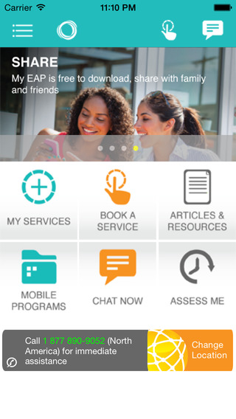
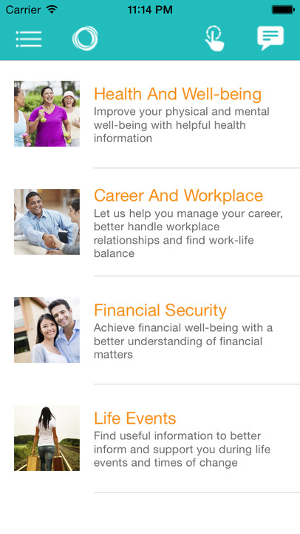
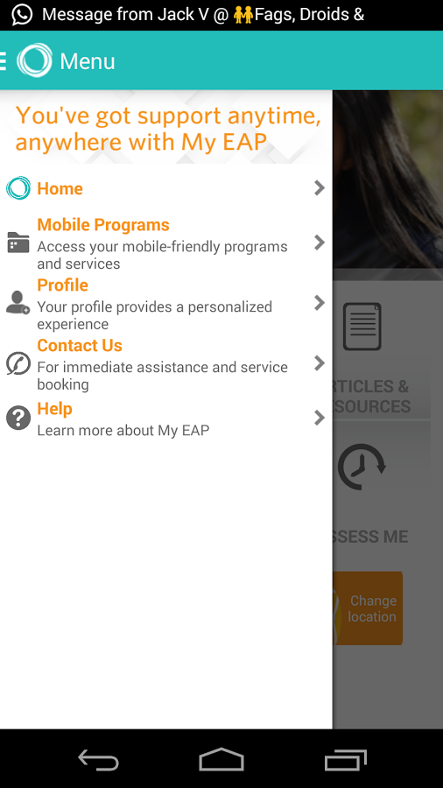
Access to our mobile My EAP app
Free download
Immediate access to counselling
Interactive tools and resources
Health an wellness articles and videos
Search “My EAP” at your device app store
Learn more online at CaterpillarEAP.com
Notes:
In addition to the Global workhealthlife website, we also have our award-winning mobile APP, called My EAP.
The My EAP app allows you to instantly connect to a counsellor to schedule appointments, chat and obtain additional support resources, including articles and tip sheets, while on-the-go.
Download the My EAP app today for free in your app store - simply search “My EAP”.

Slide 10
Access anytime, anywhere
You and your family have various ways to access immediate and confidential support. Call us 24/7/365 or visit us online for immediate support or to book an appointment.
For a list of worldwide access numbers, visit:
CaterpillarEAP.com
or via the Caterpillar benefits portal:
EAP.cat.com
Notes:
In summary, your Caterpillar Employee Assistance Programme, provided by Morneau Shepell, is a free, confidential resource for you and your eligible family members to seek assistance on a variety of issues. Log on to our global website today at Caterpillar EAP (dot) com for a list of worldwide access numbers to obtain the local number for your country.
You may also obtain additional EAP information and brochures containing local numbers on the Caterpillar benefits portal: EAP (dot) CAT (dot) com.

Slide 11
Thank You!
Notes:
Remember, your EAP is here for you. Let us help!
Thank you for listening, and have a great day!

