Slide 1
Caterpillar’s
Employee
Assistance
Program (EAP)
Employee Orientation
December 2018
Notes:
This presentation is designed to provide an introductory overview of Caterpillar global Employee Assistance Program (EAP) as of January 1, 2019. This presentation is suitable for all employee audiences.
Caterpillar has offered an EAP to employees for decades. Following an RFP in 2018 the decision was made to continue our vendor relationship with Morneau Shepell and expand our EAP from covering about 75% of our employees, to full global coverage. As of January 1, 2019 all employees will have access to EAP services.
This presentation is a general overview of EAP. Services will vary around the world. Contact your countries EAP access number for local details.

Slide 2
Total Health is Caterpillar’s commitment to the health of Caterpillar employees and their families.
We fulfill this commitment through a partnership with our global businesses to provide benefits and resources that help our people achieve their best health.
Employee Assistance Program (EAP) supports nearly every dimension of employee health.
Notes:
We come to work every day to help our customers build a better world, but it can be tough to do when any part of your health is troubling you.
Caterpillar’s EAP is part of our Total Rewards and is a deliverable of our Total Health Strategy.
A healthy life involves more than a healthy body – a healthy mind, healthy finances, a feeling of belonging and knowing your purpose in life matter, too. We call this Total Health.
Total Health is Caterpillar’s global health strategy. This is Caterpillar’s commitment to employee health. When our people achieve their best health the individual, their family, their community and the workplace all benefit.
Caterpillar’s EAP aligns most closely with the emotional and social dimensions of health. But EAP delivers services that support all 5 dimension of our health.

Slide 3
What is EAP?
Employee Assistance Program or “EAP” is a workplace program that can help you and your dependents with a variety or problems and challenges, before they impact your lives at work or at home.
EAP is available to all regular full and part time Caterpillar employees and their eligible family members.*
EAP is not new to Caterpillar.
In fact, Caterpillar was one of the first companies to ever deploy an EAP.
Some locations have had EAP-type services since the 1940s
* Local eligible of family members will vary. Check with your HR representative.
Notes:
Caterpillar has been a leader in providing personal support for our employees and families. Caterpillar’s was one of the first EAP’s in existence.
The philosophy of EAP is that when employees and their families are free from mental health concerns, substance abuse problems and can management life stressors, everyone wins: the employee, the family, the community and the company. So we say that EAP is a “workplace program.” By supporting our employees, Caterpillar benefits.
Eligibility for EAP is governed by HR policies and local law. Where not prohibited, EAP is available to all full time and part time employees and their legal dependents. In some but not all instances this includes all family members living in the employee’s home.
Check with your HR or Benefits representative for questions about eligibility.

Slide 4
Why is EAP important for employees?
Rarely
Life’s demands come neatly packaged one at a time.
Sometimes
We all face circumstances that distract from our important roles at home and work.
Always
We recognize the importance of:
Resolving personal issues early
Finding the right balance
Staying Healthy
Notes:
Why do we, as individuals need an EAP?
Life is complicated and challenges rarely come to us in tidy packages that are easy to resolve
At some point all of us will experience challenges that, if left un resolved, can impact our lives at work and home.
We need to place a priority on our health: in resolving problems early, balancing the demands in our lives, and maintaining health lifestyles

Slide 5
How EAP supports Caterpillar and our People
Clinical counseling
Work/Health/Life
Professional Consultation
Workplace Support
Up to 6 sessions with a professional counselor per family member, per year, per problem
Relationships and conflict management
Personal / emotional issues
Work / family issues
Change / transition / stress
Grief and loss
Depression and anxiety
Addictive behavior
24/7 Crisis and emergency response
Work-life services involve assessment, coaching, and referrals for a variety of other personal concerns:
Family Support coaching and referrals
Child care
Elder care
Caregiving
Parenting
Lifestyle Coaching referrals
Smoking Cessation
Parenting
Weight Loss
Physical Activity
Legal advice/referrals
Civil, consumer, domestic, family
Landlord/ tenant
Estate matters/Real estate
Financial Planning/Review
Debt management and consolidation
Credit counseling and coaching
Retirement and estate planning
Tax planning and preparation
Budgeting
Relocation support
ISE predeparture counseling
Educational information, including the Living Abroad website
School Choice International
Global support for families in transition
Consultation
Training and education
Emergency response
Threat assessment
Organizational development and engagement
Benefit management
Occupational health
Wellness
To learn more about your EAP services, visit CaterpillarEAP.com or EAP.cat.com
Notes:
EAP deliverables fall into several different categories of supportive services. The availability of some services may be limited in some parts of the world. Please contact the EAP through one of the following methods
By phone: 1-866-228-0565, 1-309-820-3604, or through your local EAP access number which can be found at workhealthlife.com/caterpillar
By email, text or chat at www.workhealthlife.com/caterpillar
Clinical counseling:
Clinical counseling is available to address a wide range of personal concerns, including mental health, substance abuse, work related concerns, relationship problems and emergency situations. Services are available 24/7 by phone or online. Face to face services are provided through a carefully chosen network of providers that are appropriately credentialed in the country where they practice. Appointments are usually available within 3 working days, or sooner in emergencies.
Caterpillar’s EAP providers up to 6 sessions with a counselor, per problem, per year for each employees and eligible family member. This means that each eligible person can access the EAP and receive counseling throughout the year for unique problems that arise. Please note that not all EAP cases will require 6 sessions. In some cases referrals can be made after the first session. The EAP providers have discretion to limit EAP services when clinically appropriate, but will work with employees to ensure they are receiving the most appropriate resources.
Work/life/health and Professional consultation:
Work-life and consultation services deliver information, assessment, consultation and referrals for a wide variety of non-clinical issues, such as help finding childcare, eldercare and other caregiving support. Through EAP counseling and work-life, employees can get assessment, counseling and referrals for lifestyle issues like smoking, parenting, weight loss and increasing physical activity. Legal and Financial consultation involves assessment, coaching and referrals for many legal and financial issues. When the basic EAP services can’t address a problem, the EAP consultants will make referrals to the most appropriate resource.
Work-life services also support our ISEs and families in transition. The EAP will reach out to families who have accepted an international assignment and offer a predeparture assessment and counseling to help prepare and adjust to the international move. The EAP will send periodic educational and promotional materials to ISEs to help with issue related to life living abroad, and to remind them of the global EAP support for ISEs.
Workplace support
In addition to support for individuals and families, the EAP provides a variety of support to Caterpillar organizations, including HR and supervisor consultation, training and education, emergency responses, threat assessment, and response to critical incidents such as workplace accidents or the unexpected death of an employees. EAP can help address organizational stress, change management and developing leadership skills. EAP also provides many training programs on mental health, stress, building better relationships, working across diversity, Emotional Intelligence and how to identify co-workers who may need help.

Slide 6
EAP counseling, coaching and consultation
Short-term, goal-orientated support for work and life issues:
Clinical counseling
Professional guidance and coaching
Information, consultation and referrals for a variety of work-life issues such as legal, financial and help finding child and eldercare
Appointments are available without delay or wait
EAP is confidential. No one will know you have used the EAP.
There is no cost for using the EAP
EAP is available 24/7 by phone, online or through the My EAP App
Notes:
We will get into more details about the EAP services in a moment.
As an overview, EAP offers a variety of services to support your overall well being, such as:
problem assessment
personal counseling
and referrals for specialized care.
But EAP also provides
Coaching and consultation
Training and education
and referrals for other work-life issues such as legal consultation, financial counseling, and help finding resources for child care and elder care.
EAP is completely confidential, governed by local laws protecting healthcare data privacy.
There is never any cost for EAP. All services are funded by Caterpillar in advance. Cost may be incurred when referrals are made outside of the EAP.
EAP is always available by phone and online. In-person appointments are made promptly, typically within 3 working days or sooner in urgent situations.

Slide 7
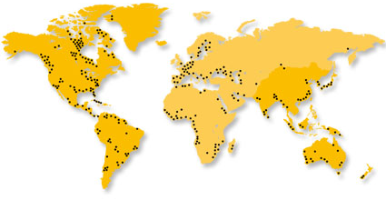
Global Access
Caterpillar has partnered with Morneau Shepell to deliver EAP services everywhere our employees live and work through a network of in-country providers. EAP services are delivered in local culture and language.
Powered by:
For local and regional access information, visit CaterpillarEAP.com or EAP.cat.com
Notes:
In 2017 Morneau Shepell acquired Caterpillar’s long time EAP vendor partner, Chestnut Global Partners (CGP). After a lengthy RFP, Caterpillar chose to remain with Morneau Shepell and expand the EAP as a standard global benefit.
The new and refreshed EAP will combine the best of CGP’s global network and program innovation, with the global infrastructure, account management and cutting edge digital technology that Morneau Shepell brings.
We will talk in a moment about the use of technology to access EAP and received services. But one of Morneau Shepell’s strengths is the ability to:
deliver EAP to our global employees in the country where they live and work
in the languages they use
and in their local culture.
When you call the EAP, it rings in your country and is answered in your language. Visit workhealthlife.com/caterpillar for a list of EAP contact information by country.

Slide 8
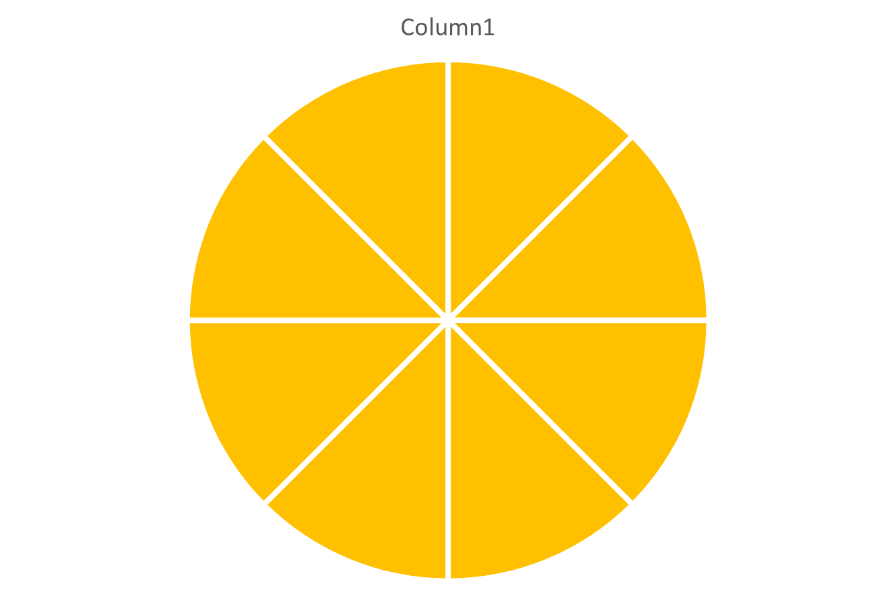
Multiple ways to access support*
Group Counseling
Online Services
Online chat
Video counseling
24/7 Access
In Person
counseling, onsite in some locations
E-counseling
* May not be available in all countries
Telephonic
counseling
My EAP App
Accessibility
Choice
Confidentiality
Notes:
*Not all technologies are available in all countries. Visit CaterpillarEAP.com for more information and local EAP contact information.
One of the most important elements of EAP is ease of access and ease of use. We want to offer as many points of access as possible so our people can access EAP in a way that is most comfortable.
Please note that not all of these are available in all locations.
[elaborate on each]

Slide 9
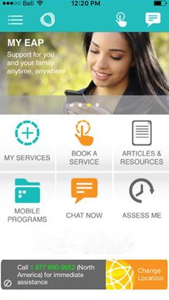
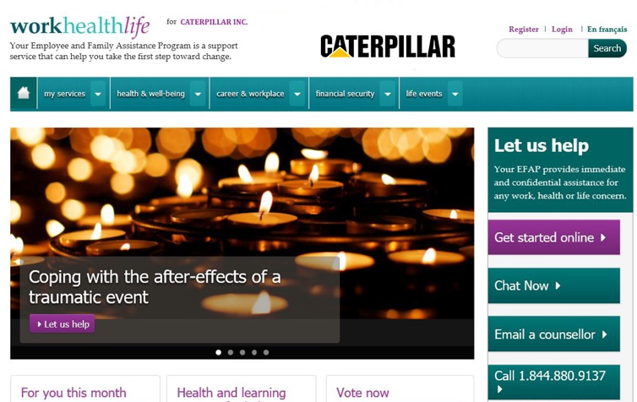
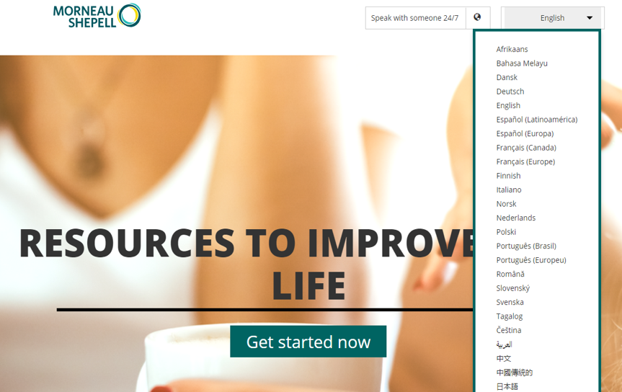
Engaging, convenient digital access
My EAP App
Multilingual website that is meaningful and interactive
27 languages
Employee and Supervisory orientation videos
Information on accessing your EAP
Expert information on many personal and work-related topics
Links to resources
Current events
Polling and surveys
Videos, webinars, interactive content
WCAG AA accessibility standards
Free download on all smartphones
QR scan code
Available in multiple languages
Immediate in-app counseling
First Chat instant messaging interactive tool
Health and wellness articles and videos
Visit: CaterpillarEAP.com
Enter your country for program access information
Notes:
Face to face counseling is the heart of EAP services. However, with the growing availability of digital connectivity and the increasing comfort with technology of younger employees, EAPs are evolving to offer more options.
Morneau Shepell is a leader in digital EAP services. They will deliver Caterpillar a web site in 27 languages that is full of helpful information, including local EAP contact information. You can access EAP and chat with a counselor all online.
You can also download their My EAP app. The app is full of educational content. But most importantly, you can initiate EAP services, get in-app counseling, and text with a counselor on demand. It is currently available in English, Spanish and French.

Slide 10
Accessing EAP
By Phone
<via local number>
Online
My EAP App
Onsite
CaterpillarEAP.com
Or through our benefits portal
EAP.cat.com
For iOS, Android and Blackberry
EAP counselors are available onsite in many locations
N. America Care Access Center
+1.866.228.0565*
+1.309.820.3604
*For local provider phone numbers, visit CaterpillarEAP.com
Notes:
Caterpillar’s EAP is designed to be globally consistent, but delivered locally- in local language and local culture.
<update slide with local contact phone numbers>
EAP can be accessed four ways
By phone: The U.S. access number is also the central global number. However- employees should go to the EAP website to get the EAP access number for their country. NOTE: URLs for online EAP access will be published in December 2018
Through the website: URL to be published in December 2018
My EAP mible App- downloaded through your phone’s app store
Onsite counselors (limited locations)
.

Slide 11
Global EAP Support
Morneau Shepell Regional Customer Success Managers
North America and Global
Christine Walanka, Director, Global Customer Success
cwalanka@morneaushepell.com
Latin America
Yesenia Limon, Customer Success Manager, LAC
ylimon@morneaushepell.com
Asia Pacific
Aakanksha Gupta, Customer Success Manager, APAC
agupta@morneaushepell.com
Europe, Middle-East and Africa
Ben Peters, Senior Customer Success Manager, EMEA
bpeters@morneaushepell.com
Global EAP Governance
Dr. John Pompe, Global Manager of EAP and Employee Health Programs, Caterpillar Inc.
pompejc@cat.com
Rob Peters, LCSW, Coordinator of EAP and Employee Health Programs, Caterpillar Inc.
Peters_Rob@cat.com
Notes:
Meet the team:
North America – Christine Walanka, Director, Global Customer Success
Christine is responsible for the global success of Morneau Shepell’s Employee Assistance Program for Caterpillar. Based in Chicago, Illinois, Christine brings over 18 years of experience in customer service and relationship management across the globe. Her experienc in implementing EAP and wellbeing programs has provided her with a greater understanding of the way various cultures view EAP support. Christine has leveraged her experience across several industries to design custom, culturally-relevant promotional plans that reduce stigma and drive awareness and engagement into the EAP, resulting in increased utilization. Christine holds a B.S. in Psychology with a minor in Marketing from Loyola University Chicago.
Latin America – Yesenia Limon, Customer Success Manager, LAC.
Yesenia ensures program consistency across the US, Latin America and the Caribbean. Yesenia is accountable to ensure that the EAP is promoted in a way that connects with all Caterpillar employees and family members in the region. Based in Chicago, Illinois, Yesenia brings over 11 years of experience in customer service, marketing and account management. As a Latin American native and with her experience in client implementation, content creation and translation will ensure the EAP offering is directly aligned with Caterpillar's needs in the region. Yesenia holds a B.A. in Fine Arts from The Illinois Institute of Art and is fluent in English and Spanish.
Asia Pacific – Aakanksha Gupta, Customer Success Manager, APAC
Aakanksha brings a wealth of cross functional expertise to her role and will support Caterpillar locally across India and will connect regional HR partners with in-country resources across the APAC region. She has demonstrated success in creation and execution of topical communications and training campaigns to address timely topics and help connect employees with the EAP. Aakanksha has a degree in Psychology from Delhi University, studied Industrial Relations and Personnel Management, and is an active volunteer at various NGOs. Aakanksha is based in Delhi, India.
Europe, Middle-East and Africa – Ben Peters, Senior Customer Success Manager, EMEA
Ben oversees the launch and delivery of EAP services in the EMEA region. Ben is a consultative, strategic Customer Success Manager with excellent relationship building skills, which help him support his clients in maximizing their return-on-investment. He has twelve years of relationship management experience supporting clients with their health management needs in the workplace. Ben has worked with clients in a variety of industries, including technology and healthcare. Ben is located in the U.K. and has been successful in establishing key relationships across EMEA.

Slide 12
Questions?
Caterpillar’s Global EAP
For local and regional access information, visit:
CaterpillarEAP.com or EAP.cat.com
Powered by:
Notes:
Contact your local EAP access number for questions about local services.
For program administrative question, contact Dr. John Pompe, Global Manager of EAP and Employee Health Programs. pompejc@cat.com or 1 309 675 6263

