Slide 1
Caterpillar’s
Employee
Assistance
Program (EAP)
HR / Leader Orientation
December 10-12, 2018
Notes:
This presentation is designed to provide an introductory overview of Caterpillar global Employee Assistance Program (EAP) as of January 1, 2019. This presentation is suitable for all employee audiences.
Caterpillar has offered an EAP to employees for decades. Following an RFP in 2018 the decision was made to continue our vendor relationship with Morneau Shepell and expand our EAP from covering about 75% of our employees, to full global coverage. As of January 1, 2019 all employees will have access to EAP services.
This presentation is a general overview of EAP. Services will vary around the world. Contact your countries EAP access number for local details.

Slide 3
Project review
EAP Orientation
The role of HR and Leaders
What we need from you
Agenda

Slide 4
Total Health is Caterpillar’s commitment to the health of Caterpillar employees and their families.
We fulfill this commitment through a partnership with our global businesses to provide benefits and resources that help our people achieve their best health.
Employee Assistance Program (EAP) supports nearly every dimension of employee health.
Notes:
We come to work every day to help our customers build a better world, but it can be tough to do when any part of your health is troubling you.
Caterpillar’s EAP is part of our Total Rewards and is a deliverable of our Total Health Strategy.
A healthy life involves more than a healthy body – a healthy mind, healthy finances, a feeling of belonging and knowing your purpose in life matter, too. We call this Total Health.
Total Health is Caterpillar’s global health strategy. This is Caterpillar’s commitment to employee health. When our people achieve their best health the individual, their family, their community and the workplace all benefit.
Caterpillar’s EAP aligns most closely with the emotional and social dimensions of health. But EAP delivers services that support all 5 dimension of our health.

Slide 5
What is EAP?
Employee Assistance Program or “EAP” is a workplace program that can help you and your dependents with a variety or problems and challenges, before they impact your lives at work or at home.
EAP is available to all regular full and part time Caterpillar employees and their eligible family members.*
EAP is not new to Caterpillar.
In fact, Caterpillar was one of the first companies to ever deploy an EAP.
Some locations have had EAP-type services since the 1940s
* Local eligible of family members will vary. Check with your HR representative.
Notes:
Caterpillar has been a leader in providing personal support for our employees and families. Caterpillar’s was one of the first EAP’s in existence.
The philosophy of EAP is that when employees and their families are free from mental health concerns, substance abuse problems and can management life stressors, everyone wins: the employee, the family, the community and the company. So we say that EAP is a “workplace program.” By supporting our employees, Caterpillar benefits.
Eligibility for EAP is governed by HR policies and local law. Where not prohibited, EAP is available to all full time and part time employees and their legal dependents. In some but not all instances this includes all family members living in the employee’s home.
Check with your HR or Benefits representative for questions about eligibility.

Slide 6
Why does Caterpillar offer EAP?
Notes:
Let’s spend a moment and discuss why this is so important. Caterpillar is invested in EAP and similar health programs for a variety of reasons.
Our health and mental health are things that bring us all together. It is the common global denominator necessary for our productivity and Caterpillar’s success.
Whether it’s healthcare costs, productivity, absenteeism or safety, Caterpillar thrives only when employees are healthy
Health programs are now the standard. It is expected that employers play a supportive role by offering benefits and programs to support good health.
EAP and our health programs align with our HR strategy.
It’s the right thing to do. Caterpillar fundamental cares about our employees and families.

Slide 7
Why is EAP important for employees?
Rarely
Life’s demands come neatly packaged one at a time.
Sometimes
We all face circumstances that distract from our important roles at home and work.
Always
We recognize the importance of:
Resolving personal issues early
Finding the right balance
Staying Healthy
Notes:
Why do we, as individuals need an EAP?
Life is complicated and challenges rarely come to us in tidy packages that are easy to resolve
At some point all of us will experience challenges that, if left un resolved, can impact our lives at work and home.
We need to place a priority on our health: in resolving problems early, balancing the demands in our lives, and maintaining health lifestyles

Slide 8
EAP services support nearly every dimension of health
Notes:
EAP can help with a wife variety of issues that span across the dimension of health:
Mental health concerns, like depression, anxiety and problems with children
Marital, relationship and parenting problems
Drug and alcohol problems
Work related problems, including stress, job change, relocation decisions, and peer/supervisory relationships
Greif and loss
Work life services, such as debt counseling, help finding child care and elder care
Just to name a few. The rule of thumb is….if you don’t know where to start, try EAP. If we can’t help resolve the problem, we will get you to the best resource.

Slide 9
How EAP supports Caterpillar and our People
Clinical counseling
Work/Health/Life
Professional Consultation
Workplace Support
Up to 6 sessions with a professional counselor per family member, per year, per problem
Relationships and conflict management
Personal / emotional issues
Work / family issues
Change / transition / stress
Grief and loss
Depression and anxiety
Addictive behavior
24/7 Crisis and emergency response
Work-life services involve assessment, coaching, and referrals for a variety of other personal concerns:
Family Support coaching and referrals
Child care
Elder care
Caregiving
Parenting
Lifestyle Coaching referrals
Smoking Cessation
Parenting
Weight Loss
Physical Activity
Legal advice/referrals
Civil, consumer, domestic, family
Landlord/ tenant
Estate matters/Real estate
Financial Planning/Review
Debt management and consolidation
Credit counseling and coaching
Retirement and estate planning
Tax planning and preparation
Budgeting
Relocation support
ISE predeparture counseling
Educational information, including the Living Abroad website
School Choice International
Global support for families in transition
Consultation
Training and education
Emergency response
Threat assessment
Organizational development and engagement
Benefit management
Occupational health
Wellness
To learn more about your EAP services, visit CaterpillarEAP.com or EAP.cat.com
Notes:
EAP deliverables fall into several different categories of supportive services. The availability of some services may be limited in some parts of the world. Please contact the EAP through one of the following methods
By phone: 1-866-228-0565, 1-309-820-3604, or through your local EAP access number which can be found at workhealthlife.com/caterpillar
By email, text or chat at www.workhealthlife.com/caterpillar
Clinical counseling:
Clinical counseling is available to address a wide range of personal concerns, including mental health, substance abuse, work related concerns, relationship problems and emergency situations. Services are available 24/7 by phone or online. Face to face services are provided through a carefully chosen network of providers that are appropriately credentialed in the country where they practice. Appointments are usually available within 3 working days, or sooner in emergencies.
Caterpillar’s EAP providers up to 6 sessions with a counselor, per problem, per year for each employees and eligible family member. This means that each eligible person can access the EAP and receive counseling throughout the year for unique problems that arise. Please note that not all EAP cases will require 6 sessions. In some cases referrals can be made after the first session. The EAP providers have discretion to limit EAP services when clinically appropriate, but will work with employees to ensure they are receiving the most appropriate resources.
Work/life/health and Professional consultation:
Work-life and consultation services deliver information, assessment, consultation and referrals for a wide variety of non-clinical issues, such as help finding childcare, eldercare and other caregiving support. Through EAP counseling and work-life, employees can get assessment, counseling and referrals for lifestyle issues like smoking, parenting, weight loss and increasing physical activity. Legal and Financial consultation involves assessment, coaching and referrals for many legal and financial issues. When the basic EAP services can’t address a problem, the EAP consultants will make referrals to the most appropriate resource.
Work-life services also support our ISEs and families in transition. The EAP will reach out to families who have accepted an international assignment and offer a predeparture assessment and counseling to help prepare and adjust to the international move. The EAP will send periodic educational and promotional materials to ISEs to help with issue related to life living abroad, and to remind them of the global EAP support for ISEs.
Workplace support
In addition to support for individuals and families, the EAP provides a variety of support to Caterpillar organizations, including HR and supervisor consultation, training and education, emergency responses, threat assessment, and response to critical incidents such as workplace accidents or the unexpected death of an employees. EAP can help address organizational stress, change management and developing leadership skills. EAP also provides many training programs on mental health, stress, building better relationships, working across diversity, Emotional Intelligence and how to identify co-workers who may need help.

Slide 10
EAP counseling, coaching and consultation
Short-term, goal-orientated support for work and life issues:
Clinical counseling
Professional guidance and coaching
Information, consultation and referrals for a variety of work-life issues such as legal, financial and help finding child and eldercare
Appointments are available without delay or wait
EAP is confidential. No one will know you have used the EAP.
There is no cost for using the EAP
EAP is available 24/7 by phone, online or through the My EAP App
Notes:
We will get into more details about the EAP services in a moment.
As an overview, EAP offers a variety of services to support your overall well being, such as:
problem assessment
personal counseling
and referrals for specialized care.
But EAP also provides
Coaching and consultation
Training and education
and referrals for other work-life issues such as legal consultation, financial counseling, and help finding resources for child care and elder care.
EAP is completely confidential, governed by local laws protecting healthcare data privacy.
There is never any cost for EAP. All services are funded by Caterpillar in advance. Cost may be incurred when referrals are made outside of the EAP.
EAP is always available by phone and online. In-person appointments are made promptly, typically within 3 working days or sooner in urgent situations.

Slide 11
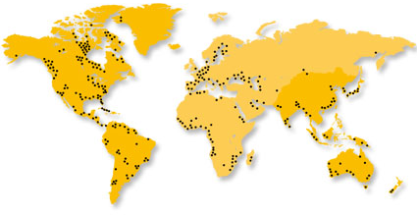
Global Access
Caterpillar has partnered with Morneau Shepell to deliver EAP services everywhere our employees live and work through a network of in-country providers. EAP services are delivered in local culture and language.
Powered by:
For local and regional access information, visit CaterpillarEAP.com or EAP.cat.com
Notes:
In 2017 Morneau Shepell acquired Caterpillar’s long time EAP vendor partner, Chestnut Global Partners (CGP). After a lengthy RFP, Caterpillar chose to remain with Morneau Shepell and expand the EAP as a standard global benefit.
The new and refreshed EAP will combine the best of CGP’s global network and program innovation, with the global infrastructure, account management and cutting edge digital technology that Morneau Shepell brings.
We will talk in a moment about the use of technology to access EAP and received services. But one of Morneau Shepell’s strengths is the ability to:
deliver EAP to our global employees in the country where they live and work
in the languages they use
and in their local culture.
When you call the EAP, it rings in your country and is answered in your language. Visit workhealthlife.com/caterpillar for a list of EAP contact information by country.

Slide 12
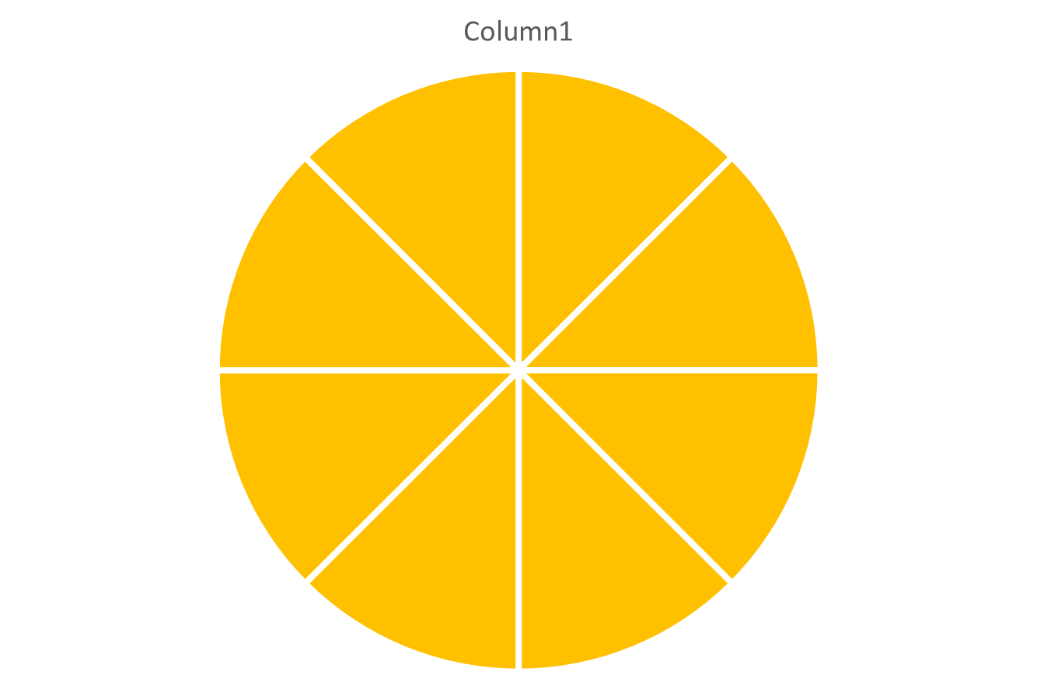
Multiple ways to access support*
Group Counseling
Online Services
Online chat
Video counseling
24/7 Access
In Person
counseling, onsite in some locations
E-counseling
* May not be available in all countries
Telephonic
counseling
My EAP App
Accessibility
Choice
Confidentiality
Notes:
*Not all technologies are available in all countries. Visit CaterpillarEAP.com for more information and local EAP contact information.
One of the most important elements of EAP is ease of access and ease of use. We want to offer as many points of access as possible so our people can access EAP in a way that is most comfortable.
Please note that not all of these are available in all locations.
[elaborate on each]

Slide 13
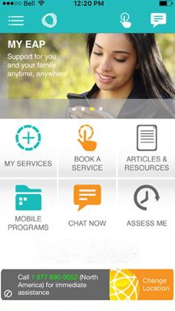
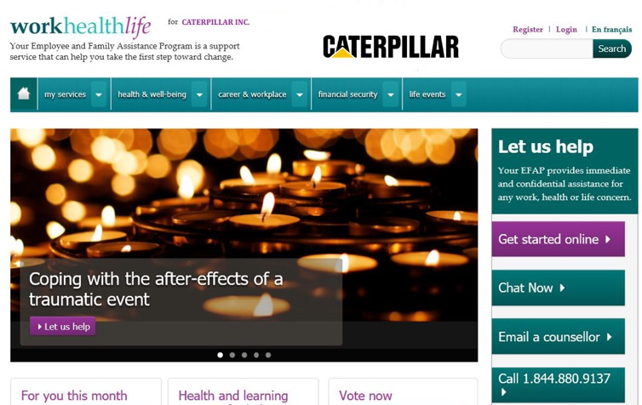
Engaging, convenient digital access
My EAP App
Multilingual website that is meaningful and interactive
27 languages
Employee and Supervisory orientation videos
Information on accessing your EAP
Expert information on many personal and work-related topics
Links to resources
Current events
Polling and surveys
Videos, webinars, interactive content
WCAG AA accessibility standards
Free download on all smartphones
QR scan code
Available in multiple languages
Immediate in-app counseling
First Chat instant messaging interactive tool
Health and wellness articles and videos
Visit: CaterpillarEAP.com
Enter your country for program access information
Notes:
Face to face counseling is the heart of EAP services. However, with the growing availability of digital connectivity and the increasing comfort with technology of younger employees, EAPs are evolving to offer more options.
Morneau Shepell is a leader in digital EAP services. They will deliver Caterpillar a web site in 27 languages that is full of helpful information, including local EAP contact information. You can access EAP and chat with a counselor all online.
You can also download their My EAP app. The app is full of educational content. But most importantly, you can initiate EAP services, get in-app counseling, and text with a counselor on demand. It is currently available in English, Spanish and French.

Slide 14
Accessing EAP
By Phone
<via local number>
Online
My EAP App
Onsite
CaterpillarEAP.com
Or through our benefits portal
EAP.cat.com
For iOS, Android and Blackberry
EAP counselors are available onsite in many locations
N. America Care Access Center
+1.866.228.0565*
+1.309.820.3604
*For local provider phone numbers, visit CaterpillarEAP.com
Notes:
Caterpillar’s EAP is designed to be globally consistent, but delivered locally- in local language and local culture.
<update slide with local contact phone numbers>
EAP can be accessed four ways
By phone: The U.S. access number is also the central global number. However- employees should go to the EAP website to get the EAP access number for their country. NOTE: URLs for online EAP access will be published in December 2018
Through the website: URL to be published in December 2018
My EAP mible App- downloaded through your phone’s app store
Onsite counselors (limited locations)
.

Slide 15
Brief Supervisor Orientation

Slide 16
How HR and Leaders can use EAP:
To support your people
Manage behavior
Improve performance
Notes:
As we have discussed, EAP is a helpful resource for employees and their families to address a variety of personal and work related concerns. But EAP can also be a helpful organizational resource to support HR and leaders.
EAP offers a variety of training and organizational development support. But EAP is most useful when used as a tool for HR and leaders to help manage employees who are struggling.
Often, supervisors or HR managers are the first to learn when employees are struggling with a personal or performance concerns. By identifying employees in need, HR and leaders can play an important role in getting employees the help they may need.
So let’s talk about how to use EAP as a supervisory resource.

Slide 17
Global Governance /
Customer Support
BU HR and Local EAP stakeholders
Caterpillar Global Process Owners
Caterpillar Regional Total Rewards Managers
Director, Global Customer Success
Regional Customer Success Managers
Morneau Shepell Leadership
In-country Global Partners
Notes:
CHRISTINE
POINT TO DRIVE HOME: experience in working with multinational matrixed organizations. It can be complex; however, the development of the LOCAL relationship is key.
Our globally consistent, locally relevant account management structure consists of a multinational account consultant that spearheads the global engagement strategy. The multinational account consultant is supported by regional account executives in APAC, EMEA and the Americas to facilitate relationships with Caterpillar’s key regional HR stakeholders to execute the global strategy as culturally appropriate for each region. The regional account executives are supported by Morneau Shepell’s proprietary network of global partners, each of which serve as local extensions of our regional and global team. Our partners provide on-the-ground support and recommendations for each country that are in local language and aligned with the cultural values of the location.
I want to focus on the right side of this slide, and perhaps add more CAT field offices and connect them with the In-Country.
Narrative to include:
Our globally consistent, locally relevant account management structure consists of a Multinational Account Consultant that spearheads the global engagement strategy. The Multinational Account Consultant is supported by Regional Account Executives in APAC, EMEA and the Americas to facilitate relationships with Caterpillar’s key regional HR stakeholders to execute the global strategy as culturally appropriate for each region. The Regional Account Executives are supported by Morneau Shepell’s proprietary network of Global Partners, each of which serve as local extensions of our regional and global team. Our partners provide on-the-ground support and recommendations for each country that are in local language and aligned with the cultural values of the location.
Our team will partner with you to drive thought leadership within the EAP Industry

Slide 18
Global Governance / Customer Support
Dr. John Pompe
Global Mgr, EAP and Employee Health Programs, Caterpillar Inc.
pompejc@cat.com
Christine Walanka
Director, Global Customer Success
cwalanka@morneaushepell.com
Aakanksha Gupta
Customer Success Representative,
APAC (based in India) agupta@morneaushepell.com
Yesenia Limon
Customer Success Manager,
US/LATAM
(based in North America)
ylimon@morneaushepell.com
Ben Peters
Senior Customer Success Manager,
EMEA (based in UK)
bpeters@morneaushepell.com
Caterpillar
Regional Total Rewards Managers
BU and local HR stakeholders
Notes:
Christine
Our account management structure is designed to support CAT on all levels. Myself and Kasra set the strategic direction of our US programs, ensure high client satisfaction and will participate in annual reviews
Matt Mollenhauer still remains in contact with you- but you have also been assigned Christine Walanka as an account Consultant who will work closely with you as well. provide consultations, set the strategic direction of the program, establish a communication plan and promotional strategy. Each quarter she will review the program progress, utilization and make reccomendations on how the plan can be adapted to suit the evolving needs of fiserve
Supporting Christine is our global regional account managers who act as the on the ground support in EMEA, India and Asia Pacific.
Melissa Nunez oversees our clinical delivery team who will provide consultations for troubled employees, management referrals or cases of high sensitivity Your onsite clinicians will report directly to Melissa.

Slide 19
Leaders play an important role
Champion
Healthy, productive behaviors; the importance of self-care; and the value of the EAP.
Support
When employees struggle with personal or health related issues
Recognize
The signs of health, personal, and performance problems
Identify and Respond
When personal problems have a severe impact workplace performance or safety
Notes:
Leaders have the ability to influence employee health, from prevention and promoting good health, all the way through identifying employees who may be at risk of a performance, personal or medical problem.
We ask leaders to :
Be a champion for all 5 dimension of Total Health
Support employees during times of need
Identify when health or personal problems impact performance or the workplace
Respond when performance problems worsen or behaviors of concerns arise.
NOTE: there is additional training available on “behaviors of concern” and workplace violence prevention.

Slide 20
Sometimes taking action is simple
Notes:
We can significantly impact culture and employee engagement by simply observing our employees’ behaviors and reaching out when problems arise. It shows we care, we are supportive and we are willing to help.
Intervening at the very earliest indications of employee problems can help prevent more serious issues, health problems, mental and social health problems, performance problems, even workplace violence. We always want to identify employees’ personal and performance problems early and get them the support they need to resolve the problem.
Sometimes it’s no more complicated that asking “are you OK,” finding a quiet place to talk, listen and make an EAP referral.
NOTE: there is additional training available on identify employees in need and the RUOK? program.

Slide 21
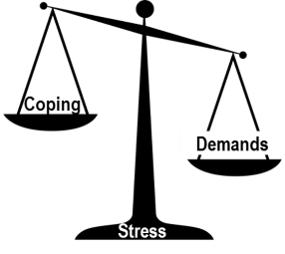
Identifying employees who could benefit from EAP
Life Stress
Performance Problems
Behavioral Risk
Significant health problems
Loss of job; poor rating; missed promotion; layoff
Relationship problems at home or work
Losses; including death, divorce, custody problems
Alcohol or drug use
Financial or legal problems
Work stress, managing change, job instability, or difficulty meeting job demands
Absenteeism or tardiness
Declining performance or productivity.
Less communication via email or remote meetings. More time logged off.
Relationship problems
Missed meetings, calls, deadlines
Failing to follow instructions or accepting coaching
Excessive physical problems
Confusion, poor memory or concentration
Dramatic changes in mood or appearance
Signs of drug or alcohol use
Social avoidance or withdrawal
Anger, negativity, intimidating or disrespectful behavior
Threatened words, harassment, bullying, threats of violence
Violent behavior towards self, others, the facility or company reputation.
Notes:
Employee personal problems can impact the workplace. And those problems can take many forms. This list just a few examples.
Often, more serious problems start out as routine stressors at home or work. Sometimes those concerns, if left unresolved, can worsen and become more serious over time, even to the point where they disrupt our lives at home or work. Sometimes the result of unresolved problems can be severe.

Slide 22
Everyone exhibits some of these behaviors some of the time. Make EAP referrals early and often.
Look for and document objective behavioral patterns that are well-defined and work-related
Do not ignore
Maintain your performance expectations
Know your resources (HR, Medical, EAP, Security). Consult with HR and EAP when problems emerge before taking action.
As soon as a pattern emerges, take action and refer to EAP.
Notes:
It is important to remember that all of us struggle with life stress. All of us have bad days. Leaders have to be able to recognize the signs early, but mot importantly, identify patterns that emerge over time.
When you see the signs, take note. Consult with senior leaders, HR and the EAP.
Get ready to take action, including making referrals to the EAP.

Slide 23
Types of EAP Referrals
Self Referral | Employee seeks EAP privately. Primary way EAP is accessed.
Informal or “Friendly” referral | Performance is acceptable. Supervisor hears of or observes a personal problem and suggests EAP as a helpful resource.
Formal* | Performance or behavioral problems have been documented. Supervisor constructively confronts the employee to educate, train and develop any improvement plans.
 | EAP is “strongly encouraged” and may be written into a development or action plan.
 | EAP can report attendance with written employee consent.
Fitness-for-duty* | Part of HR and Medical processes. EAP is involved when an employee’s medical condition is thought to risk workplace safety. Should only be made in consultation with HR, LR and Medical
Last Chance* | (Rare) When an employee is brought back to work following a suspension or termination and required to sign a LCA, EAP involvement may be mandated as a portion of the contract.
* Always consult with local HR practices before using this process.
Notes:
There are several ways to make referrals to the EAP.
Most employees who access EAP do so on their own. This is called a “self referral.”
HR and leaders often have the option of 4 ways to refer employees to EAP.
The Informal or “Friendly” Referral is made when there are no indications of performance or behavioral problems, but the supervisor has reason to believe the employee is struggling with an issue where EAP may be able to help. This is the most common type of supervisory referrals. We encourage leaders to make friendly EAP referrals often. Example: “I noticed you seemed distracted the other day. Is everything OK? Have you considered calling the EAP?”
Formal referrals are made once a pattern has emerges. Supervisors inform the employee of their observations and concern, the desire to help, and the expectation that performance will improve. Formal referrals are typically documented and may be written into a formal development or action plan. EAP remains a voluntary option to help the employee resolve any personal issues that may be contributing to the workplace problem. Example: “I’ve noticed a pattern of absenteeism and declining performance. I encourage you to use whatever resource that may be helpful to improve performance, including the EAP. Here is some information about the EAP and I strongly encourage you to call.”
Fitness for duty referrals are made when there are clear indications that the employee may not be medically capabile to work safely and effectively. These referrals must be made under the guidance of local HR policy.
Last Chance referrals are built into personnel action. They are rare and often associated with bargained (Unionized) employees or following positive drug tests. Again, these referrals must be made under the guidance or local HR policy

Slide 24
Employees should not be disciplined for refusing to access EAP.
Personal problems and EAP use does not excuse poor performance.
Employees at work and considered “fit for duty” must be held to the same standards as everyone else
It is everyone’s best interest to identify problems early, assist in resolving problems before there are performance problems and negative impact to the organization.
Notes:
Sometimes we are so concerned about our employees that we want to excuse inappropriate behavior or poor performance. It is important that we treat all employee consistently, even when they are struggling with personal concerns.
If employees come to work and have provided no indication that they are not medically fit for duty, they should be held the same performance standards as all other employee.
In order to prevent medical or personal problems from impacting an employee’s job, it is important to identify problems and work to resolve them early.

Slide 25
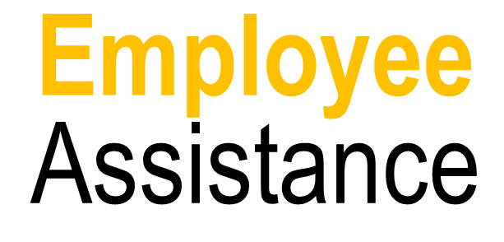
Consulting with EAP
EAP can offer expert consultation on employee behavior and performance.
Consider consulting with the EAP at the earliest signs of a problems, before you make the referral.
Local contact information can be found at CaterpillarEAP.com or our Caterpillar benefits portal at EAP.cat.com
For North American EAP access and for administrative issues: +1.866.228.0565 or +1.309.820.3604
Notes:
Through our partnership with Morneau Shepell, we have local and regional EAP provider that can deliver services in local language and culture.
If you have questions about the EAP or would like to receive expert consultation about an employee situation , contact your local or regional EAP provider. Local EAP access information and phone numbers can be found at [new EAP URL to be determined by December 1, 2018]

Slide 26
What we need from you
Champion the importance of employee health and the value of EAP. Make EAP referrals for those in need.
Seek ways to communicate EAP to employees
Webinars / supervisory training
Onsite presentations by local providers
Print media
printable pdf and link to catpublications.com for print-on-demand
EAP.cat.com
CaterpillarEAP.com
Plasma images
Let us know who you are. We want to link key EAP stakeholders to regional account managers and local providers.
Notes:
Through our partnership with Morneau Shepell, we have local and regional EAP provider that can deliver services in local language and culture.
If you have questions about the EAP or would like to receive expert consultation about an employee situation , contact your local or regional EAP provider. Local EAP access information and phone numbers can be found at [new EAP URL to be determined by December 1, 2018]

Slide 27
Global EAP Support
Morneau Shepell Regional Customer Success Managers
North America and Global
Christine Walanka, Director, Global Customer Success
cwalanka@morneaushepell.com
Latin America
Yesenia Limon, Customer Success Manager, LAC
ylimon@morneaushepell.com
Asia Pacific
Aakanksha Gupta, Customer Success Manager, APAC
agupta@morneaushepell.com
Europe, Middle-East and Africa
Ben Peters, Senior Customer Success Manager, EMEA
bpeters@morneaushepell.com
Global EAP Governance
Dr. John Pompe, Global Manager of EAP and Employee Health Programs, Caterpillar Inc.
pompejc@cat.com
Rob Peters, LCSW, Coordinator of EAP and Employee Health Programs, Caterpillar Inc.
Peters_Rob@cat.com
Notes:
Meet the team:
North America – Christine Walanka, Director, Global Customer Success
Christine is responsible for the global success of Morneau Shepell’s Employee Assistance Program for Caterpillar. Based in Chicago, Illinois, Christine brings over 18 years of experience in customer service and relationship management across the globe. Her experienc in implementing EAP and wellbeing programs has provided her with a greater understanding of the way various cultures view EAP support. Christine has leveraged her experience across several industries to design custom, culturally-relevant promotional plans that reduce stigma and drive awareness and engagement into the EAP, resulting in increased utilization. Christine holds a B.S. in Psychology with a minor in Marketing from Loyola University Chicago.
Latin America – Yesenia Limon, Customer Success Manager, LAC.
Yesenia ensures program consistency across the US, Latin America and the Caribbean. Yesenia is accountable to ensure that the EAP is promoted in a way that connects with all Caterpillar employees and family members in the region. Based in Chicago, Illinois, Yesenia brings over 11 years of experience in customer service, marketing and account management. As a Latin American native and with her experience in client implementation, content creation and translation will ensure the EAP offering is directly aligned with Caterpillar's needs in the region. Yesenia holds a B.A. in Fine Arts from The Illinois Institute of Art and is fluent in English and Spanish.
Asia Pacific – Aakanksha Gupta, Customer Success Manager, APAC
Aakanksha brings a wealth of cross functional expertise to her role and will support Caterpillar locally across India and will connect regional HR partners with in-country resources across the APAC region. She has demonstrated success in creation and execution of topical communications and training campaigns to address timely topics and help connect employees with the EAP. Aakanksha has a degree in Psychology from Delhi University, studied Industrial Relations and Personnel Management, and is an active volunteer at various NGOs. Aakanksha is based in Delhi, India.
Europe, Middle-East and Africa – Ben Peters, Senior Customer Success Manager, EMEA
Ben oversees the launch and delivery of EAP services in the EMEA region. Ben is a consultative, strategic Customer Success Manager with excellent relationship building skills, which help him support his clients in maximizing their return-on-investment. He has twelve years of relationship management experience supporting clients with their health management needs in the workplace. Ben has worked with clients in a variety of industries, including technology and healthcare. Ben is located in the U.K. and has been successful in establishing key relationships across EMEA.

Slide 28
Questions?
Caterpillar’s Global EAP
For local and regional access information, visit:
CaterpillarEAP.com or EAP.cat.com
Powered by:
Notes:
Contact your local EAP access number for questions about local services.
For program administrative question, contact Dr. John Pompe, Global Manager of EAP and Employee Health Programs. pompejc@cat.com or 1 309 675 6263

