Slide 1
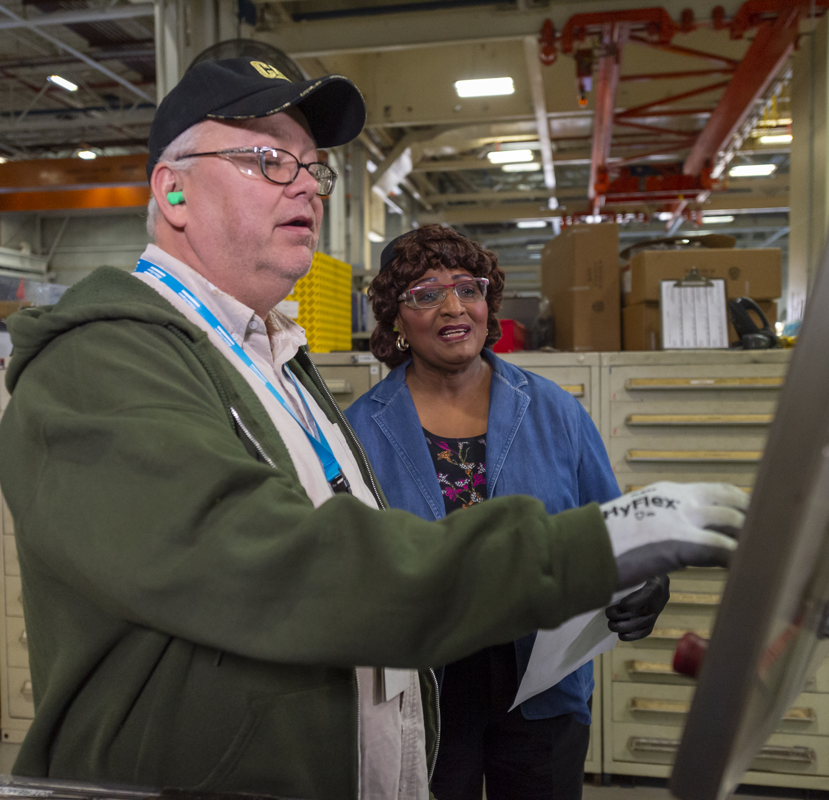
Resources on Building Healthy Relationships now on
.cat.com

Slide 2
The A to Zs of Total Health available
on
.cat.com

Slide 3
Resources on how to “Build Relationships” now available on
.cat.com

Slide 4
The A to Zs of Total Health available
on
.cat.com

