Slide 1
Welcome to Caterpillar
New Hire Orientation (Singapore)
Notes:
Updated 2023.11.03

Slide 2
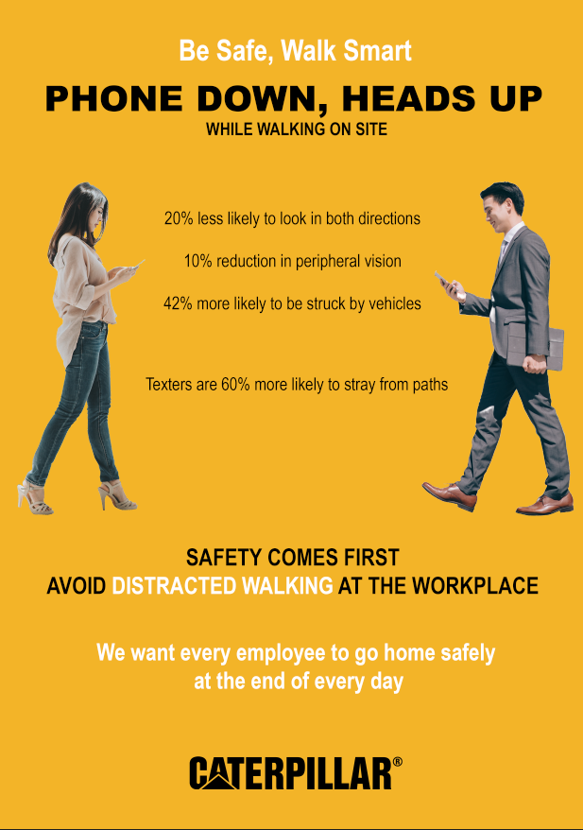
Safety Briefing
FREE WORKSPACE OF TRIP HAZARDS
Remove electrical cords, boxes, and toys from around your feet
SET UP ERGONOMIC WORKSTATION
Set monitor or laptop at eye level in front of you, not at an angle
TAKE MENTAL & PHYSICAL BREAKS
Stand up for 1 minute every hour and take stretch breaks or move around
CLEAN HANDS FREQUENTLY
Wash hands with soap and water for at least 20 seconds
EMERGENCY PHONE NUMBERS
What are the numbers for your location?
2

Slide 3
8 PROTOCOLS FOR A VIRTUAL MEETING
Actively participate
Camera on all the time, unless experiencing network issues
No multi-tasking
Respect time
Mute when not speaking to minimize background noise
Only ask questions when prompted by facilitator or use chat function or Raise Your Hand function
Whilst using camera, use a background photo that reflects YOU
This meeting is being recorded. Your presence provides your consent.

Slide 4
Notes:
Talking points for Be Present slides:​
For all meetings, we ask all participants to be present, today I’d like to call out being present as an action we can all take to drive an inclusive environment:​
Seek the opinions and ideas of others, give everyone a chance to share their thoughts.​
Share your view and experiences openly​
Listen, listen better, don’t be quick to dismiss​
Be a champion for the underrepresented​
​
This is especially important in today’s context as we seek to do things differently, do things better to achieve our ​business goals
--​

Slide 5
Agenda
Safety Briefing
History of Caterpillar Inc. and Caterpillar Singapore
Introduction to Caterpillar
Caterpillar Overview
Our Strategy
Our Values in Action – Caterpillar’s Code of Conduct
Essentials To Know
Singapore Employee Handbook
Getting Involved Around Caterpillar
Useful Contact List and Links

Slide 6
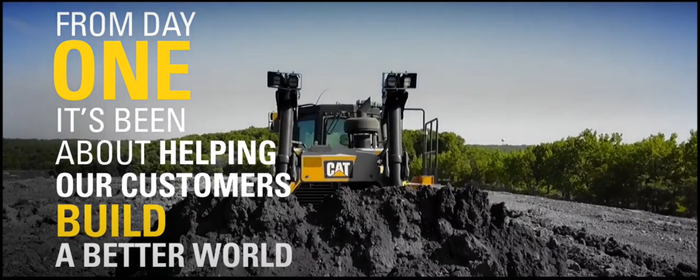
Click to play This is Caterpillar overview video (Youtube)
Notes:
I’d like to share a video that shows what we do.
Pay close attention because at the end there will be a quiz.
What businesses is Caterpillar in?
Construction Industries & Growth Markets
Our Construction Industries segment is focused on helping our customers build what the world needs – new highways, railroads, airports, water systems, housing, hospitals and schools, to name a few.
The need for new infrastructure is especially acute in the world's fastest-growing economies. This segment, led by Group President Rich Lavin, designs, manufactures and markets construction machines, including backhoe loaders, small and medium wheel loaders, small and medium track-type tractors, track-type loaders, skid steer loaders, multiterrain loaders, mini excavators, compact wheel loaders, select work tools, small, medium and large track excavators, wheel excavators, motor graders and pipelayers.
Resources Industries
The Resource Industries segment, led by Group President Steve Wunning, makes it possible for our customers to mine and harvest these resources in a profitable and sustainable way. The business units within Resource Industries design, manufacture and market products for Surface and Underground mining, paving and forestry equipment, machinery components and electronics and control systems.
Energy and Power Systems
Our Power Systems segment, under the leadership of Group President Gerard Vittecoq, is focused on helping to meet these needs through a variety of solutions and applications across multiple industries. This segment designs, manufactures and markets products including generator sets, integrated systems and solutions for marine and petroleum industries and reciprocating engines supplied to global Original Equipment Manufacturers (OEMs) for a variety of diverse applications as well as Cat® machinery. Power Systems also includes the operations of Progress Rail and Solar Turbines, both subsidiaries of Caterpillar.
Customer & Dealer Support
Customer & Dealer Support (C&DS), led by Group President Stu Levenick, strengthens Caterpillar's product support excellence. Through our Customer Services Support and Distribution Services Divisions, C&DS builds competitive advantage and brings strong focus to Caterpillar-branded parts and customer services and delivers outstanding dealer development. (Parts Distribution & Logistics, Reman)
Financial Products & Corporate Services
Financial products include a variety of equipment financing alternatives, leasing options and insurance coverage plans. Our Financial Products segment businesses report to Caterpillar Group President and CFO Ed Rapp, whose responsibilities also include Corporate Services, encompassing the administrative functions to support the enterprise, including Finance Services, Human Services, Global Information Services, Global Purchasing, Investor Relations, Strategy & Business Development and Corporate Auditing.

Slide 7
History of Caterpillar Inc. and Caterpillar Singapore

Slide 8
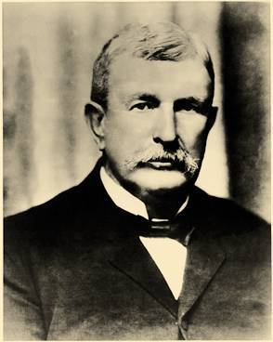
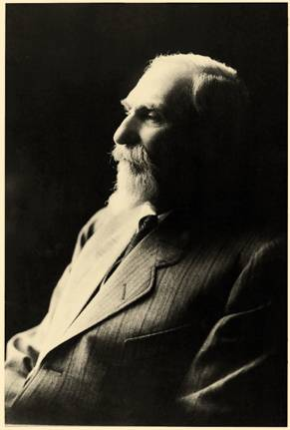
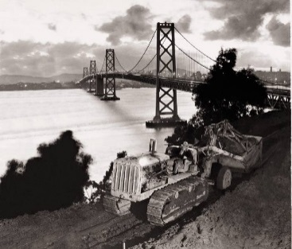
Our History
Caterpillar Inc. established in 1925 with merger of Holt and Best tractor companies
First diesel tractor model built in October 1931 in East Peoria, Illinois
Notes:
Benjamin Holt(left) and Daniel Best(right) merged their tractor companies. This is Caterpillar Tractor Company.
In 1931, the first Diesel Sixty Tractor built.

Slide 9
Notes:
Pictured: First Caterpillar diesel Tractor, an industry first.​
​
Over the last century we’ve grown with our customers. We’ve changed together as the world has changed: creating, building, problem solving, innovating, testing, servicing and improving. When customers choose our products, services and solutions today, they also gain nearly 100 years of experience and expertise. ​
​
From transitioning to diesel-powered engines from gas in 1931, to creating the first electric drive track-type tractor in 2008, to most recently launching the prototype of the first battery electric 793 large mining truck, Caterpillar has been at the forefront of innovation and sustainability that is helping our customers build a better, more sustainable world for nearly 100 years.​
.

Slide 10
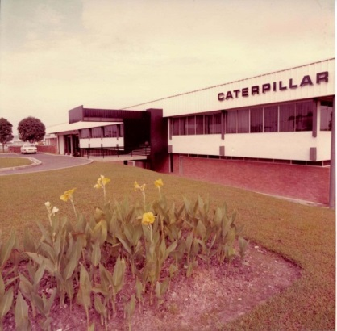
Our Beginning in Singapore
1967
Started with 20+ employees in Singapore (branch)
Established Asia Distribution Centre (at current 14 Tractor Road)
Jurong Swampy area, no road name, Tractor Road was named
1992
Major expansion, Hong Kong office was relocated to Singapore at Gateway
Singapore became Asia HQ.
1994
7 Tractor Road building was completed. Office shifted from Gateway
Rapid expansion, prompted the decision to expand 14 Tractor Road building
Due to Asia crisis in 1997, project was put on hold
2002
New 14 Tractor Road building was completed (the 6-storey building)
2010
5 Tukang Innovation Grove office building opened

Slide 11
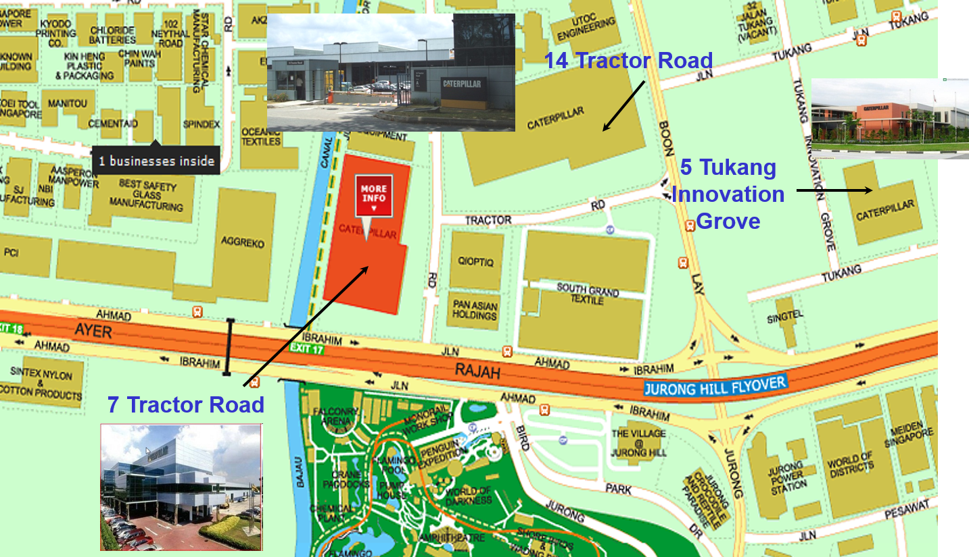
Three Major Office Locations

Slide 12
Business Units in Singapore
700+ employees (More than 22 different nationalities)
Over 20 Business Units
Asia Pacific Distribution
Americas Distribution Services Marketing
Building Construction Products
CI Services Division
Earthmoving Division
Electric Power Division
Excavation Division
Finance Services Division
Financial Products Division
Global Construction & Infrastructure Division
Global Information Services Division
Government & Corporate Affairs
Human Resources
Industrial Power Systems Division
Product Support & Logistics Division
CAT Digital
CAT Oil & Gas
Enterprise Strategy
Large Power Systems Growth Market
Resource Industries Sales, Services and Technology
Solar Turbines

Slide 13
Caterpillar Overview

Slide 14
Notes:
For nearly 100 years, along with our customers, we’ve helped make the world a better place to live. ​
​
From providing power that brought Neil Armstrong’s first words from the moon, to protecting more than 11,000 miles of the world’s greatest rivers, to building the Panama Canal and more. We’ve taken a place in history alongside our dealers and customers.​
​
Improving: Our products and services have been building the world’s infrastructure, enabling higher standards of living. Through the work of our global team, our solutions help make our planet a better place to live – where roads connect families, schools educate children, and hospitals heal the sick.​
​
Power: From cities to remote regions, communities depend on power to keep hospitals running, lights on, clean water flowing and more.​
​
Restoring: Our solutions help our customers build a better world. But in some cases, it’s rebuilding a better world. When disasters strike, Caterpillar and Cat® dealers stand ready with experienced teams who can bring help and hope in the face of devastating damage. From providing emergency backup power and equipment for rescue and recovery efforts to helping communities rebuild once danger has passed, our team is here. Often, Cat® equipment is first on the scene to clear roads, allowing first responders to enter the area.​
​
Inspiring: Every day – Caterpillar employees, dealers, suppliers and customers are doing the work to bring out purpose to life. Whether it’s through the work of the Caterpillar Foundation

Slide 15
Notes:
A growing world is built on infrastructure: roads and bridges, airports and seaports, homes and businesses. Our customers make it a reality, taking on everything from residential construction jobs to complex infrastructure and commercial building projects. With an expansive construction industry, our customers also perform work in applications like landscaping, forestry, paving, waste management, snow removal and agriculture. Available through a worldwide dealer network, our construction products, technologies and services are sold under the Cat®, Cat Financial, Cat Rental Store, Cat Reman brands and in some parts of the world under the SEM brand. ​
Construction Industries (CI) supports customers using machinery in infrastructure, forestry and building construction applications. ​
​
The product portfolio includes backhoe loaders, small wheel loaders, small track-type tractors, skid steer loaders, multi-terrain loaders, mini excavators, compact wheel loaders, telehandlers, select work tools, small, medium and large track excavators, wheel excavators, medium wheel loaders, compact track loaders, medium track-type tractors, track-type loaders, motor graders, pipelayers, forestry and paving products and related parts.

Slide 16
Notes:
Turning on a light, driving down a road, sending a text message: Many daily activities we take for granted are made possible by mined resources. Surface and underground mines rely on us for proven, scalable solutions, including a broad product range and autonomous capabilities, as they extract and haul aggregates, coal, copper, gold, iron ore and other minerals. Our mining products, technologies and services — sold under the Cat brand services under the Cat Reman brand — improve productivity, keep the jobsite safe and support miners on their sustainability journey.​
Our product portfolio includes trucks, dozers, drills, shovels, scrapers and the technology solutions to help our customers work safely and productively.​
Our commitment to the mining industry means the world can continue to benefit from advanced medical devices that save lives, farming equipment that puts food on the table, and cell phones that connect loved ones.​
​

Slide 17
Notes:
Our Energy and Transportation segment is a diverse portfolio delivering solutions for our customers’ growing energy and transportation needs. ​Through our diverse brands including Cat, Solar Turbines, Progress Rail, MWM, Perkins and FG Wilson, we support customers in industries like:​
Marine: Our engines power fishing vessels, cargo ships, tugboats, cruise ships, recreational and yacht vessels and so much more. By combining our power systems with our technology-enabled solutions, we’re able to keep vessels running safely, efficiently and profitably.​
Oil & Gas: Our product and service offerings support gas compression, land and offshore drilling and production and well services. Combining the best equipment, technology and services results in more productivity, improved safety and increased sustainability. ​
Power Generation: We began producing generator sets more than 80 years ago. Diesel and natural gas engines provide prime power for electric utilities, combined heat and power for industrial customers, rental power for temporary power needs and critical standby power for hospitals, data centers and other businesses that can’t afford to be without.​
​
Rail: Through our Progress Rail subsidiary, we provide rolling stock and infrastructure solutions and technologies for the global rail industry. Solutions include locomotives, railcars, engines, technologies, trackwork, fasteners, signaling, rail welding, repair services, aftermarket parts support and recycling operations.​

Slide 18
Notes:
SD&D supports our customers with a comprehensive portfolio of parts and services, including rental. We partner with the Cat Dealer Network to deliver a superior customer experience and realize our shared goals for growth and success. SD&D includes the following functions:​
The Distribution Services Divisions (DSDs) drive alignment with the dealer network to ensure our distribution channel remains a competitive differentiator. ​
The Global Rental & Used Equipment Services team delivers world-class rental and used equipment to enable customer success​
The Global Service team enables dealer service technicians in support of customers. ​
The Global Marketing & Brand team works with the segments to deliver consistent and compelling customer engagement by elevating our brand.​
Cat Digital delivers industry-leading digital solutions in support of profitable growth for Caterpillar, dealers and our end customers.​
Product Support & Logistics Division manages all inbound and outbound logistics, the global parts distribution network and end-to-end responsibility for wear and maintenance components.

Slide 19
Notes:
For more than 40 years, Cat Financial has provided a wide range of financing solutions to customers and Cat® dealers for machines, engines, Solar® gas turbines, genuine Cat parts and services. Headquartered in Nashville, Tennessee, Cat Financial serves customers globally with offices and subsidiaries located throughout North and South America, Asia, Australia, Europe and Africa. Visit cat.com to learn more about Cat Financial. ​

Slide 23
Notes:
Caterpillar’s global dealer network provide expert service and knowledgeable advice. Cat dealers are locally operated, independent businesses. Many customer-dealer relationship go back generations. Cat dealers deliver a superior customer experience throughout the entire equipment lifecycle – from the initial purchase, parts and service, advice and support – as well as rental and used equipment.

Slide 24
Notes:
​
Caterpillar suppliers are a valuable contributor to our extended value chain and an essential link to deliver on our commitment to quality. From product creation to product support, we rely on our suppliers for our mutual success in all aspects of the Caterpillar business model.

Slide 26
Notes:
Caterpillar has a long-standing commitment to sustainability, one of our five Values in Action and a strategic area of focus. It is part of who we are and what we do. We have a legacy of providing products and services that continually improve the quality of life and the environment by fulfilling society’s need for infrastructure including shelter, clean water, transportation and reliable energy – in a sustainable way.​
​We are committed to further reducing Caterpillar’s greenhouse gas emissions while helping our customers meet their climate-related objectives. We are supporting our customers during the energy transition to a lower-carbon future through investments in new products, technologies and services.

Slide 27
Notes:
Since its founding in 1952, the Caterpillar Foundation has contributed to helping improve the lives of people around the world. As a company, Caterpillar works alongside our dealers and our customers to build the societal infrastructure needed to make the world run. As a Foundation, we focus on the complementary human, natural and basic services infrastructure needed for individuals to thrive and communities to be resilient.​

Slide 28
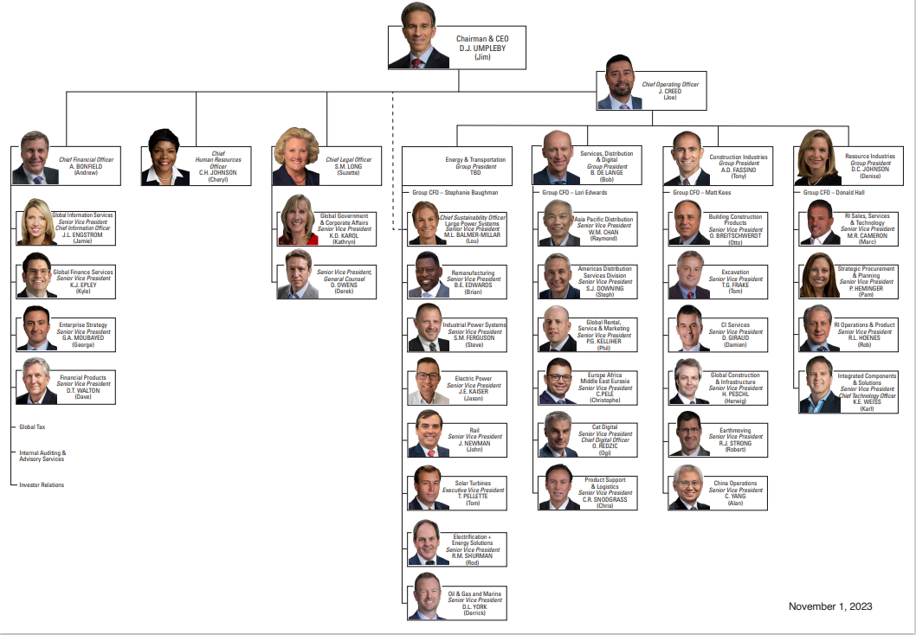
Caterpillar Inc. Operating Council Organizational Chart
Notes:
Updated – 2023.10.26
Caterpillar is the world’s leading manufacturer of construction and mining equipment, diesel and natural gas engines, industrial gas turbines and diesel-electric locomotives. The company principally operates through its three primary segments - Construction Industries, Resource Industries and Energy & Transportation - and also provides financing and related services through its Financial Products segment. Caterpillar is also a leading U.S. exporter. Through a global network of independent dealers and direct sales of certain products, Caterpillar builds long-term relationships with customers around the world. Currently, we have six operating segments, of which four are reportable segments and are described below.
Categories of Business Organization
1. Machinery, Energy & Transportation — Represents the aggregate total of Construction Industries, Resource Industries, Energy & Transportation and All Other operating segments and related corporate items and eliminations.
2. Financial Products — Primarily includes the company’s Financial Products Segment. This category includes Caterpillar Financial Services Corporation (Cat Financial), Caterpillar Insurance Holdings Inc. (Insurance Services) and their respective subsidiaries.
Construction Industries: Our Construction Industries segment is primarily responsible for supporting customers using machinery in infrastructure, forestry and building construction. The majority of machine sales in this segment are made in the heavy and general construction, rental, quarry and aggregates markets and mining.
Resource Industries The Resource Industries segment is primarily responsible for supporting customers using machinery in mining, quarry and aggregates, heavy construction, waste and material handling applications. Caterpillar offers a broad product range and services to deliver comprehensive solutions for our mining customers. We manufacture high productivity equipment for both surface and underground mining operations around the world. Our equipment is used to extract and haul copper, iron ore, coal, oil sands, aggregates, gold and other minerals and ores. In addition to equipment, Resource Industries also develops and sells technology products and services to provide customers fleet management systems, equipment management analytics and autonomous machine capabilities.
Energy & Transportation Our Energy & Transportation segment supports customers in oil and gas, power generation, marine, rail and industrial applications, including Cat® machines. The product and services portfolio includes reciprocating engines, generator sets, marine propulsion systems, gas turbines and turbine-related services, the remanufacturing of Caterpillar engines and components and remanufacturing services for other companies, diesel-electric locomotives and other rail-related products and services and product support of on-highway vocational trucks for North America.
Financial Products Segment The business of our Financial Products segment is primarily conducted by Cat Financial, a wholly owned finance subsidiary of Caterpillar. Cat Financial’s primary business is to provide retail and wholesale financing alternatives for Caterpillar products to customers and dealers around the world. Retail financing is primarily comprised of the financing of Caterpillar equipment, machinery and engines. Cat Financial also provides financing for vehicles, power generation facilities and marine vessels that, in most cases, incorporate Caterpillar products. In addition to retail financing, Cat Financial provides wholesale financing to Caterpillar dealers and purchases short-term trade receivables from Caterpillar and its subsidiaries. The various financing plans offered by Cat Financial are primarily designed to increase the opportunity for sales of Caterpillar products and generate financing income for Cat Financial. A significant portion of Cat Financial’s activity is conducted in North America, with additional offices and subsidiaries in Latin America, Asia/Pacific, Europe, Africa and Middle East.

Slide 29
Caterpillar Annual Reports
Caterpillar’s Annual Reports provide great insight into our company’s Strategy and highlights for the year.
Caterpillar Annual Report
Caterpillar Sustainability Report
A great example of the insights that our Annual Reports provide is one from 2003. It laid out 10 Common Sense Steps to build a great Company. These steps still ring true today and that is why Caterpillar is a great company to work for!
Other Caterpillar materials can be found on the Cat@work.
Click on image to download 2003 report

Slide 30
OUR STRATEGY

Slide 31
Notes:
Our company strategy reflects our legacy and our continuing commitment to meet the needs of our customers and the communities in which we live and work. ​
​
United by our Values, Caterpillar employees around the world share a focused view of our business through the Operating & Execution Model, through which we are making strategic choices today to create profitable growth for tomorrow. ​
​
Together, with our partners, we are providing the solutions that help our customers build a better, more sustainable world.​
​

Slide 32
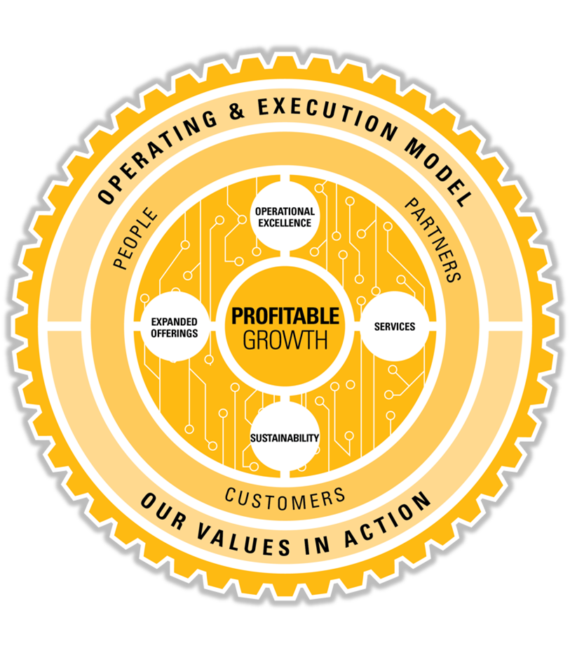
Our Enterprise Strategy
HOW
we act and manage
WHO
we engage
WHAT
we’re going to focus on
WHY
our goal

Slide 33
Notes:
OPERATING & EXECUTION MODEL​
Growing our business profitably.​
At Caterpillar, our goal isn’t to simply grow the business. Our enterprise strategy for profitable growth means investing in areas with the most potential to create value.​
To accomplish this, we use the Operating & Execution (O&E) Model. It helps us identify whether individual areas of our business are creating or consuming value. We use facts and data to understand which industries are most attractive and what it would take to win. We then implement strategies to improve our competitive position in profitable businesses and allocate resources to areas that have the best potential for future growth. ​
​
​
OUR VALUES IN ACTION​
We make our work environment and the world better through our actions.​
Though our business evolves with a changing marketplace, Our Values in Action are timeless, guiding our conduct with customers, partners and one another around the world. Our Values in Action defines what we do and how we do it. Using our Values, we go beyond compliance to create an inclusive work environment where we are proud to belong and can do our best work.

Slide 34
Notes:
Caterpillar’s purpose is defined as, “We help our customers build a better, more sustainable world.” Every product and service, both present and future, gets us one step closer to fulfilling this purpose.
Our purpose is a clear statement of why we exist. Through this statement, we align to a fundamental reason for being, compelling us to commit our energies to strategize, focus and execute; it represents our business priorities, the results we deliver to our customers and pride in our work.
Today, more than ever, Caterpillar is a critical component in many important and ambitious projects worldwide – developing new, sustainable communities; enabling economic growth through infrastructure and energy development; improving standards of living; and developing new technologies to help our customers succeed.
We remain humble, yet proud, of our commitment to our customers and what our partnerships create in the world.
Our purpose helps define our solutions to help our customers and the industries they serve – to drive innovation focused on finding tomorrow’s answers, today.
https://cawcontent.cat.com/en/2-5-values-strategy/ourstrategy/Purpose.html

Slide 35
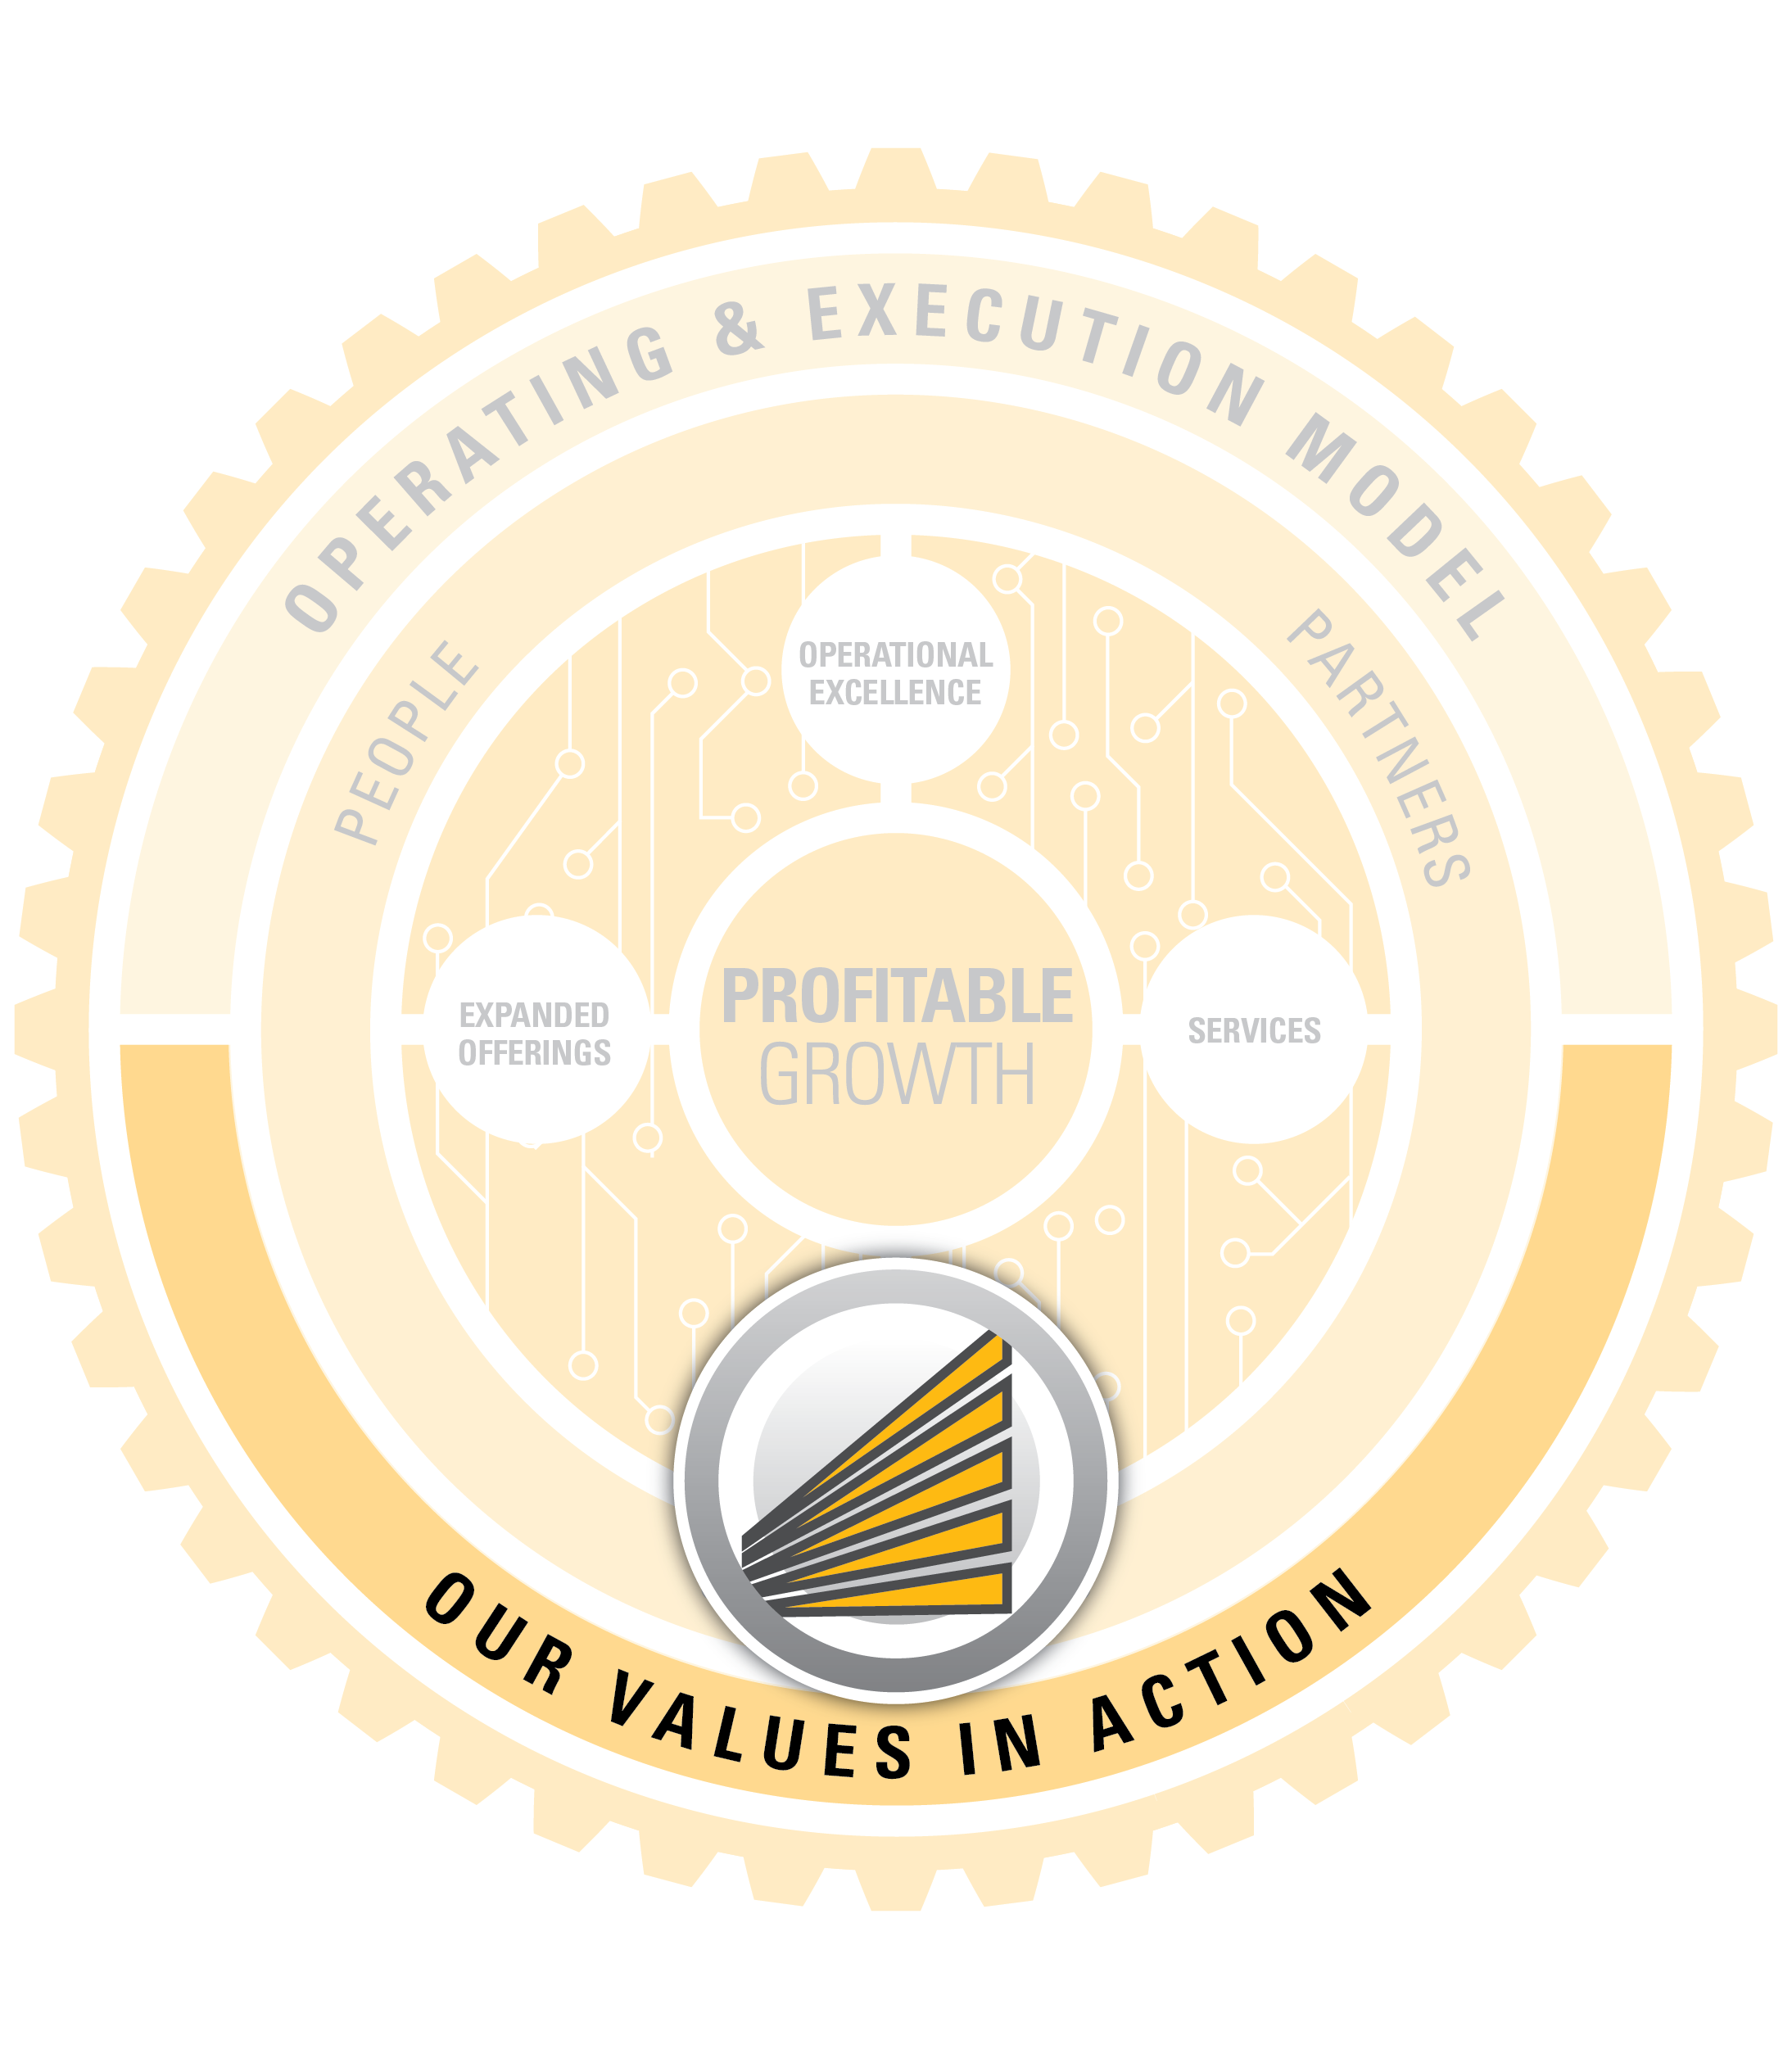
Caterpillar’s Code of Conduct

Slide 36
Living Our Values in Action
For detailed description of each value click here
Caterpillar’s values are critical to ensuring the company remains a global leader in all of the markets we serve.
The values set clear expectations on how we treat one another. We are not just accountable for the work we do we also care deeply about how we do it. Our people help fulfill our purpose by living Our Values in Action every day.
Our Values in Action are:
Integrity
Excellence
Teamwork
Commitment
Sustainability
Notes:
Our Code of Conduct defines those Values in Action -- what we stand for and how we conduct ourselves with our customers, suppliers and one another. Its purpose is not to provide a set of rules that covers every situation or challenge we may face, but to guide us in living those values everyday. The Code of Conduct explains what Integrity, Excellence, Teamwork, Commitment and Sustainability mean to us and how we use these Values to make sound, ethical decisions.
As employees, we are responsible for bringing Our Values in Action to life. Please take some time to read, understand and embrace our Code of Conduct. It is much more than a compliance document - it is a written expression of our culture. Lead by example, our Values must always drive our behavior and each of us has a shared commitment to the highest standards of conduct.
It is the foundation of both our proud legacy and our promise for the future.

Slide 37
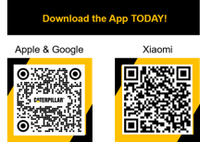
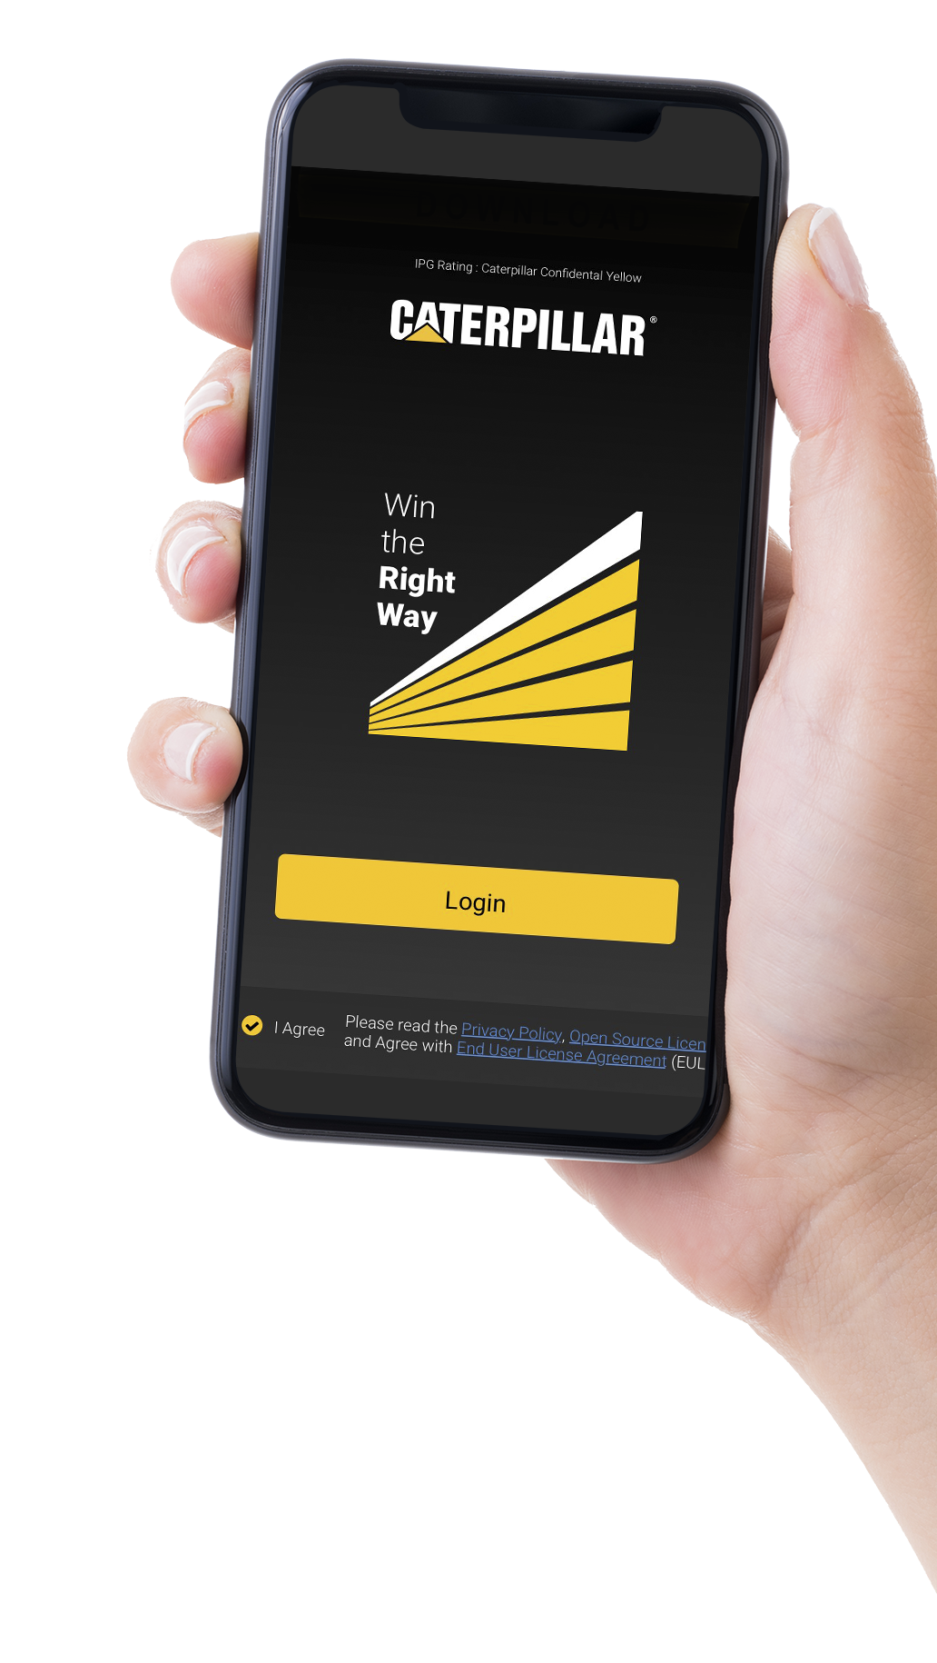
WIN THE RIGHT WAY
ETHICS AND COMPLIANCE LEADERSHIP AT CATERPILLAR
ALWAYS...
Always lead with our Values. They are the foundation of our Company.
Always put safety first.
Always comply with laws, regulations and reporting requirements.
Always represent Caterpillar’s best interests when working with business partners and maintain an enterprise point of view.
Always be vigilant regarding external electronic communications and unusual activity.
Always obtain the necessary approvals for travel, gifts and entertainment.
Always treat every employee with dignity and respect.
Always be environmentally responsible, practice Lean and prevent waste/rework.
Always ensure necessary safeguards are in place to protect personal information.
Always ask yourself: what if my actions appeared in a headline?
NEVER...
Never give bribes or facilitation payments of any kind.
Never engage in activities that create or appear to create a conflict of interest.
Never make agreements with competitors about pricing, product offerings, customers, output, or markets served.
Never submit or approve false business expenses.
Never access, share or copy confidential yellow or red information, unless authorized to do so.
Never ship a product without following all requirements for import and export activities.
IF YOU SEE SOMETHING, SAY SOMETHING.
If you become aware of circumstance that appears to violate our Code of Conduct, an enterprise policy or procedure, or the law, contact your supervisor, Human Resources, the OBP Helpline or Legal Services right away.
Notes:
How to use – To guide a discussion around specific areas of risk
Provides opportunity to discuss, in detail, specific behaviors that employees should participate in and others that should be avoided (Each of these behaviors is detailed in Our Values in Action – Caterpillar’s Code of Conduct)
Leverages specific examples of behaviors to support that our reputation is built not only on what we achieve but how we achieve it

Slide 38
ESSENTIALS TO KNOW

Slide 39
Singapore Employee Handbook
For Caterpillar Singapore Payroll Employees, please download and read the
Singapore Employee Handbook. The Handbook provides general guidance and information to all Salaried & Management (S&M) employees of Caterpillar.
Essentials:
Business Hours
Cafeteria
Salary Payment
Employee Access Pass
Dress Code
Business Travel
Travel Security
Shuttle Bus
Parking

Slide 40
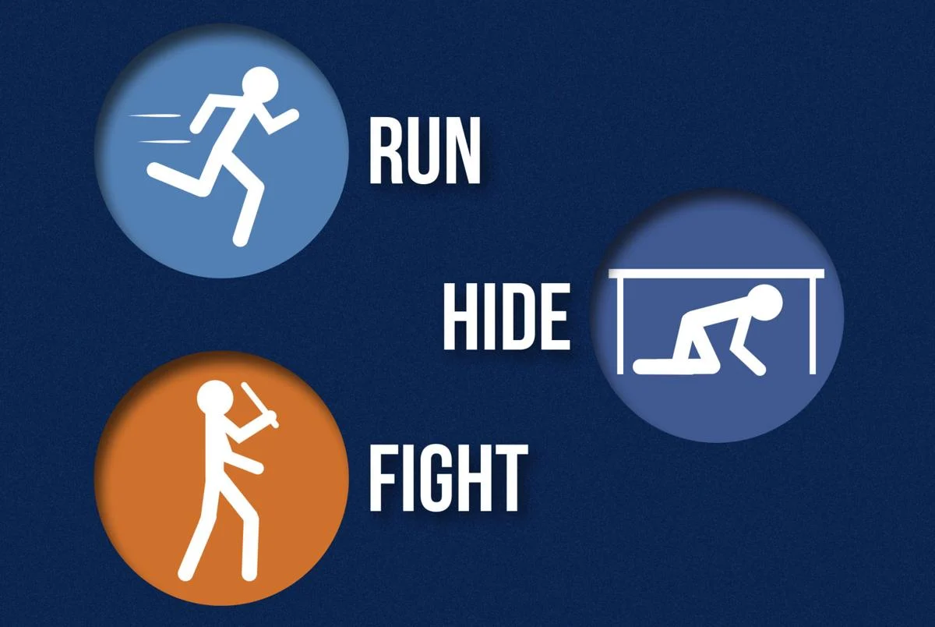
Security Processes & Expectations
Always display your ID badge and swipe at the card readers , for every entry
Report suspicious behaviour or security issues to your host contact or security guards
Take note of emergency procedures and areas. Follow instructions, communicate
If an armed threat is imminent, be decisive and prepare to Run, Hide, Fight
If there is a fire, evacuate promptly and safely. If possible, notify and help others
Secure valuable items & confidential information when not in use
Follow company policy when sharing or disposing confidential information
Lock computer screen when unattended. Don’t share passwords
Remember, Security is Everybody’s responsibility. If you see something, say something.
IF YOU SEE SOMETHING, SAY SOMETHING.
If you become aware of circumstance that appears to violate our Code of Conduct, an enterprise policy or procedure, or the law, contact your supervisor, Human Resources, the OBP Helpline or Legal Services right away.
For further information: security.cat.com

Slide 41
Emergency Phone Numbers
Police: 999
Ambulance :995
Non – emergency : 1777
Security Ext : 6828 7303
6829 3137
Emergency Point
Evacuation Route
Assembly point near Guard House
No Photography / Video
Do not take photos / videos within office area.
Emergency Caller & Information
Designated emergency caller
Fire Extinguisher
Located throughout facility
No Loitering
Visitors must be accompanied by authorized personnel at all times
CPR / CPR + AED or EMT / FR Certified
Located on every floor
Alarms
One stage alarm system
Visitor Badge
Visitor’s Badge must be visibly worn at all times
In – House Mobile Policy
No using of mobile phone while walking
Facility Lockdown
Proceed to nearest area of refuge and wait for an all-clear announcement
All Clear
An All – Clear communication will be given by Security Personnel

Slide 42
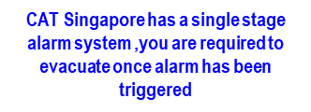
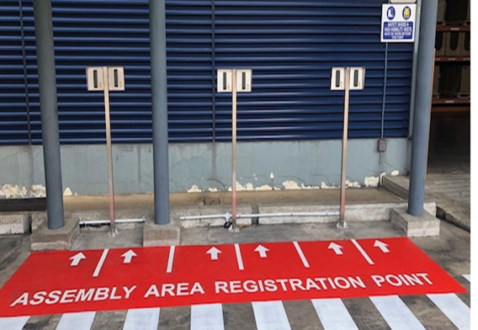
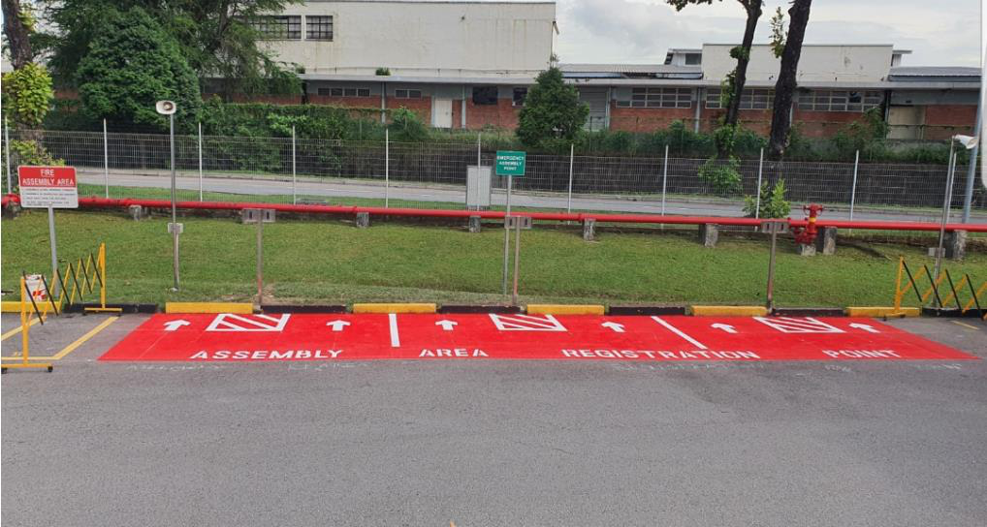
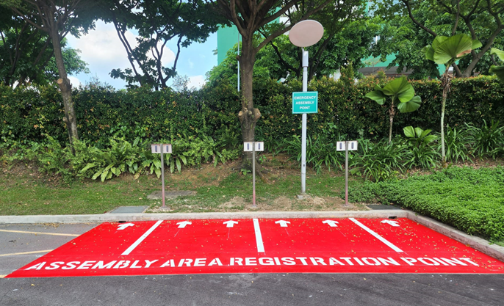
Fire Evacuation at Work
If you are in the office when a fire alarm sounds, follow these evacuation procedures :
Stop all work immediately
Do not gather any items from your desk or drawers
Do not use lifts
Follow evacuation routes and walk quickly down the nearest exit staircase
Eevacuate the building in a calm and orderly manner
Proceed to the predetermined assembly area to have your attendance taken
Employees are required to tap their access card at the mustering readers (as shown below)
Do not re – enter the building unless instructed by the SMC (Site Main Controller).
In the event of fire alarm activation, employees are required to tap their access card at the mustering readers located at assembly area registration point
14T
5T
7T

Slide 43
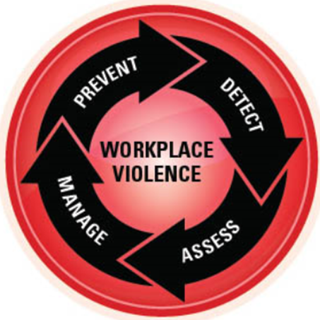
Facility Lockdown
If a Facilities Lockdown announcement is received:
Restrict movement around the office
Proceed to the nearest area of refugee
Lock the door unit and keep quiet.
Place handphone on silent mode, stay quiet, use concealment, limit movement
Wait for an ALL-CLEAR announcement from the ERT (Emergency Management Team)
14 Tractor
Warehouse | ◾ Traffic Office ◾ Inbound Rest Room
Lvl 1 | Cafeteria Rest Room
Lvl 2 | ◾Prayer Room ◾Miners Room ◾Melbourne Room
Lvl 6 | Legal Boardroom
7 Tractor
Lvl 1 | Prayer Room
Lvl 2 | ◾Excavation Boardroom ◾Teamwork Hall
Lvl 3 | Synergy Hall
Warehouse | Warehouse
5 Tukang
Lvl 2 | ◾Quality Room ◾Strategy Room
When you are unable to access into the area of refuge, proceed to the next available “ safe area”,
a room which can be locked from the inside and provide no visible view from the external

Slide 44
Business Hours, Cafeteria, Salary Payment
Business Hours | Cafeteria | Salary Payment
Standard Business Hours: 8:30am to 5:30pm Flexible Working Hours is allowed with supervisor’s approval | 50% company subsidy for most items for local payroll employees International Assignee needs to scan employee badge and pay with cash | Pay Day – 24th of each month Pay Day for new hires based on join date: 1st to 9th of the month After 9th of the month | Pay date: > 24th of the joining month > Last day of the month or Within 7 days of the following month
Lunch Time: 11:30am onwards Lunch Break: 1 hour | Operating Hours 7 Tractor Road 7:00am to 4:30pm 14 Tractor Road^ 7:00am to 6:15pm (^no pork & lard) | Deduction and reimbursement of expenses incurred will be processed via payroll E-Payslip is available online

Slide 45
Employee Access Pass, Visitor Access
Employee Access Pass | Visitor Access
Employee Access Pass to be worn prominently at all times Employee Access Pass is non-transferable; to be used by employee only Access restrictions apply on: Saturdays - 5pm onwards Sundays - whole day For weekends access, send email notification to Security (SECURITY_TRACTOR_CAMPUS@cat.com/ TUKANG_SECURITY@CAT.COM), one day in advance If employee pass is lost, inform Office Services (Rahim at Ext 7358 / Sordy_Abdul_Rahim@cat.com) immediately. A replacement cost of S$15.00 will be applied If you did not bring the pass, request for a Temporary Pass at Guard House. | Notification of visit: Host to send out email notification to Security at SECURITY_TRACTOR_CAMPUS@cat.com or TUKANG_SECURITY@CAT.COM at least 1 day in advance. Information required in email includes: Visitor’s full name Name of company Date and time of visit Host’s office contact and mobile number Note: Host to remind visitor to bring along their personal photo identification card, applicable to both local and foreign visitors.

Slide 46
Dress Code
Employees are expected to use their professional judgment in determining the appropriate work attire, and should strive to positively represent Caterpillar and themselves through appearance, behavior, and work.
The following provides a foundation for employees to determine how they should dress in the workplaces:
Keep safety in mind: Attire, including footwear, must adhere to facility safety guidelines for both offices, warehouse, and job site environments.
Dress appropriately for audience expectations: including customers, dealers, suppliers or any Caterpillar internal meetings.
Attire choices: Attire to be appropriate in length, fit and coverage for various situations and environments. Attire should be free of holes, tears, or rips and not be too revealing. Attire should be without offensive language or inappropriate designs, especially in the context of religion, ethnicity or disability.

Slide 47
Business Travel, Travel Security
Business Travel | Travel Security
Contact BCD Travel Email: caterpillar@bcdtravel.sg for air ticket bookings, travels & visa process Tel: 6496 5418 (9am to 6pm, After business hours, service fees apply) Contact respective Business Unit HR for travel related letters (e.g visa application) Use of Corporate credit card for travel related expenses only For hotel booking, refer to Caterpillar Global Preferred Hotel Directory For more information, read the Global Travel Policy | Update Emergency Contact via Workday Risk Fusion Center (RFC) serves as the “one-stop shop” for all things Caterpillar related. You can contact the RFC for high risk travel, workplace violence, medical assistance, travel assistance, any severe weather or natural disaster, civil unrest or protest, serious injury or fatality, environmental spills or releases, etc. Tel : + 1 309 494 4460 Email: Risk Fusion Center For more information: Travel Security Information

Slide 48
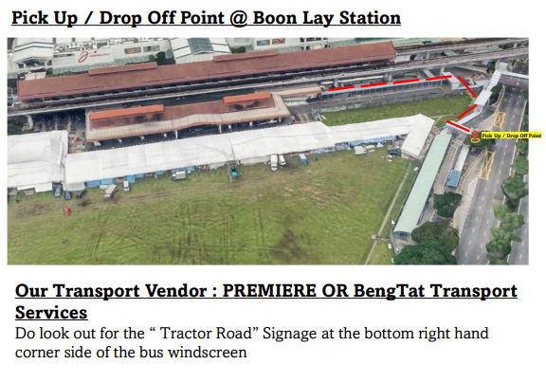
Shuttle Bus, Parking
Shuttle Bus
Free transport to and from Boon Lay MRT station
From Boon Lay MRT to: | Mon to Fri | Sat
7 & 14 Tractor Road | 0640, 0720, 0740, 0800, 0810,0820, 0830, 1245,1345 | 0740
14 Tractor Road | 2240
5 Tukang Innovation Grove | 0720, 0745 | Nil
To Boon Lay MRT From: | Mon to Fri | Sat
7 & 14 Tractor Road | 1205, 1450, 1545, 1640, 1715, 1730, 1740, 1800, 1830, 1900, 2300 | 1650
14 Tractor Road | 0715 | Nil
5 Tukang Innovation Grove | 1635, 1715 | Nil
Parking
Free! Register license plate and IU with Security Office 7 & 14 Tractor Road – Send email to: SECURITY_TRACTOR_CAMPUS@cat.com 5 Tukang Innovation Grove – Send email to: TUKANG_SECURITY@CAT.COM Park at designated areas

Slide 49
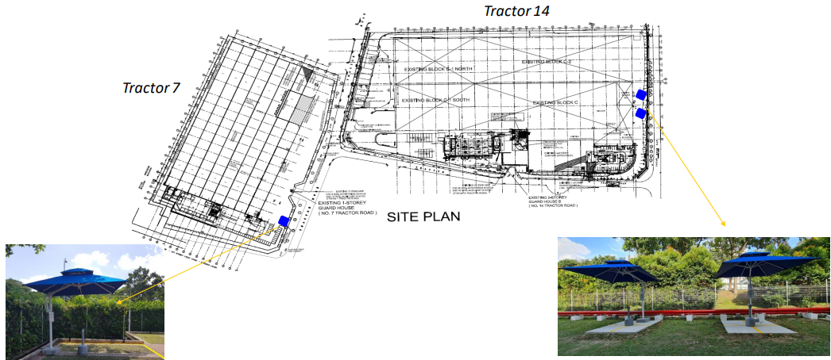
Designated smoking areas – Tractor 7 and 14
Location : Opposite to Main building
Location Next to Cafeteria

Slide 50
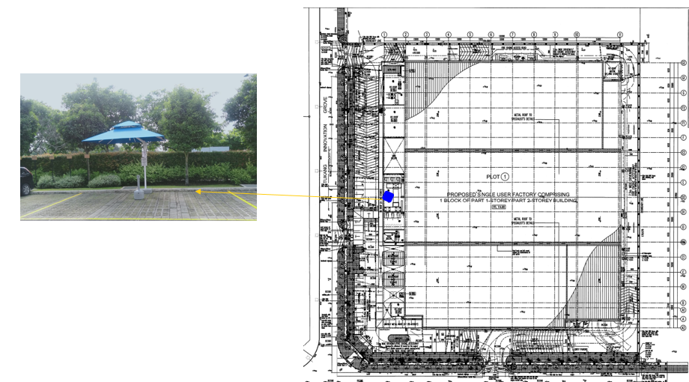
Designated smoking areas – 5 Tukang
Location : Near to 5T –guardhouse

Slide 51
Workday Update
Add Emergency Contacts
Add Photo
Update Worker Profile
Update bank account details
Access to
Workday
Human Capital Management (HCM)/Workday Hub
Workday Payroll Help Guide Singapore
Notes:
2023.10.26 update to include Workday Payroll Help Guide Singapore

Slide 52
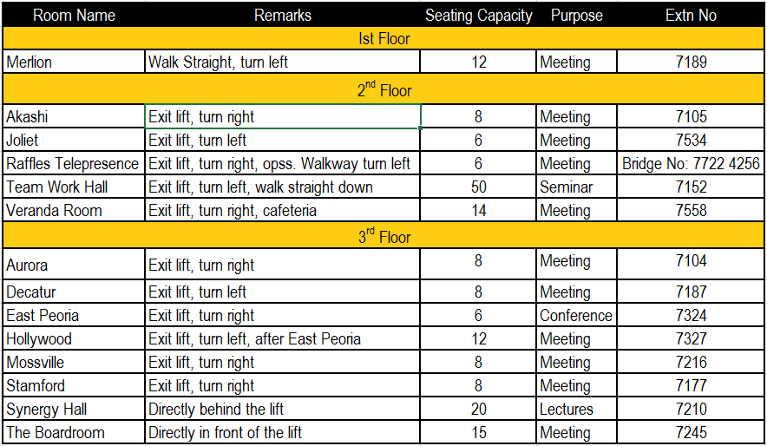
Location of Meeting Rooms at 7 Tractor
Select “SG Singapore CR” when booking a meeting room)

Slide 53
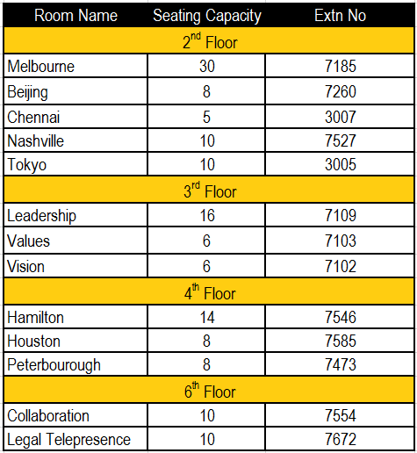
Location of Meeting Rooms at 14 Tractor
(Select “SG Singapore Tower Lx CR” when booking a meeting room)

Slide 54
Getting involved around Caterpillar
: Employee Resource Groups in Singapore
Group | Purpose | Primary Contact
Corporate Social Initiatives Singapore (CSI) | Corporate Social Innovations (CSI) creates positive community social value proposition through activities focusing on social responsibility, sustainability and community outreach. | Ang_Morgan@cat.com
Cat Toastmasters Singapore | Cat Toastmasters Singapore provides a mutually supportive and positive learning environment in which every member has the opportunity to improve their communications and leadership skills, which in turn empowers them to achieve their full potential and realize their goals. | Sankar_S@cat.com
Women’s Initiative Network Singapore (WINs) | Women's Initiative Network Singapore(WINs) aims to create a gender balanced and inclusive workplace at Caterpillar. WINs focus on driving better employees' engagement, professional development and community outreach | Zhiqin_Wu@cat.com
Young Professional Singapore (YP) | Young Professionals of Singapore provides a safe platform for all employees who keen in continuous learning and developing themselves. | Tan_Eve@cat.com
LAMBDA Singapore network | Lambda is an ERG helping to create an inclusive environment for Caterpillar’s LGBT+ employees & allies. We conduct trainings to educate employees and try to align policies to promote a culture of inclusion. | Argent_Glenn_E@cat.com
Notes:
Updated 2023.10.26

Slide 55
Useful Contacts
What | Contacts
Reception @ 7 Tractor Road | Ext 7333
Office Services | Harun Bin Mustam Ext 7355 Abdul Rahim Sordy Ext 7358
Facilities Management (Security, Fire Safety) | Prabakaran Kannan Ext 3050
Compensation & Benefits Enquiries | Daphne Liew Ext 7111
My Caterpillar Travel Expense (MCTE) | Singapore Helpdesk: Credit_Card_Asia@cat.com Ext 3198
Payment (Invoice) Processing | Seetha Anapana Ext 7235
General HR Enquiries and Consulting | Your Business Unit HR (Workday>View Profile>Job>Support Role)
Travel-related Visa Letters | For Employees, Singapore HRSS Chee Si Wan , April Zheng
Notes:
Updated 2023.10.26

Slide 56
Useful Links
What | Purpose | Links
Cat @work | Main portal on information: Company News & Info, Business Unit Info Workday, Human Resources Info, Support Services Info | https://catatwork.cat.com/
CLUES | General information about people found in the Caterpillar Global Directory | https://clues.cat.com/clues/clues_search.jsp
IT Requests | Self service IT portal | https://cat.service-now.com/sp/
IT support (GIS Helpdesk) | IT related issues | Email: ESC-AP-English_Servicedesk@cat.com / Call Enterprise Service Center :ext 7435
Wireless Guest Access (Available at 7 & 14 Tractor) | Temporary wireless internet access for guests | https://security.cat.com/en.html
Singapore HR Policies | Access to HR Policies | https://cawcontent.cat.com/en/2-3-support-services/2-3-7-corporateHR/hr-policies/2-3-7-9-asiapacificpolicies/singapore.html
Singapore Payroll | Access to Payslip | Singapore Payslip
Absence | Request for leave application | https://wd5.myworkday.com/wday/pex/client/home/cat
Mercer Portal | Employee benefits portal | https://ssl2.perquisite.net/RewardCentre/M/Login#/
Singapore Connect Group | One-source for you to stay connected with one another and get updates on Singapore-wide announcements, events, ERG activities, and all other relevant communications | Singapore Connect Group Yammer
Notes:
2023.10.26 Links verified

Slide 58
Notes:
In summary,
At Caterpillar, we've been in business for nearly 100 years, supporting our customers in developing the world's infrastructure. Building and expanding the Panama Canal and the construction of landmarks like the Hoover Dam and Golden Gate Bridge are just a few examples of how we continue to make sustainable progress
possible.
Today, customers turn to Caterpillar to help them develop infrastructure, energy and natural resource assets. With a diverse brand portfolio, Caterpillar is the world's leading manufacturer of construction and mining equipment, off-highway diesel and natural gas engines, industrial gas turbines and diesel-electric locomotives.
The company principally operates through its three primary segments:
Construction Industries -- Construction Industries is built to support customers using machinery in infrastructure, forestry and building construction applications
Resource Industries – Making it possible for customers to mine and harvest resources such as coal, iron ore and lumber profitably and sustainably.
Energy & Transportation—From Solar power, creating micro-grid power solutions, generators for supporting natural disasters and rail—this segment is focused on meeting the world's increasing energy and transportation needs.
Other organizations include:
Services Distribution & Digital– Providing best practices and support for our global dealers who serve global customers Cat products worldwide.
Financial Products & Corporate Services – Our support functions like HR, finance, collaboration with our suppliers' procurement/purchasing and IT. Our Financial Products Division also focuses on finding sustainable, financially sound relations with dealers, suppliers, and customers.
Our global employees are driving innovation
We have a global and diverse tea who live Our Values in Action
We take a stand on issues
We are a respected voice in Washington and other countries, helping legislatures understand how their policies impact our business.
A proactive member of our community …Caterpillar Foundation is focused on turning the spiral of poverty into a path to prosperity by investing in education, the environment and basic human needs
Sustainability is Caterpillar's commitment to building a better world ... it is part of who we are and what we do every day (part of our Values In Action). Sustainability is one of our core values, and we recognize progress involves a balance of environmental stewardship, social responsibility and economic growth.
Caterpillar is a critical component in many important and ambitious projects worldwide – developing new, sustainable communities, enabling economic growth through infrastructure and energy development, helping alleviate poverty, and building new technologies to help our customers succeed.
We remain humble yet proud of our commitment to our customers and what our partnerships create.
Our purpose helps define the market we serve – and the customers we support – to drive innovation focused on finding tomorrow's answers today.

