Slide 1
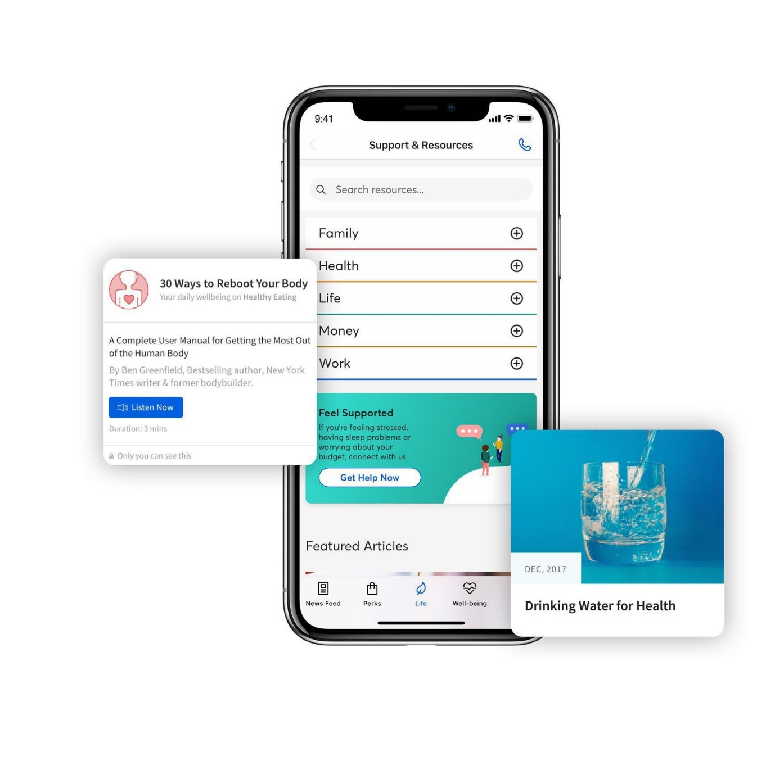
The new digital platform for Caterpillar’s Global Employee Assistance Program (EAP)!
● Available in 47 languages ● 24/7 access to Caterpillar’s confidential EAP through phone, email or chat
● Resources to support physical, emotional, social and financial well-being ● Perks and savings
● Invite family members to log on and create a profile ● And much more!
Learn more and log on at CaterpillarEAP.com!

Slide 2
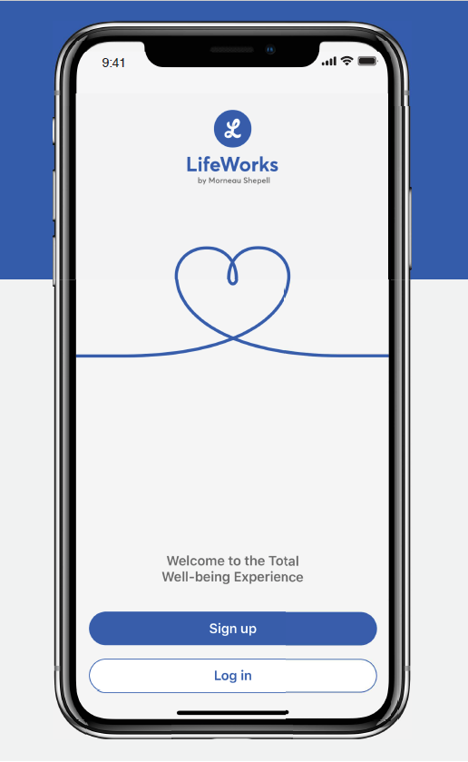
Introducing LifeWorks:
The new digital platform for Caterpillar’s Global Employee Assistance Program (EAP)!
Available in 47 languages
24/7 access to Caterpillar’s confidential EAP through phone, email or chat
Resources to support physical, emotional, social and financial well-being
Perks and savings
Invite family members to log on and create a profile
Learn more and log on at CaterpillarEAP.com!

