Slide 1
Progressive Muscle Relaxation
Progressive Muscle Relaxation
Progressive Muscle Relaxation
Progressive Muscle Relaxation

Slide 2
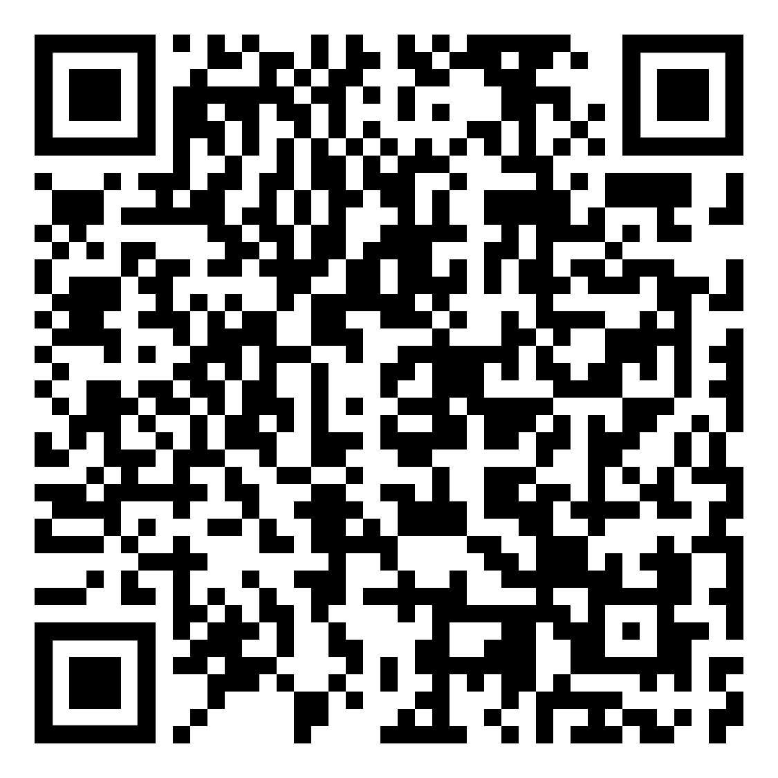
Progressive muscle relaxation is a technique that can help you ease stress symptoms by relaxing one muscle group at a time:
Find a comfortable place to sit or lie down.
Start with a few deep breaths. Breathe in slowly and deeply, then exhale slowly.
Start at the top of your head. Focus on that area and slowly tense the muscles there. Keep them tight for 10-15 seconds and then slowly relax them.
Continue to tense and relax all muscle groups this way by slowly increasing the tension, holding the tension, and then slowly releasing: feet, legs, hips and buttocks, arms, abdomen, chest, shoulders, neck and face.
Finish by slowly tensing all your muscles at once, holding for a few counts and then slowly releasing.
For more Self-Care tips, scan the QR code!
Progressive muscle relaxation is a technique that can help you ease stress symptoms by relaxing one muscle group at a time:
Find a comfortable place to sit or lie down.
Start with a few deep breaths. Breathe in slowly and deeply, then exhale slowly.
Start at the top of your head. Focus on that area and slowly tense the muscles there. Keep them tight for 10-15 seconds and then slowly relax them.
Continue to tense and relax all muscle groups this way by slowly increasing the tension, holding the tension, and then slowly releasing: feet, legs, hips and buttocks, arms, abdomen, chest, shoulders, neck and face.
Finish by slowly tensing all your muscles at once, holding for a few counts and then slowly releasing.
For more Self-Care tips, scan the QR code!
Progressive muscle relaxation is a technique that can help you ease stress symptoms by relaxing one muscle group at a time:
Find a comfortable place to sit or lie down.
Start with a few deep breaths. Breathe in slowly and deeply, then exhale slowly.
Start at the top of your head. Focus on that area and slowly tense the muscles there. Keep them tight for 10-15 seconds and then slowly relax them.
Continue to tense and relax all muscle groups this way by slowly increasing the tension, holding the tension, and then slowly releasing: feet, legs, hips and buttocks, arms, abdomen, chest, shoulders, neck and face.
Finish by slowly tensing all your muscles at once, holding for a few counts and then slowly releasing.
For more Self-Care tips, scan the QR code!
Progressive muscle relaxation is a technique that can help you ease stress symptoms by relaxing one muscle group at a time:
Find a comfortable place to sit or lie down.
Start with a few deep breaths. Breathe in slowly and deeply, then exhale slowly.
Start at the top of your head. Focus on that area and slowly tense the muscles there. Keep them tight for 10-15 seconds and then slowly relax them.
Continue to tense and relax all muscle groups this way by slowly increasing the tension, holding the tension, and then slowly releasing: feet, legs, hips and buttocks, arms, abdomen, chest, shoulders, neck and face.
Finish by slowly tensing all your muscles at once, holding for a few counts and then slowly releasing.
For more Self-Care tips, scan the QR code!

