Slide 1
Recognize the Signs of Depression
Recognize the Signs of Depression
Recognize the Signs of Depression
Recognize the Signs of Depression

Slide 2
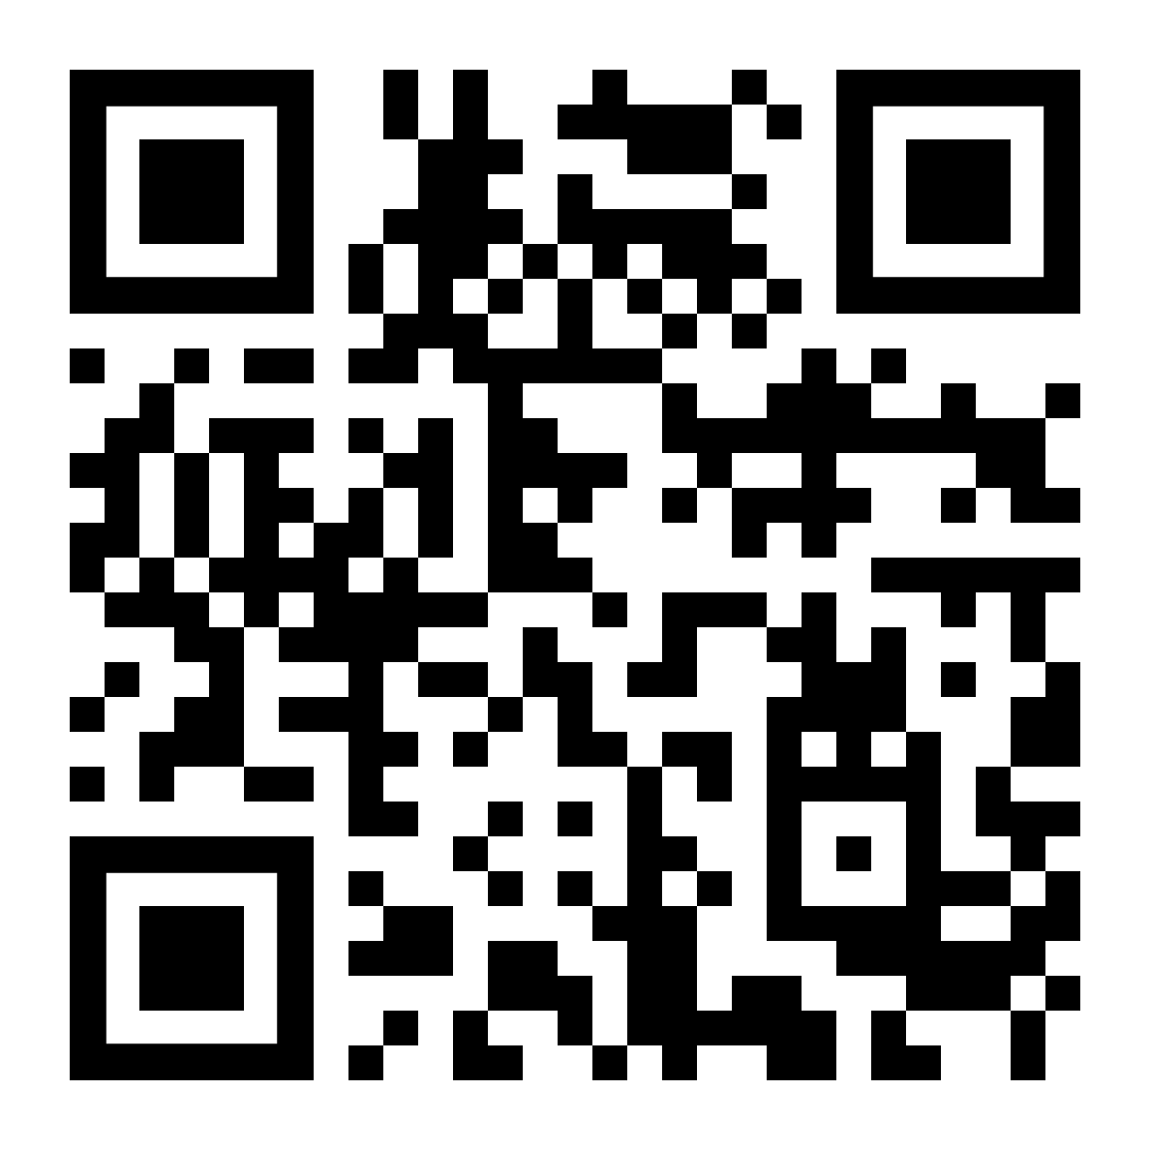
Everyone feels down from time to time, but depression is a serious medical condition that can negatively impact one’s work, social life, and health. Be aware of the signs of depression, which include but are not limited to:
Changes in mood or relationships
Loss of interest or effectiveness in daily activities
Feeling tired or having little energy
Changes in appetite or alcohol use
Excessive absenteeism or tardiness
Feeling bad about yourself or that you have let others down
Trouble concentrating or making decisions
Thoughts of harming yourself
If you or someone you know has been struggling, help is available.
Contact the Caterpillar Employee Assistance Program (EAP) at 1-866-228-0565 or CaterpillarEAP.com.
Everyone feels down from time to time, but depression is a serious medical condition that can negatively impact one’s work, social life, and health. Be aware of the signs of depression, which include but are not limited to:
Changes in mood or relationships
Loss of interest or effectiveness in daily activities
Feeling tired or having little energy
Changes in appetite or alcohol use
Excessive absenteeism or tardiness
Feeling bad about yourself or that you have let others down
Trouble concentrating or making decisions
Thoughts of harming yourself
If you or someone you know has been struggling, help is available.
Contact the Caterpillar Employee Assistance Program (EAP) at 1-866-228-0565 or CaterpillarEAP.com.
Everyone feels down from time to time, but depression is a serious medical condition that can negatively impact one’s work, social life, and health. Be aware of the signs of depression, which include but are not limited to:
Changes in mood or relationships
Loss of interest or effectiveness in daily activities
Feeling tired or having little energy
Changes in appetite or alcohol use
Excessive absenteeism or tardiness
Feeling bad about yourself or that you have let others down
Trouble concentrating or making decisions
Thoughts of harming yourself
If you or someone you know has been struggling, help is available.
Contact the Caterpillar Employee Assistance Program (EAP) at 1-866-228-0565 or CaterpillarEAP.com.
Everyone feels down from time to time, but depression is a serious medical condition that can negatively impact one’s work, social life, and health. Be aware of the signs of depression, which include but are not limited to:
Changes in mood or relationships
Loss of interest or effectiveness in daily activities
Feeling tired or having little energy
Changes in appetite or alcohol use
Excessive absenteeism or tardiness
Feeling bad about yourself or that you have let others down
Trouble concentrating or making decisions
Thoughts of harming yourself
If you or someone you know has been struggling, help is available.
Contact the Caterpillar Employee Assistance Program (EAP) at 1-866-228-0565 or CaterpillarEAP.com.

