Slide 1
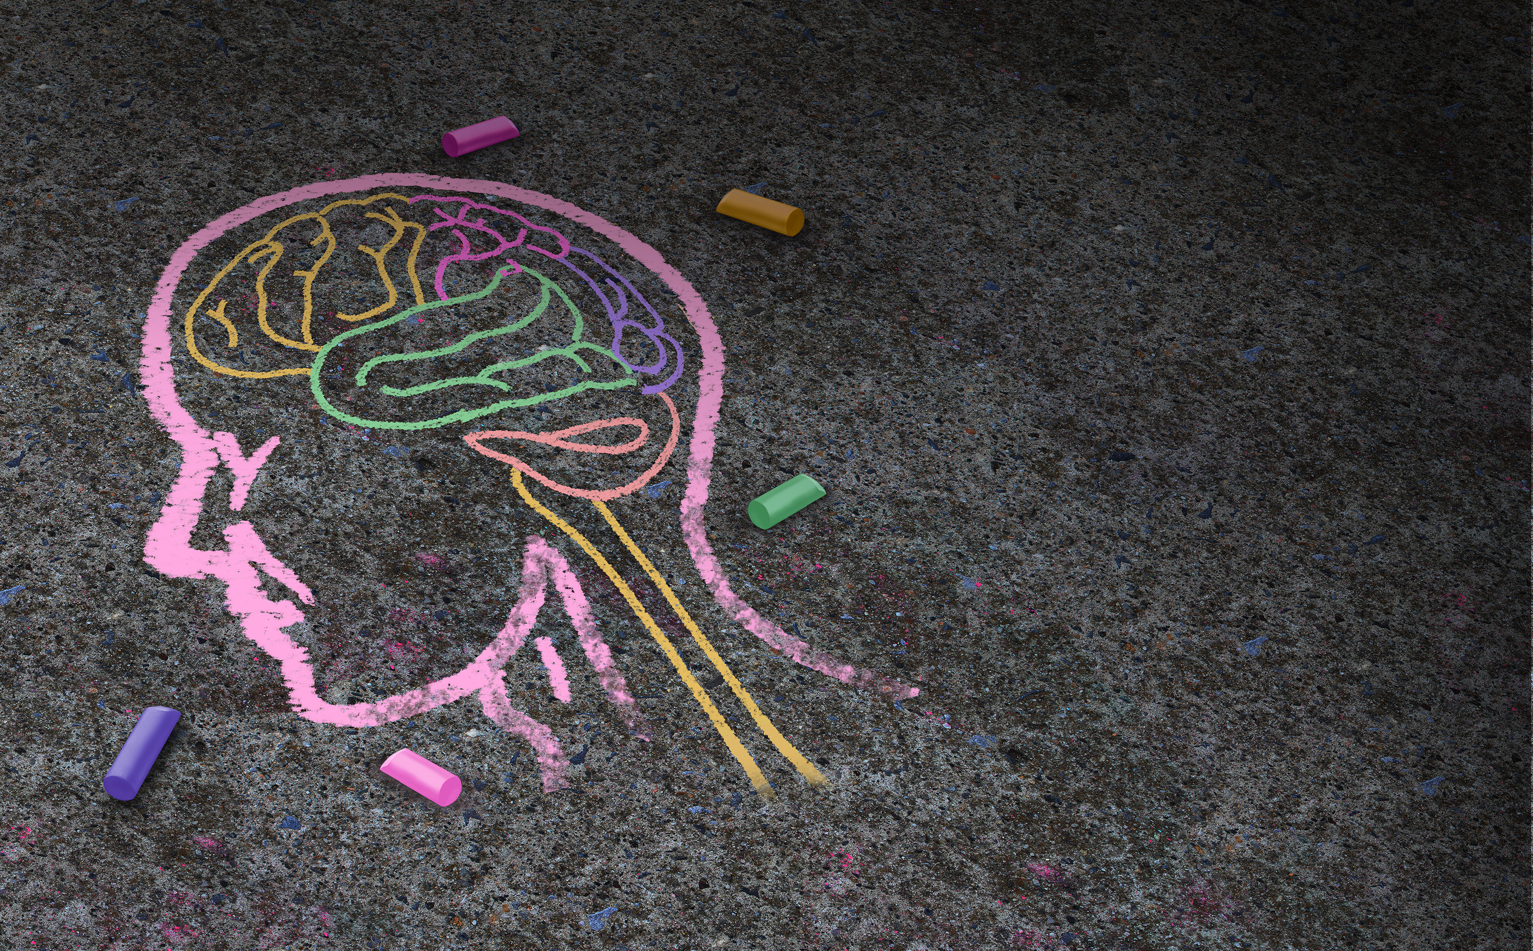
Big 7 Pillars for Good Mental Health
Big 7 Pillars for Good Mental Health
Big 7 Pillars for Good Mental Health
Big 7 Pillars for Good Mental Health

Slide 2
Sleep: Aim for 7-9 hours of quality sleep, with the same sleep/wake time daily.
Sunlight: Get 10-20 minutes of morning sunlight exposure or light therapy.
Movement: Set a goal of 180-220 minutes of vigorous activity weekly plus resistance training and at least one weekly session of high-intensity exercise.
Nutrition: Eat a balanced diet of proteins, fats, carbohydrates, vitamins and minerals. Avoid processed foods and added sugars.
Social Connections: Build connections that bring joy and support. Nurture relationships with close friends.
Stress Management: Unplug each day with mindfulness, meditation, and/or breathing techniques.
Healthy Outlook: Avoid rigid, absolute thinking. Be present. Avoid perfectionism. Allow mistakes. Keep a growth mindset.
Find more information and resources at TotalHealth.cat.com!
Sleep: Aim for 7-9 hours of quality sleep, with the same sleep/wake time daily.
Sunlight: Get 10-20 minutes of morning sunlight exposure or light therapy.
Movement: Set a goal of 180-220 minutes of vigorous activity weekly plus resistance training and at least one weekly session of high-intensity exercise.
Nutrition: Eat a balanced diet of proteins, fats, carbohydrates, vitamins and minerals. Avoid processed foods and added sugars.
Social Connections: Build connections that bring joy and support. Nurture relationships with close friends.
Stress Management: Unplug each day with mindfulness, meditation, and/or breathing techniques.
Healthy Outlook: Avoid rigid, absolute thinking. Be present. Avoid perfectionism. Allow mistakes. Keep a growth mindset.
Find more information and resources at TotalHealth.cat.com!
Sleep: Aim for 7-9 hours of quality sleep, with the same sleep/wake time daily.
Sunlight: Get 10-20 minutes of morning sunlight exposure or light therapy.
Movement: Set a goal of 180-220 minutes of vigorous activity weekly plus resistance training and at least one weekly session of high-intensity exercise.
Nutrition: Eat a balanced diet of proteins, fats, carbohydrates, vitamins and minerals. Avoid processed foods and added sugars.
Social Connections: Build connections that bring joy and support. Nurture relationships with close friends.
Stress Management: Unplug each day with mindfulness, meditation, and/or breathing techniques.
Healthy Outlook: Avoid rigid, absolute thinking. Be present. Avoid perfectionism. Allow mistakes. Keep a growth mindset.
Find more information and resources at TotalHealth.cat.com!
Sleep: Aim for 7-9 hours of quality sleep, with the same sleep/wake time daily.
Sunlight: Get 10-20 minutes of morning sunlight exposure or light therapy.
Movement: Set a goal of 180-220 minutes of vigorous activity weekly plus resistance training and at least one weekly session of high-intensity exercise.
Nutrition: Eat a balanced diet of proteins, fats, carbohydrates, vitamins and minerals. Avoid processed foods and added sugars.
Social Connections: Build connections that bring joy and support. Nurture relationships with close friends.
Stress Management: Unplug each day with mindfulness, meditation, and/or breathing techniques.
Healthy Outlook: Avoid rigid, absolute thinking. Be present. Avoid perfectionism. Allow mistakes. Keep a growth mindset.
Find more information and resources at TotalHealth.cat.com!

