Slide 1
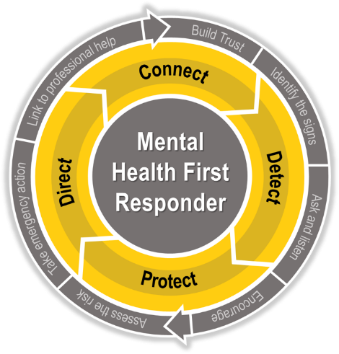
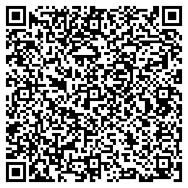
Mental Health First Responder (MHFR) training equips you with the knowledge and skills needed to:
Detect when others are experiencing a significant mental health problem.
Provide basic support.
Help link them to available care, such as the Caterpillar Employee Assistance Program (EAP).
Register today via WorkDay or learn more at TotalHealth.cat.com.
As a Mental Health First Responder, you can become a bridge to the care a struggling person needs

Slide 2
Mental Health First Responder (MHFR) training equips you with the knowledge and skills needed to:
Detect when others are experiencing a significant mental health problem.
Provide basic support.
Help link them to available care, such as the Caterpillar Employee Assistance Program (EAP).
Register today via WorkDay or learn more at TotalHealth.cat.com.
As a Mental Health First Responder, you can become a bridge to the care a struggling person needs

Slide 3
Mental Health First Responder (MHFR) training equips you with the knowledge and skills needed to:
Detect when others are experiencing a significant mental health problem.
Provide basic support.
Help link them to available care, such as the Caterpillar Employee Assistance Program (EAP).
Register today via WorkDay or learn more at TotalHealth.cat.com.
As a Mental Health First Responder, you can become a bridge to the care a struggling person needs

