Slide 1
Stress
Stress
Stress
Stress

Slide 2
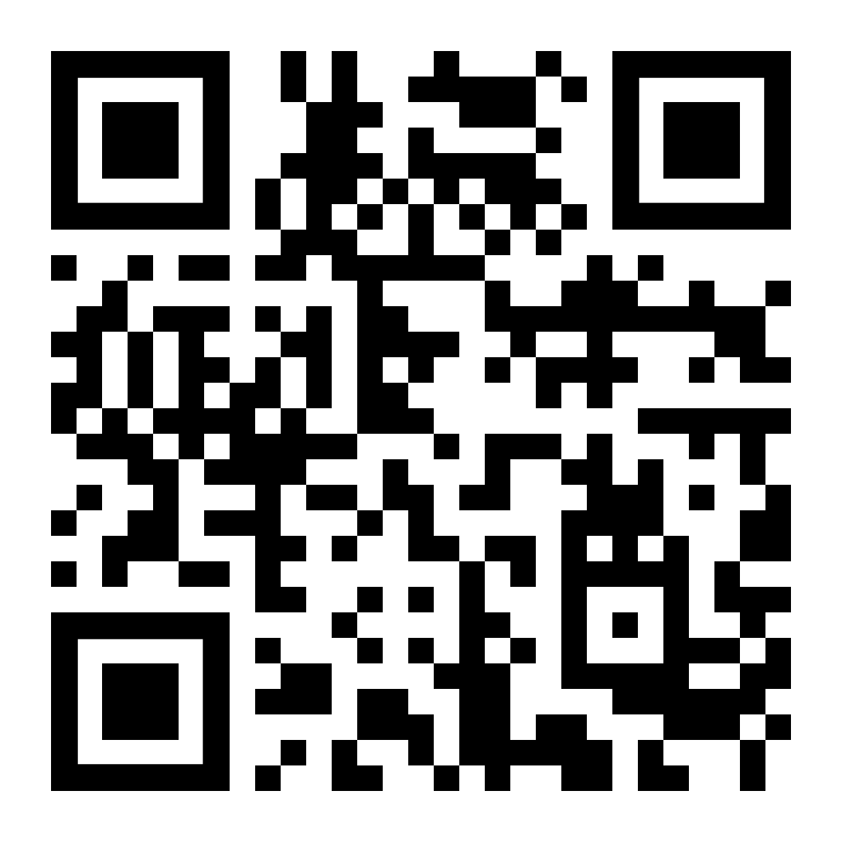
A little stress sometimes can be a good motivator to accomplish goals. But if you don’t manage your stress, it can turn into a major problem that negatively affects your health, relationships, and life. The following tips may help you cope:
Try to identify the source of your stress and find a way to resolve it. Often, addressing the source of stress will minimize the impact it has on your life.
Accept some problems can’t be solved directly. Some stressors require us to make an attitude change. Working with a professional may help you gain perspective.
Don’t overschedule yourself. Slow down and tune into what your body needs to build resilience and better face challenges.
Prioritize self-care. Take care of your body and mind by eating well, exercising regularly, and practicing mindfulness.
Make time for family and friends. Your support system can help you through challenging times.
If stress has been impacting your life, contact the Caterpillar Employee Assistance Program (EAP) at 1-866-228-0565 or scan the QR code.
A little stress sometimes can be a good motivator to accomplish goals. But if you don’t manage your stress, it can turn into a major problem that negatively affects your health, relationships, and life. The following tips may help you cope:
Try to identify the source of your stress and find a way to resolve it. Often, addressing the source of stress will minimize the impact it has on your life.
Accept some problems can’t be solved directly. Some stressors require us to make an attitude change. Working with a professional may help you gain perspective.
Don’t overschedule yourself. Slow down and tune into what your body needs to build resilience and better face challenges.
Prioritize self-care. Take care of your body and mind by eating well, exercising regularly, and practicing mindfulness.
Make time for family and friends. Your support system can help you through challenging times.
If stress has been impacting your life, contact the Caterpillar Employee Assistance Program (EAP) at 1-866-228-0565 or scan the QR code.
A little stress sometimes can be a good motivator to accomplish goals. But if you don’t manage your stress, it can turn into a major problem that negatively affects your health, relationships, and life. The following tips may help you cope:
Try to identify the source of your stress and find a way to resolve it. Often, addressing the source of stress will minimize the impact it has on your life.
Accept some problems can’t be solved directly. Some stressors require us to make an attitude change. Working with a professional may help you gain perspective.
Don’t overschedule yourself. Slow down and tune into what your body needs to build resilience and better face challenges.
Prioritize self-care. Take care of your body and mind by eating well, exercising regularly, and practicing mindfulness.
Make time for family and friends. Your support system can help you through challenging times.
If stress has been impacting your life, contact the Caterpillar Employee Assistance Program (EAP) at 1-866-228-0565 or scan the QR code.
A little stress sometimes can be a good motivator to accomplish goals. But if you don’t manage your stress, it can turn into a major problem that negatively affects your health, relationships, and life. The following tips may help you cope:
Try to identify the source of your stress and find a way to resolve it. Often, addressing the source of stress will minimize the impact it has on your life.
Accept some problems can’t be solved directly. Some stressors require us to make an attitude change. Working with a professional may help you gain perspective.
Don’t overschedule yourself. Slow down and tune into what your body needs to build resilience and better face challenges.
Prioritize self-care. Take care of your body and mind by eating well, exercising regularly, and practicing mindfulness.
Make time for family and friends. Your support system can help you through challenging times.
If stress has been impacting your life, contact the Caterpillar Employee Assistance Program (EAP) at 1-866-228-0565 or scan the QR code.

