Slide 1
Stay Hydrated
Stay Hydrated
Stay Hydrated
Stay Hydrated

Slide 2
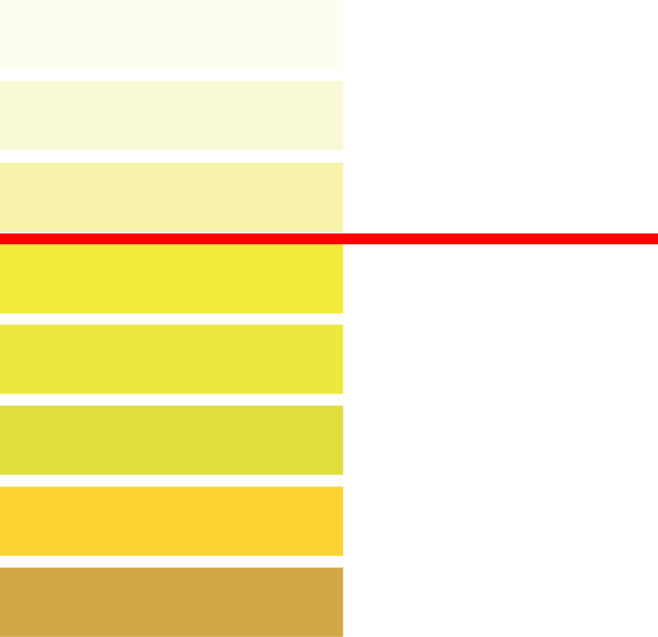
Drinking water is crucial to staying healthy and maintaining the function of every system in your body. While dehydration is always a hazard across industrial worksites, it is an even more serious concern during the hot summer months.
You can help prevent dehydration by:
Taking frequent water breaks throughout the day
Listening to your body and drinking water when thirsty
Snacking on water-rich fruits and vegetables
Avoiding caffeinated and sugary drinks
Monitoring your urine, which should be a pale yellow color (above red line on the chart)
Wearing light and loose clothing
Rehydrating at the first signs of dehydration (dark urine, dry mouth, headache, dizziness)
Find more resources at TotalHealth.cat.com!
Drinking water is crucial to staying healthy and maintaining the function of every system in your body. While dehydration is always a hazard across industrial worksites, it is an even more serious concern during the hot summer months.
You can help prevent dehydration by:
Taking frequent water breaks throughout the day
Listening to your body and drinking water when thirsty
Snacking on water-rich fruits and vegetables
Avoiding caffeinated and sugary drinks
Monitoring your urine, which should be a pale yellow color (above red line on the chart)
Wearing light and loose clothing
Rehydrating at the first signs of dehydration (dark urine, dry mouth, headache, dizziness)
Find more resources at TotalHealth.cat.com!
Drinking water is crucial to staying healthy and maintaining the function of every system in your body. While dehydration is always a hazard across industrial worksites, it is an even more serious concern during the hot summer months.
You can help prevent dehydration by:
Taking frequent water breaks throughout the day
Listening to your body and drinking water when thirsty
Snacking on water-rich fruits and vegetables
Avoiding caffeinated and sugary drinks
Monitoring your urine, which should be a pale yellow color (above red line on the chart)
Wearing light and loose clothing
Rehydrating at the first signs of dehydration (dark urine, dry mouth, headache, dizziness)
Find more resources at TotalHealth.cat.com!
Drinking water is crucial to staying healthy and maintaining the function of every system in your body. While dehydration is always a hazard across industrial worksites, it is an even more serious concern during the hot summer months.
You can help prevent dehydration by:
Taking frequent water breaks throughout the day
Listening to your body and drinking water when thirsty
Snacking on water-rich fruits and vegetables
Avoiding caffeinated and sugary drinks
Monitoring your urine, which should be a pale yellow color (above red line on the chart)
Wearing light and loose clothing
Rehydrating at the first signs of dehydration (dark urine, dry mouth, headache, dizziness)
Find more resources at TotalHealth.cat.com!

