Slide 1
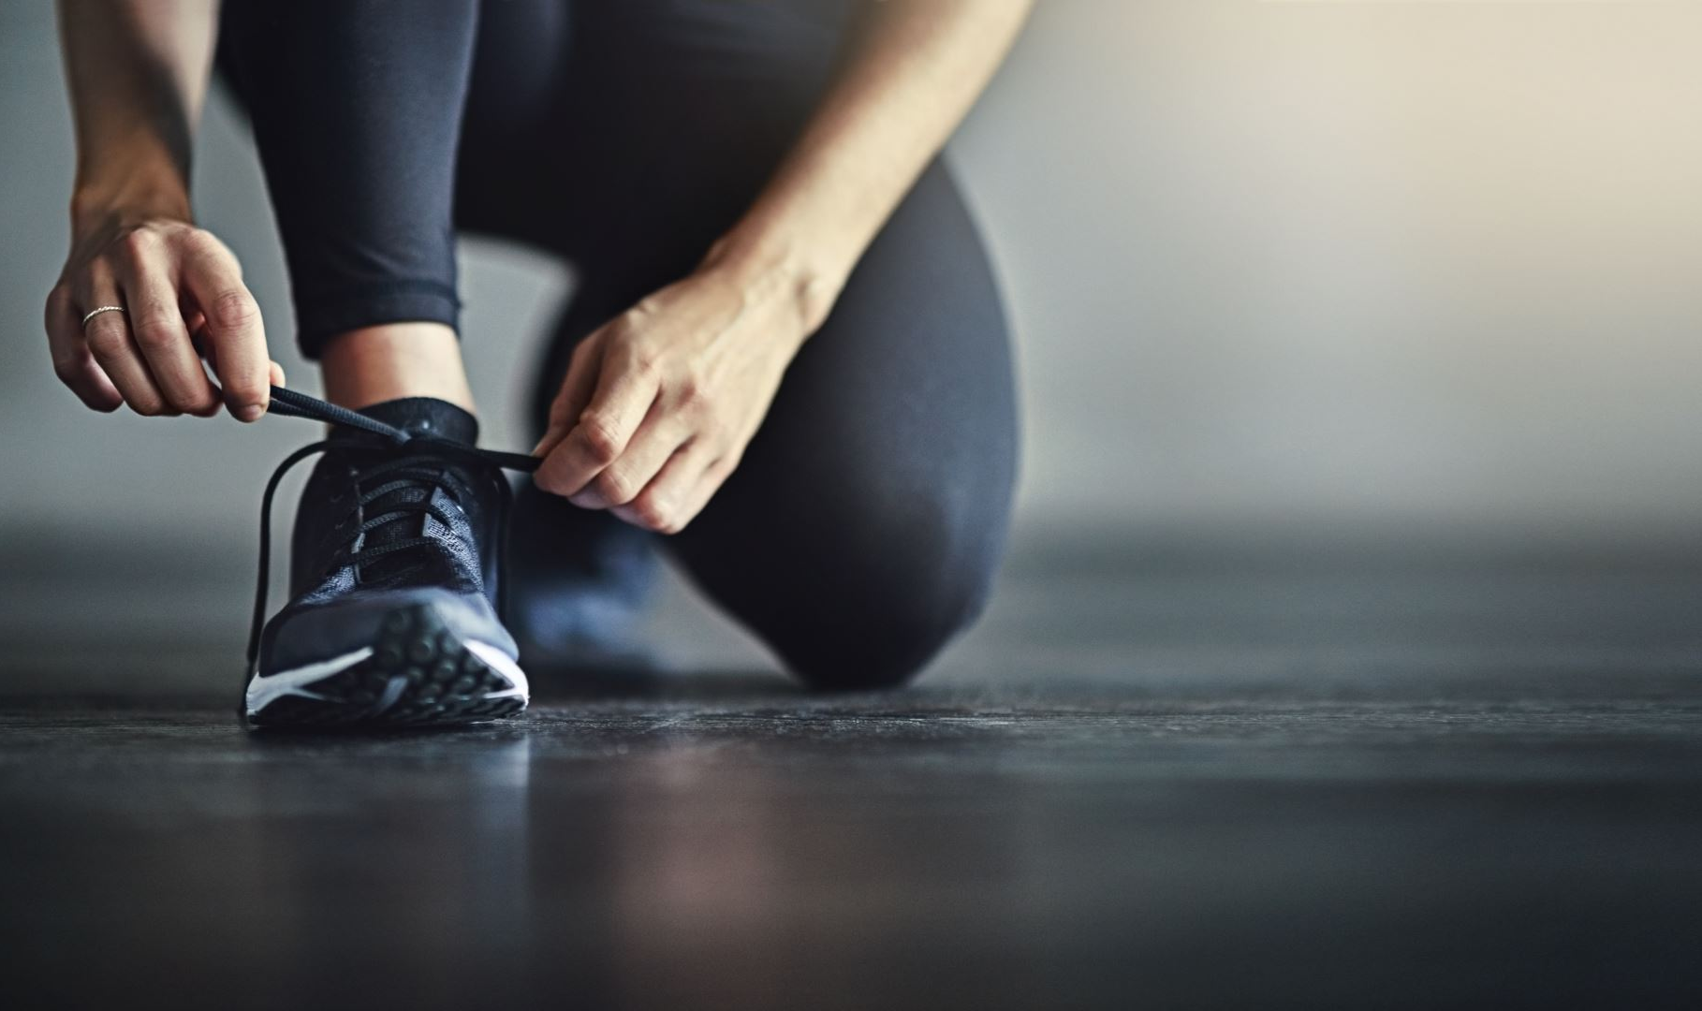
Get Active
Get Active
Get Active
Get Active

Slide 2
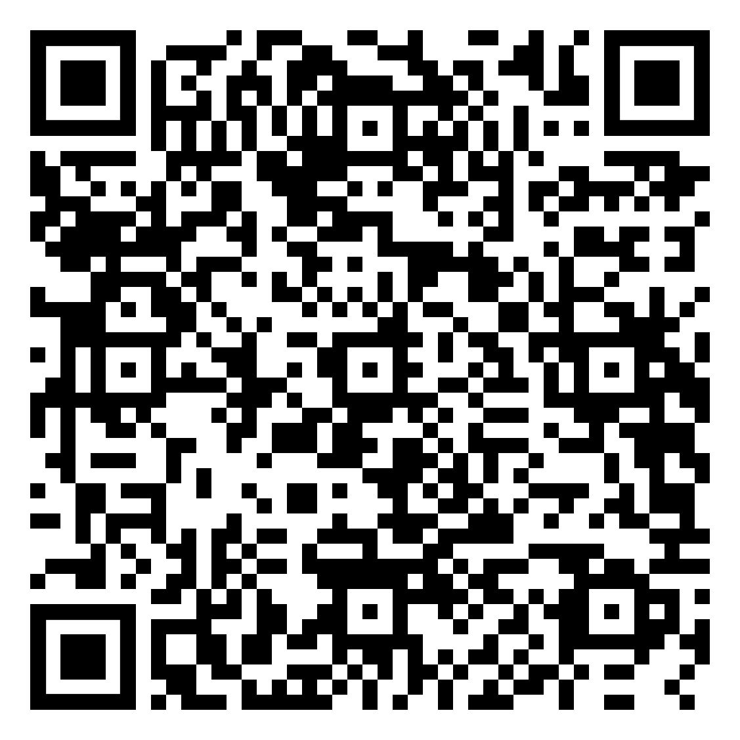
Weekly, it’s recommended adults get at least 150 minutes of moderate-intensity physical activity and 2 days of muscle-strengthening activity. It may sound like a lot, but you don’t have to do it all at once to reap the health benefits! Here are some ideas to help you get active:
Make a brisk walk part of your daily routine.
Take frequent breaks from sitting and get up to stretch.
Take the stairs over the escalator or elevator.
Sign up for a community sports league or join a yoga class.
Get outside and do some yard work or take a hike.
Go for a swim or try a water aerobics class.
Do sit-ups or lift weights while watching TV.
Turn on some music and dance!
Find more resources at TotalHealth.cat.com!
Weekly, it’s recommended adults get at least 150 minutes of moderate-intensity physical activity and 2 days of muscle-strengthening activity. It may sound like a lot, but you don’t have to do it all at once to reap the health benefits! Here are some ideas to help you get active:
Make a brisk walk part of your daily routine.
Take frequent breaks from sitting and get up to stretch.
Take the stairs over the escalator or elevator.
Sign up for a community sports league or join a yoga class.
Get outside and do some yard work or take a hike.
Go for a swim or try a water aerobics class.
Do sit-ups or lift weights while watching TV.
Turn on some music and dance!
Find more resources at TotalHealth.cat.com!
Weekly, it’s recommended adults get at least 150 minutes of moderate-intensity physical activity and 2 days of muscle-strengthening activity. It may sound like a lot, but you don’t have to do it all at once to reap the health benefits! Here are some ideas to help you get active:
Make a brisk walk part of your daily routine.
Take frequent breaks from sitting and get up to stretch.
Take the stairs over the escalator or elevator.
Sign up for a community sports league or join a yoga class.
Get outside and do some yard work or take a hike.
Go for a swim or try a water aerobics class.
Do sit-ups or lift weights while watching TV.
Turn on some music and dance!
Find more resources at TotalHealth.cat.com!
Weekly, it’s recommended adults get at least 150 minutes of moderate-intensity physical activity and 2 days of muscle-strengthening activity. It may sound like a lot, but you don’t have to do it all at once to reap the health benefits! Here are some ideas to help you get active:
Make a brisk walk part of your daily routine.
Take frequent breaks from sitting and get up to stretch.
Take the stairs over the escalator or elevator.
Sign up for a community sports league or join a yoga class.
Get outside and do some yard work or take a hike.
Go for a swim or try a water aerobics class.
Do sit-ups or lift weights while watching TV.
Turn on some music and dance!
Find more resources at TotalHealth.cat.com!

