Slide 1
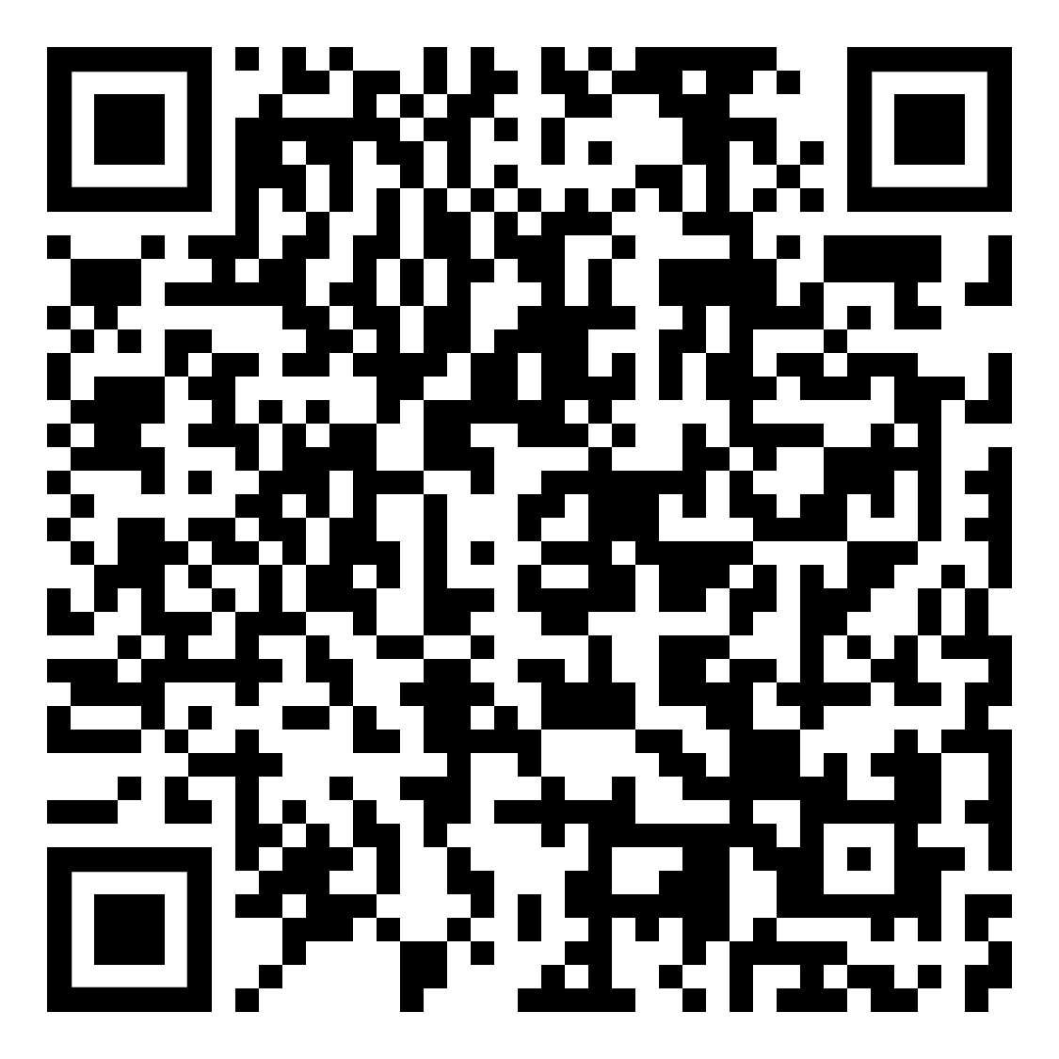
Regular physical activity helps improve your overall fitness and reduces your risk for many chronic diseases. Weekly, it’s recommended adults perform 150 minutes of moderate-intensity physical activity and 2 days of muscle-strengthening activity. It may sound like a lot, but you don’t have to do it all at once to reap the benefits! Here are some tips to help you get started:
Block time on your calendar to make exercise part of your routine.
Start slow with activities you will enjoy, such as a leisurely walk around your neighborhood, swimming, or a virtual yoga class.
Encourage loved ones to join you in an activity for extra motivation.
Spend a few minutes stretching each morning.
Lift weights or do sit-ups while watching TV.
Walk or march in place during breaks at work.
For more tips and resources, scan the QR code!

