Slide 1
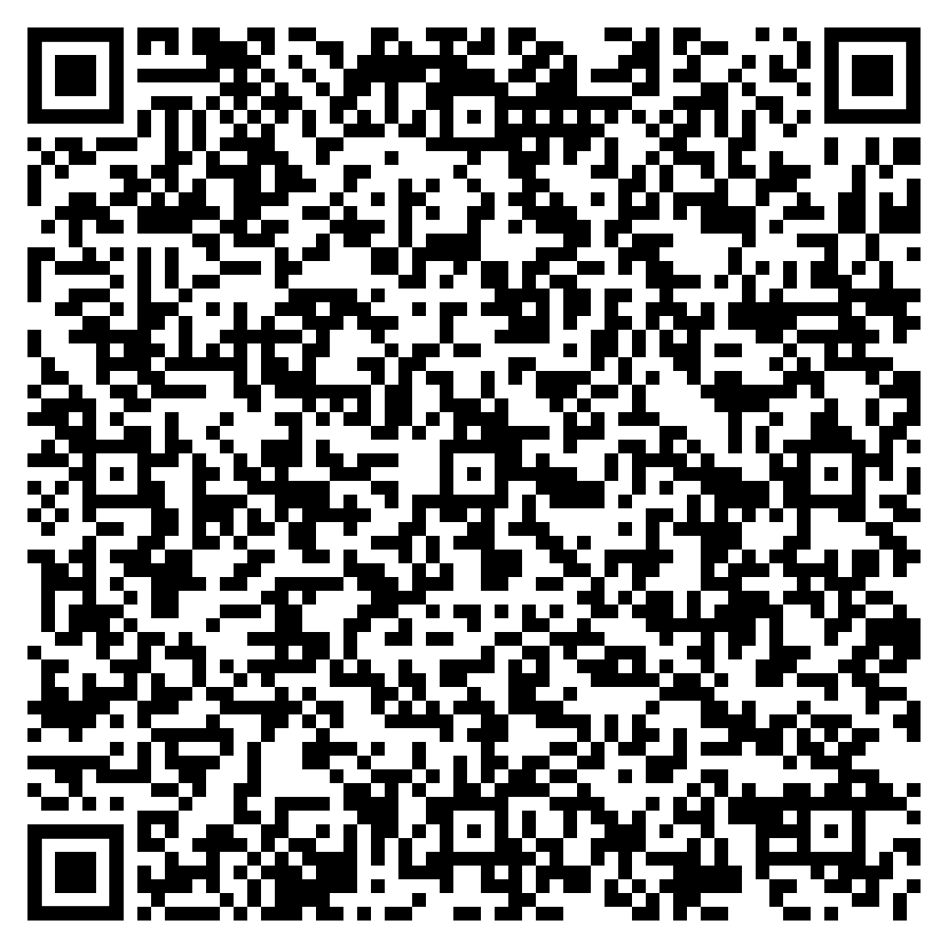
Did you know your employee benefits include convenient, confidential, comprehensive, no-cost health exams?
Full-time and part-time U.S. Caterpillar employees may participate in our Caterpillar Health Exam program, which includes:
Thorough fasting lab panel prior to physical exam
Head-to-toe physical exam with an experienced, independent provider
Review of personal health history and lab results
Discussion about personal risk factors
Opportunity to ask questions about any health concerns!
To learn more or schedule your Caterpillar Health Exam, call Caterpillar Total Health Services at 877-838-0596 or scan the QR code.

