Slide 1
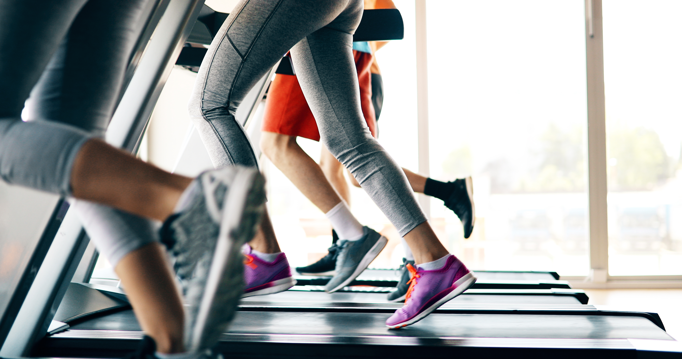
Physical Activity & Fitness
Physical Activity & Fitness
Physical Activity & Fitness
Physical Activity & Fitness

Slide 2
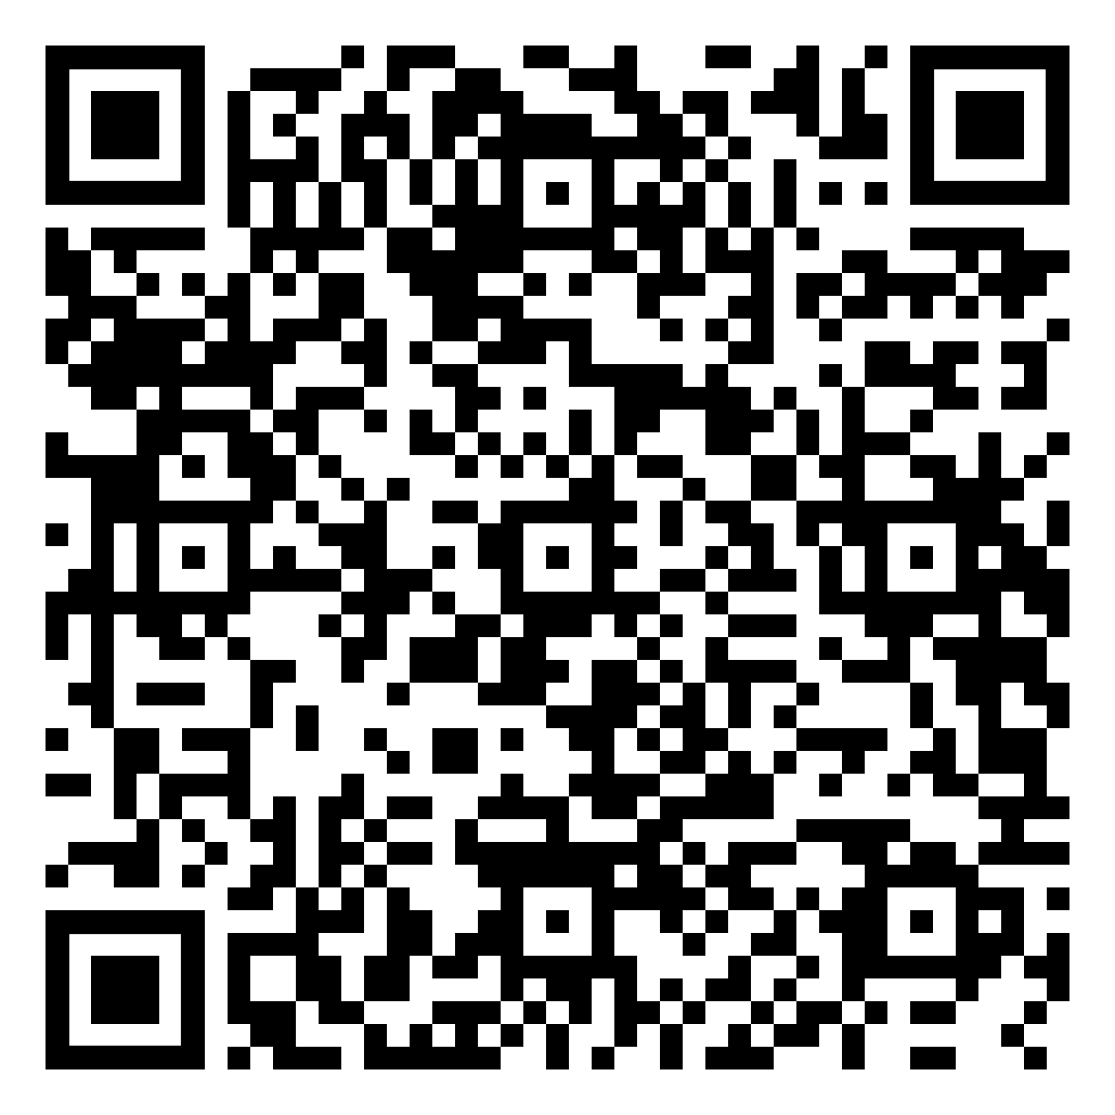
Regular physical activity helps improve your overall fitness and reduces your risk for many chronic diseases. Weekly, it’s recommended adults perform 150 minutes of moderate-intensity physical activity and 2 days of muscle-strengthening activity. It may sound like a lot, but you don’t have to do it all at once to reap the health benefits! Here are some tips to help you get started moving:
Block time on your calendar to make physical activity part of your routine.
Start slow with activities you will enjoy, such as a leisurely walk around your neighborhood or a virtual yoga class.
Encourage loved ones to join you in an activity for extra motivation.
Spend a few minutes stretching each morning.
Lift weights or do sit-ups while watching TV.
Walk or march in place during breaks at work.
For more tips and resources, scan the QR code!
Regular physical activity helps improve your overall fitness and reduces your risk for many chronic diseases. Weekly, it’s recommended adults perform 150 minutes of moderate-intensity physical activity and 2 days of muscle-strengthening activity. It may sound like a lot, but you don’t have to do it all at once to reap the health benefits! Here are some tips to help you get started moving:
Block time on your calendar to make physical activity part of your routine.
Start slow with activities you will enjoy, such as a leisurely walk around your neighborhood or a virtual yoga class.
Encourage loved ones to join you in an activity for extra motivation.
Spend a few minutes stretching each morning.
Lift weights or do sit-ups while watching TV.
Walk or march in place during breaks at work.
For more tips and resources, scan the QR code!
Regular physical activity helps improve your overall fitness and reduces your risk for many chronic diseases. Weekly, it’s recommended adults perform 150 minutes of moderate-intensity physical activity and 2 days of muscle-strengthening activity. It may sound like a lot, but you don’t have to do it all at once to reap the health benefits! Here are some tips to help you get started moving:
Block time on your calendar to make physical activity part of your routine.
Start slow with activities you will enjoy, such as a leisurely walk around your neighborhood or a virtual yoga class.
Encourage loved ones to join you in an activity for extra motivation.
Spend a few minutes stretching each morning.
Lift weights or do sit-ups while watching TV.
Walk or march in place during breaks at work.
For more tips and resources, scan the QR code!
Regular physical activity helps improve your overall fitness and reduces your risk for many chronic diseases. Weekly, it’s recommended adults perform 150 minutes of moderate-intensity physical activity and 2 days of muscle-strengthening activity. It may sound like a lot, but you don’t have to do it all at once to reap the health benefits! Here are some tips to help you get started moving:
Block time on your calendar to make physical activity part of your routine.
Start slow with activities you will enjoy, such as a leisurely walk around your neighborhood or a virtual yoga class.
Encourage loved ones to join you in an activity for extra motivation.
Spend a few minutes stretching each morning.
Lift weights or do sit-ups while watching TV.
Walk or march in place during breaks at work.
For more tips and resources, scan the QR code!

