Slide 1
Commit to Healthy Eating
Commit to Healthy Eating
Commit to Healthy Eating
Commit to Healthy Eating

Slide 2
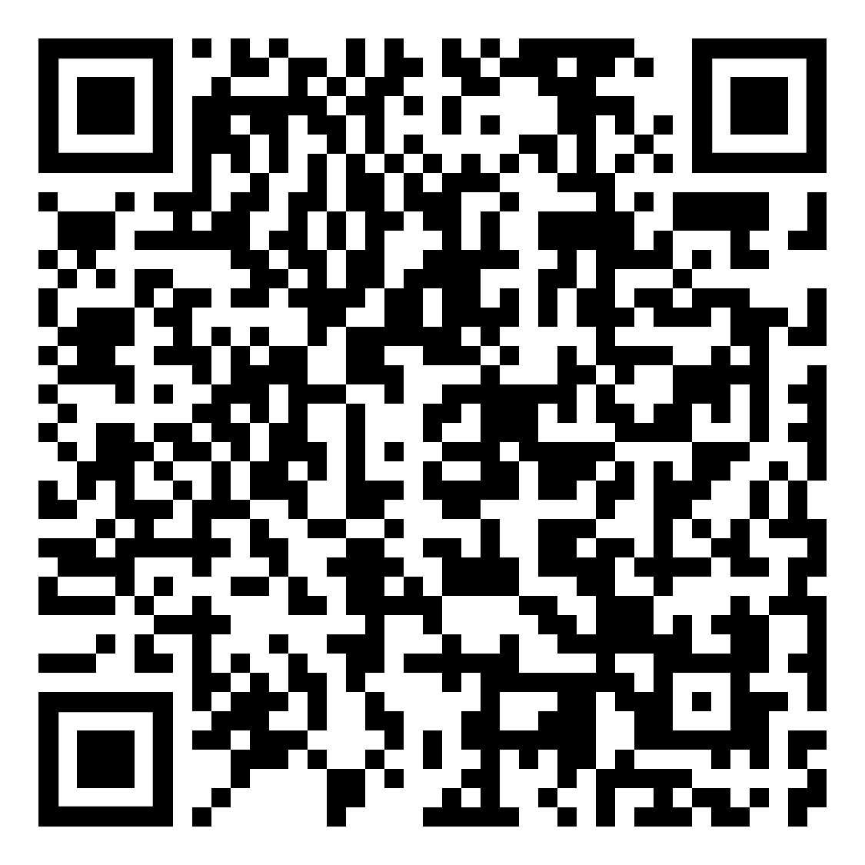
A nutritious, well-balanced diet gives you energy, protects against disease, and helps you maintain a healthy weight!
Have 2-3 nutritious snacks throughout the day in addition to balanced meals.
Drink plenty of water and avoid high-sugar beverages.
Limit or avoid alcohol.
Eat lots of fruit and vegetables and include some ﬁsh in your diet.
Slow down when you eat.
Watch your portion sizes.
Stop buying junk food.
Stay away from snacks high in sugar and/or salt.
Track your food intake.
For more Self-Care tips, scan the QR code!
A nutritious, well-balanced diet gives you energy, protects against disease, and helps you maintain a healthy weight!
Have 2-3 nutritious snacks throughout the day in addition to balanced meals.
Drink plenty of water and avoid high-sugar beverages.
Limit or avoid alcohol.
Eat lots of fruit and vegetables and include some ﬁsh in your diet.
Slow down when you eat.
Watch your portion sizes.
Stop buying junk food.
Stay away from snacks high in sugar and/or salt.
Track your food intake.
For more Self-Care tips, scan the QR code!
A nutritious, well-balanced diet gives you energy, protects against disease, and helps you maintain a healthy weight!
Have 2-3 nutritious snacks throughout the day in addition to balanced meals.
Drink plenty of water and avoid high-sugar beverages.
Limit or avoid alcohol.
Eat lots of fruit and vegetables and include some ﬁsh in your diet.
Slow down when you eat.
Watch your portion sizes.
Stop buying junk food.
Stay away from snacks high in sugar and/or salt.
Track your food intake.
For more Self-Care tips, scan the QR code!
A nutritious, well-balanced diet gives you energy, protects against disease, and helps you maintain a healthy weight!
Have 2-3 nutritious snacks throughout the day in addition to balanced meals.
Drink plenty of water and avoid high-sugar beverages.
Limit or avoid alcohol.
Eat lots of fruit and vegetables and include some ﬁsh in your diet.
Slow down when you eat.
Watch your portion sizes.
Stop buying junk food.
Stay away from snacks high in sugar and/or salt.
Track your food intake.
For more Self-Care tips, scan the QR code!

