Slide 1
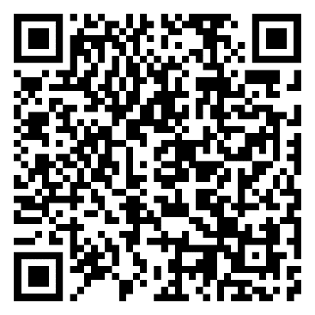
Q1 TOTAL HEALTH HIGHLIGHT
Relationships
Digital Communication | Managing Conflict | Viewpoint Diversity

Slide 2
Q1 TOTAL HEALTH HIGHLIGHT
Relationships
Digital Communication | Managing Conflict | Viewpoint Diversity

Slide 3
Q1 TOTAL HEALTH HIGHLIGHT
Relationships
Digital Communication | Managing Conflict | Viewpoint Diversity

Slide 4
Q1 TOTAL HEALTH HIGHLIGHT
Relationships
Digital Communication | Managing Conflict | Viewpoint Diversity

