Slide 1
Digital Body Language Leveraging Emotional Intelligence (EQ) in a digital workplace
February 2021
1

Slide 2
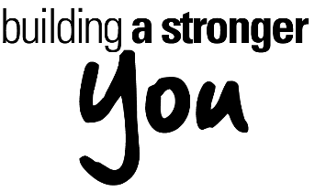
Agenda
Defining Digital Body Language and the alignment to Emotional Intelligence (EQ)
The challenges and risks of digital communication
Six factors in improving your digital body language
Additional resources
2

Slide 3
Have you ever…
Had a confused or emotional reaction to a text or email?
Been left off a meeting or important email when you should have been included?
Received an email with unnecessary people cc’ed?
Failed to reply to an email that warranted a response?
Scheduled a meeting when an email would have met the need?
Used emojis in work communication?
Sent or received an email from a leader after normal working hours?
These are examples of the subtle messages — often unintentional — that accompany the content of our communication.
3

Slide 4
Body Language
The process of communicating nonverbally through conscious or unconscious gestures, movements or positions.
Body language involves metamessages, which are the underlying or implicit messages we send.
Examples:
Facial expressions
Hand and arm gestures
Posture
Movements
Haptics (touching)
Breathing
Eye movement and contact
Tone of voice
4
Notes:
Metamessages: an underlying meaning or implicit message, especially in advertising.
Nonverbal communication can play five roles:
Repetition: It repeats and often strengthens the message you’re making verbally.
Contradiction: It can contradict the message you’re trying to convey, thus indicating to your listener that you may not be telling the truth.
Substitution: It can substitute for a verbal message. For example, your facial expression often conveys a far more vivid message than words ever can.
Complementing: It may add to or complement your verbal message. As a boss, if you pat an employee on the back in addition to giving praise, it can increase the impact of your message.
Accenting: It may accent or underline a verbal message. Pounding the table, for example, can underline the importance of your message.

Slide 5
Body Language
A significant amount of our communication and understanding of others comes from nonverbal communication.
Understanding body language is a two-way street allowing us to:
Build trust and open communications
Pick up on and send subtle messages, emotions and intent
Recognize how you are coming across to others
Adjust and influence the communication in real time
How can this happen when we communicate virtually?
“It’s hard to walk the talk when you’re writing the talk.”
5
Notes:
It is very hard to express what you mean, ensure understanding and interpret the intent of others when so much of our communication is nonverbal.
There are risks to trust levels, innovation and collaboration.
So just what does this "7% Rule" really mean?
The origin of this inimical adage is a misinterpretation, like the adage "the exception that proves the rule." This is something else people say without examining it. If you believe that this is actually true, I will demonstrate at the end of this article that it isn't. But first things first.
In the 1960s Professor Albert Mehrabian and colleagues at the University of California, Los Angles (UCLA), conducted studies into human communication patterns. When their results were published in professional journals in 1967, they were widely circulated across mass media in abbreviated form. Because the figures were so easy to remember, most people forgot about what they really meant. Hence, the myth that communication is only 7% verbal and 93% nonverbal was born. And we have been suffering from it ever since.
The fact is Professor Mehrabian's research had nothing to do with giving speeches, because it was based on the information that could be conveyed in a single word.
Subjects were asked to listen to a recording of a woman's voice saying the word "maybe" three different ways to convey liking, neutrality, and disliking. They were also shown photos of the woman's face conveying the same three emotions. They were then asked to guess the emotions heard in the recorded voice, seen in the photos, and both together. The result? The subjects correctly identified the emotions 50 percent more often from the photos than from the voice.
In the second study, subjects were asked to listen to nine recorded words, three meant to convey liking (honey, dear, thanks), three to convey neutrality (maybe, really, oh), and three to convey disliking (don't, brute, terrible). Each word was pronounced three different ways. When asked to guess the emotions being conveyed, it turned out that the subjects were more influenced by the tone of voice than by the words themselves.
Professor Mehrabian combined the statistical results of the two studies and came up with the now famous and famously misused rule that communication is only 7% verbal and 93% nonverbal. The nonverbal component was made up of body language (55%) and tone of voice (38%).
Actually, it is incorrect to call this a "rule," being the result of only two studies. Scientists usually insist on many more corroborating studies before calling anything a rule.
More to the point, Professor Mehrabian's conclusion was that for inconsistent or contradictory communications, body language and tonality may be more accurate indicators of meaning and emotions than the words themselves. However, he never intended the results to apply to normal conversation. And certainly not to speeches, which should never be inconsistent or contradictory!

Slide 6
Digital Body Language (DBL)
The cues and signals that make up the metamessages and subtext of our digital communications, such as phone calls, emails, video chat and instant messages.
Leveraging tech tools to make up for what you lose in traditional face-to-face communication.
Examples:
Word choice and tone
Length of message
Response time or no response
Level of formality
Use of camera and mute button
Teams availability indicator
Choice of communication medium
The choice and order of email recipients
Time of day of a communication
Profile picture
How you announce yourself
Use of passive aggression and sarcasm
Email signature line
Use of punctuation, shorthand, acronyms and emojis
Who you cc and bcc
Email chain on a forward
Use of importance level on email
Source: Adapted from Erica Dhawan
6

Slide 7
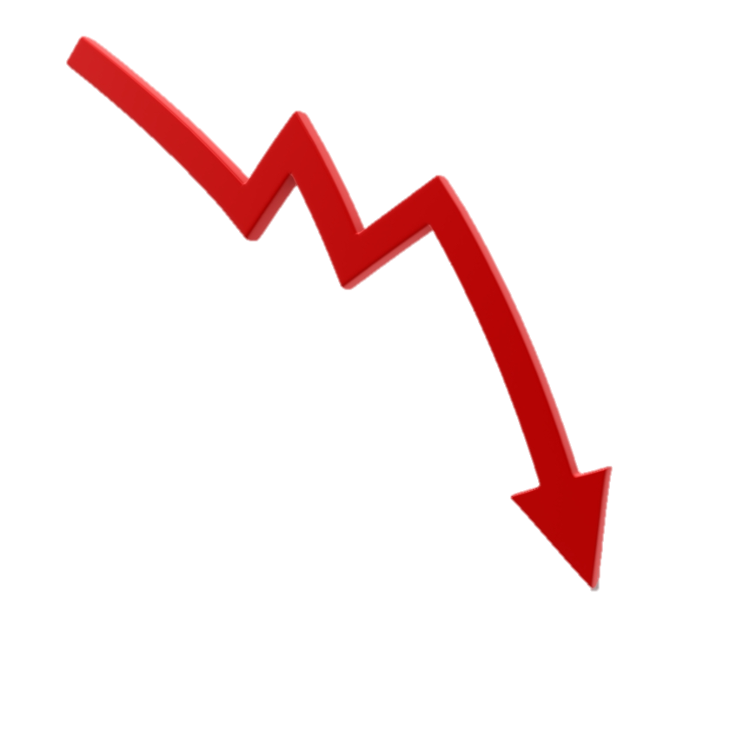
Digital Communications
Remote work and multiple communications media are the norm. They have greatly expanded how we relate and work.
When used effectively we can communicate:
More often with more people
At a higher pace
At our leisure
With more detail and precision
When used ineffectively we:
Erode trust and confidence
Decrease collaboration and engagement
Lose our interpersonal connectedness
Create confusion and errors
Brevity, speed and mass create confusion
7
Notes:
When we communicate in minimal words and time (brevity and speed) and do so many times and to many people each day, we increase our chances of error, misunderstanding and confusion. We also — particularly leaders — can negatively impact our relationships and team culture.
Let’s look at some examples.

Slide 8
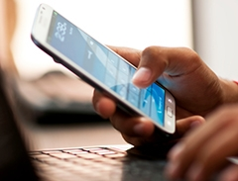
Digital Body Language (DBL)
“
The digital world isn’t Switzerland. Nothing is neutral. Everything has meaning; and everyone is looking for it.
”
- Erica Dhawan
8
Notes:
So, you may be saying, “this is silly.” To you, this may all be common sense and intuitive. You may be thinking “who cares?”
Be aware of how diversity can impact communication styles, norms and immersion into the digital world. There are cultural and age-related differences in how we communicate digitally. Take stock of your comfort level and personal style using digital communications. That will be a foundation of how you approach this discussion and improve your DBL in general.
The bottom line is, in our modern/digital/remote workplace, this is a real issue.

Slide 9
Team, HR Manager
Supervisor Thursday 10:49pm
Team, we need to meet first thing in the morning. Please clear your calendars at 8:00am. Sending an invitation now.
9
Notes:
Let’s look at an example. Ever send or receive on of these?
This is a quick, efficient way to get a last-minute meeting to the entire team.
Problems:
Sent late at night implies urgency, creates anxiety.
Sent via Teams, assuming everyone will check after hours.
No context. No explanation. Went to everyone, so that suggest magnitude.
Why is the HR Manager included?

Slide 10
Supervisor
Employee Monday 1:15pm
I thought the meeting went as well as could be expected. I was very nervous, but I think my presentation was well received and we’ll get the approval we need. Have you heard anything yet? Do you have any feedback or suggestions for me?
Supervisor: Tuesday 8:17am
We should talk!
10
Notes:
Here’s another example. You’ve checked in following an important meeting. You disclosed your emotions about the meeting and asked for an update and for feedback.
Problems:
Your supervisor doesn’t respond until the next day.
Sends an ambiguous response.
Fails to answer your question.
Use of exclamation mark.
May not be the right tone of email to use an emoji.
What is the message that is being sent?

Slide 11
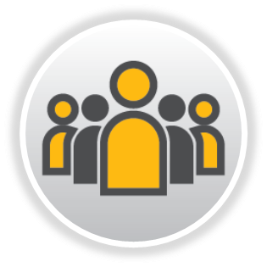
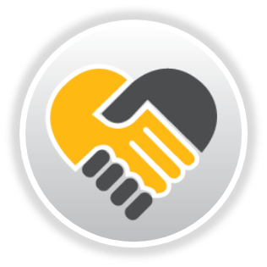
Digital Body Language starts with Emotional Intelligence
EQ is the ability to apply a high level of self-awareness and empathy to build healthy, effective relationships.
Self-Awareness
In-the-moment awareness of your emotions, emotional reactions and how you impact others.
Self-Management
Using your awareness to be intentional and actively control what you say and do in the moment.
Social Awareness
Empathy. In-the-moment awareness of experience of others, the intent behind their action and how you are impacting them.
Social Skills
Using your awareness to adjust your actions, impact others and shape your relationships.
11
Notes:
Here are some examples of EQ in action in our digital communications.
Have you ever:
Sent an email or text full of emotion and later regretted it (low self awareness and self management)?
Received feedback that surprised you (low self awareness)?
Put something in draft, came back to it later, and made changes before you sent it (high self management)?
Sent a communication and were misinterpreted (low social awareness)?
Stopped to consider how your message would be received before you sent it (high self management and social awareness)?
Ask for clarity on someone else’s message (social awareness)?
Changed your approach to influence the audience and your relationship with them (social skills)?

Slide 12
Six Factors in Improving Your Digital Body Language

Slide 13
Digital Body Language - The Basics
There are no hard and fast rules. There is no single, clear etiquette.
Before you hit “Send,” ask yourself:
1.
Did I give enough context? Does the audience know the “why?”
2.
Is my meaning clear? Am I sending the information and message I intended?
3.
Is the medium appropriate? Does it align with the context?
4.
Am I striking the right emotional tone? Am I injecting my own emotions when they aren’t relevant?
5.
Am I clear on any calls to action?
6.
What are the power differentials? Have I used the right levels of trust and authority in my message?
Notes:
First a few basics. Here are a few questions to ask yourself about any given communication.

Slide 14
1.
Manage Clarity and Brevity
Be clear in your expectations and needs, including action items, the path and timeline.
Are the right people involved? Is it clear to everyone why they are included or excluded, and how they are positioned?
Be ULTRA clear. Even if you aren’t directive or in a power position, you’ll do less harm by explicitly stating parameters rather than being vague.
Don’t be brief if details are needed or an explanation is warranted. This may require a more robust communication medium.
Messages that are shorter and actionable need more clarity
Notes:
Clarity and actionability are directly correlated. The more action you need, the clearer the message needs to be.
Brevity and clarity are inversely related. The shorter the message, the clearer it needs to be.

Slide 15
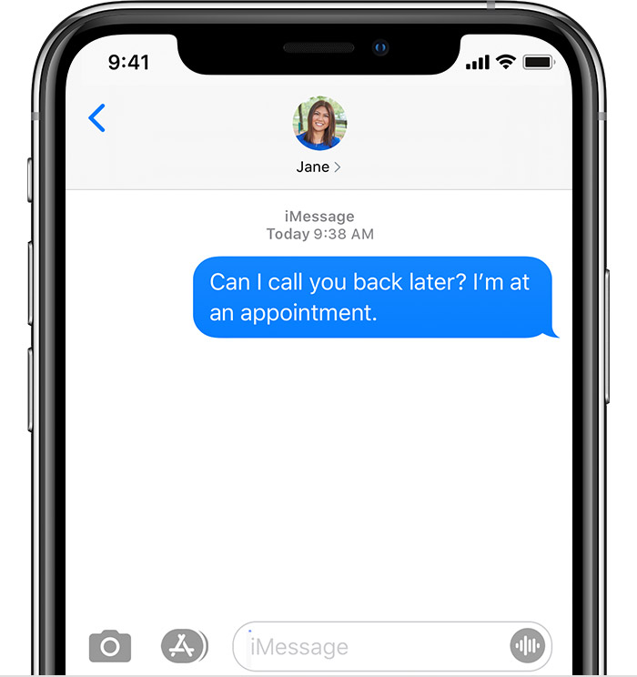
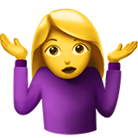
Hey are you there??? I’ve been texting all day? Are we still planning to have dinner?
SORRY
???
Notes:
What do we know about this message?
What are the “levels” of communication? Overt message? Meta or underlying message?
What are the DBL messages? Notice the multiple question marks, rapid fire questioning, caps, emoji.
What do they tell us about each person?
How does the sender feel and what does the sender really want? She expressed neither, doesn’t get the desired response and gets more frustrated.
Brevity is a problem and clarity is lacking.

Slide 16
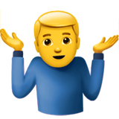
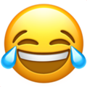
Hey are you there??? I’ve been texting all day? Are we still planning to have dinner?
SORRY
???
Whatever. Sure. IDC.
Notes:
What’s happened now?
We have some hints and some definite signals. But it’s not entirely clear.

Slide 17
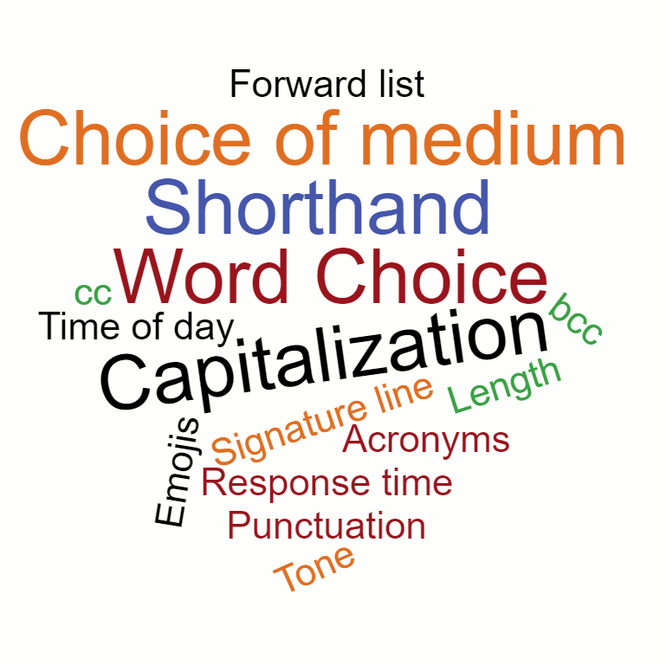
2.
Seek to understanding the message and intent
Digital body language is full of vague messages.
Start by assuming good intent.
Use EQ: Stop, drop anchor and think before you communicate.
What is your mindset and mood? How are they influencing your message and your interpretation of others’.
What’s the context? What do you know about the person or situation?
Ask yourself why they communicate what and the way they did.
Be curious. It’s OK to ask to clarify the content and intent before responding.
Notes:
We want to be able to:
Control our message.
Be very clear about out intent.
Work to understand the message and intent of others.

Slide 18
2.
Seek to understanding the message and intent
Control the tone. Be intentional in order to influence the communication.
Verify you are being understood (content and tone).
Use open-ended dialog: “Help me understand…” or “Tell me more about that…”
To gain clarity, shift to a more robust medium.
Phone call
Teams IM
Text
Email
FTF Meeting
Video Chat

Slide 19
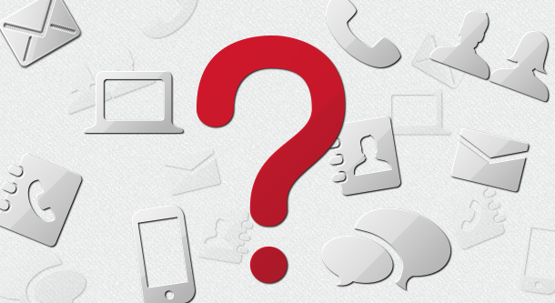
3.
Pick your communication medium wisely
What are the ground rules and norms for your organization?
Pick one or two communication channels for any given communication.
Use communication tools:
the right way,
at the right time,
for right message,
with the right audience.
Notes:
Too many communication channels can get confusing and cause people to tune out. It also makes you look chaotic and unsophisticated.

Slide 20
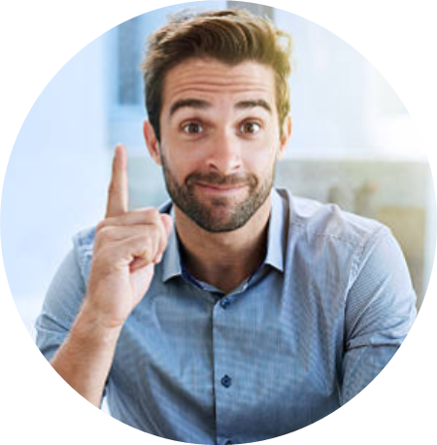
Project Team
Employee Wednesday 3:30pm
Great meeting today everyone! I have sent the meeting minutes in a separate email. I will make the edits to the slides and send them by the end of the week. Have a good day.
Employee Thursday 8:32am
@Bill did you get my text last night? I’ll call you later so we can talk about next week’s presentation.
Bill: Wednesday 3:33pm
OK.
Notes:
What do we see here?
An IM to alert people about an email. Redundancy?
Mixing a personal correspondence in the Team message?
Texting after hours.
An IM to alert about a subsequent phone call.
This is confusing. The redundancy misuses everyone’s time and uses too many comms media.

Slide 21
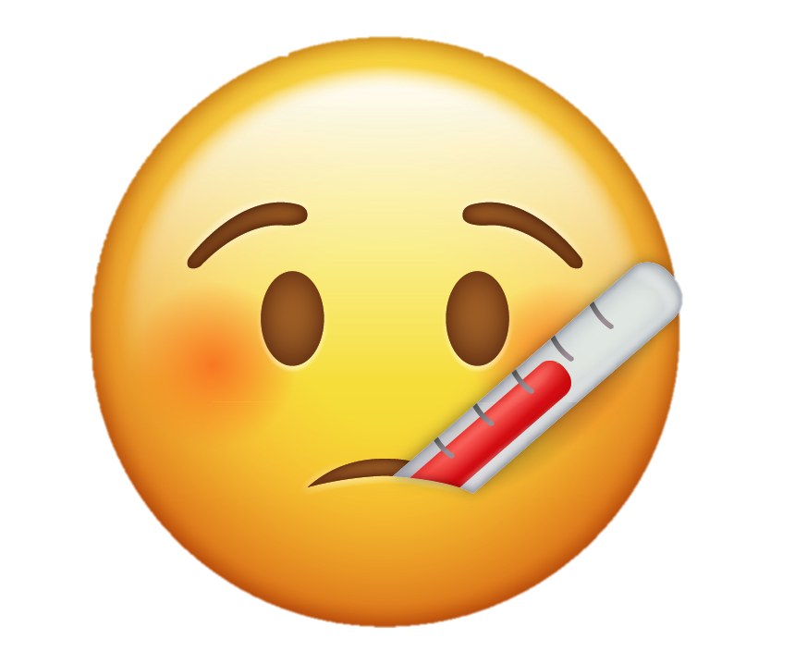
Dominic >
Hi. I hope you are feeling better?
A little bit. Thanks for asking.
Today is the deadline to deliver final ratings. I didn’t think you’d want to wait until Monday to find out about your merit increase.
I have you in as a Meets with a 2.5% increase.
Notes:
Is this the right medium for this message?
Probably not. We are going to talk about familiarity, formality and power differences in a minute. You may have some relationships where this is OK. But in general, performance reviews are not the kind of information you share in a text format.

Slide 22
3.
Pick your communication medium wisely
Length
Longer messages require a more robust medium.
How formally and how well do you know the audience? How well do they know the context? Text is less formal and assumes knowledge.
Familiarity
Complexity
More complexity requires a more robust medium. Consider urgency, importance and sensitivity. Are there action items involved?
Be intentional and pick one medium. Err on the side of less written content, particularly when it’s confidential or personal.
Discipline

Slide 23
4.
Respond carefully
Digital communication and remote work carry risks for our communications:
Expectations of a quick reply
Multi-tasking and using mobile comms on-the-move
Moving quickly and failing to proofread
Working at sub-optimal times of day
Visual-special deficits
Failing to pick up on the DBL
Read and re-read.
Empathize — read from the other’s view and look for ways it can be misinterpreted.
Let some time pass. Use Drafts folder.
Be conscious of time of day and week.
Read YOUR digital body language. Consider the underlying message of your reply.
Lower quality communications create more work and send underlying messages that we may not desire.

Slide 24
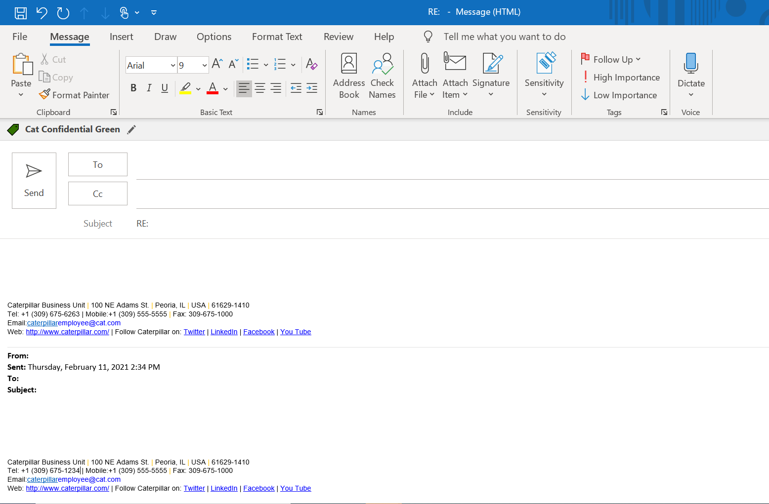
You
Financial projections for the NPI
What do u mean??? I thougt we resolved this...
Your supervisor
You
Your supervisor
Good morning. I was checking in to see if you had time to look at the reports I sent last week. The team is not confident in the financial projections. Given the importance of the launch and EO visibility I don’t want to move forward without your support.
Notes:
What is going on here?
Just an email check-in?
Employee and team anxiety?
What does the supervisor’s response mean?
The supervisor’s lack of response doesn’t match the urgency and importance. Needs to be reminded.
Shorthand and typo don’t align with the importance.
The response is vague and slightly hostile. What does “what do you mean” mean? Three “???” suggests emotion.
Accusatory? At least vague.
What do the ellipses imply?
The supervisor did not respond carefully.

Slide 25
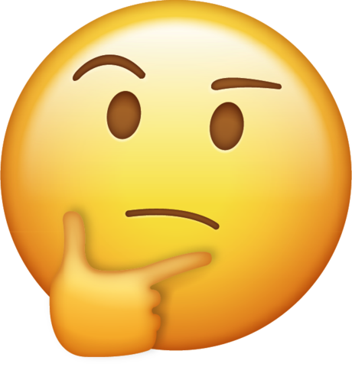
5.
Learn to read signals. THEN USE THEM INTENTIONALLY.
!!!
?
.
Exclamation Points
Question Marks
Periods
Emojis
! Warmth
!! Excitement, urgency
!!! Enthusiasm
!!!! Sarcasm, wit, anger
? Interest or clarification.
?? Confusion or interrogation
??? Frustration or anger
Can be used as a standalone message.
Message seems less sincere. Given the words, can mean abrupt or anger.
Multiple (ellipse) means more to say, still thinking or an unfinished thought. Meme — these are overused by older people.
They are now mainstream. Message seems more genuine and authentic. Typically used as shorthand in informal communication.
Overuse/misuse = unserious or disrespectful.

Slide 26
6.
Power Differentials
Team
Supervisor Thursday 4:36pm
In case you missed my earlier email, please review the documents that were attached and provide your feedback ASAP.
Notes:
Ever get one of these?
(intro to power differentials)
This is an IM to the team, from the leader who is a) reminding them about a prior email and b) giving an instruction.
What may be the underlying message?

Slide 27
Team
RE: Feedback needed
A gentle reminder…
Your supervisor
Supervisor
Team
Feedback needed
Team: See the attachments. I will present this information at the next AEM. Please review the information relevant to your area and provide any feedback/changes.
Notes:
Another version… “a gentle reminder”. Others include, “ICYMI” or “per my prior email” or “not sure everyone saw my prior note.”
These can mean:
You’re not moving fast enough.
I don’t trust you to deliver.
I think you are blowing me off.
I’m anxious about it and need your action to put me at ease.
Or, just checking in.

Slide 28
6.
Power Differentials
Power dynamics are very important in creating context and understanding intent. We communicate through our words, actions and influence.
Authority can also be abused through our digital body language.
When communicating, be aware of:
Who has more or less power
The level of familiarity and trust
Notes:
This is NOT to suggest that just because YOU have an emotional reaction that it’s a valid reaction. Our emotions mislead us all the time. It is always important to clarify the context and intent.
It IS all right to offer feedback to others to clarify intent and about the best way to communicate to you.
E.g. “when you send me an email in the evening it sends me the message that I should be working all hours. Is that your intent?” Or, “if you need action, please just say so. That way I know your message isn’t just informative, but also a call to action.

Slide 29
Power and Trust Matrix
Up
Trust Level
Far
Close
Down
Power Level
Notes:
This matrix can help guide which DBL signals we should use in what situations.

Slide 30
Power and Trust Matrix
Up
Brevity and informality. More room for error and influence on climate.
Trust Level
Far
Close
Down
Power Level
Notes:
This matrix can help guide which DBL signals we should use in what situations.

Slide 31
Power and Trust Matrix
Up
Brevity and informality. More room for error and influence on climate.
Trust Level
Far
Close
Longer explanations. Quick responses. Formality.
Down
Power Level
Notes:
This matrix can help guide which DBL signals we should use in what situations.

Slide 32
Power and Trust Matrix
Up
Build trust through reliability and quality. Appreciation and recognition.
Brevity and informality. More room for error and influence on climate.
Trust Level
Far
Close
Longer explanations. Quick responses. Formality.
Down
Power Level
Notes:
This matrix can help guide which DBL signals we should use in what situations.

Slide 33
Power and Trust Matrix
Up
Build trust through reliability and quality. Appreciation and recognition.
Brevity and informality. More room for error and influence on climate.
Trust Level
Far
Close
Longer explanations. Quick responses. Formality.
Responsive. Reliable. Clear. Room for informality and risk.
Down
Power Level
Notes:
This matrix can help guide which DBL signals we should use in what situations.

Slide 34
Summary Tips
Work to develop your EQ: self-awareness, self-management and an understanding of others. Use that to guide your DBL.
Pause to understand the content, the intent and the metamessages for the messages you send and receive.
Assume good intent. Trust but clarify.
Identify the digital norms, at home and work.
Recognize Trust + Power differentials to guide your DBL.

Slide 35
Summary
Align the medium, timing and message to your audience.
Communicate feelings accurately, with the right language and symbols.
Practice empathy. Seek to understand. Don’t assume you understand or that you are understood.
Digital communication skills and DBL are iterative — a work in progress. Learn from every encounter.

Slide 36
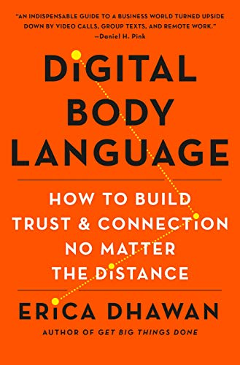
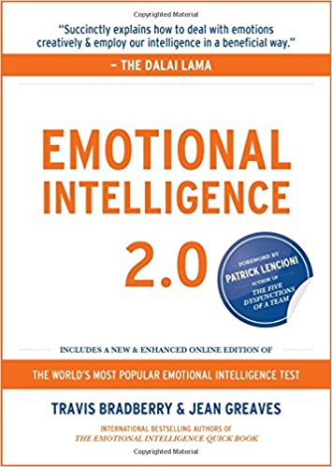
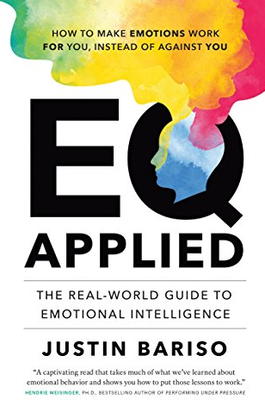
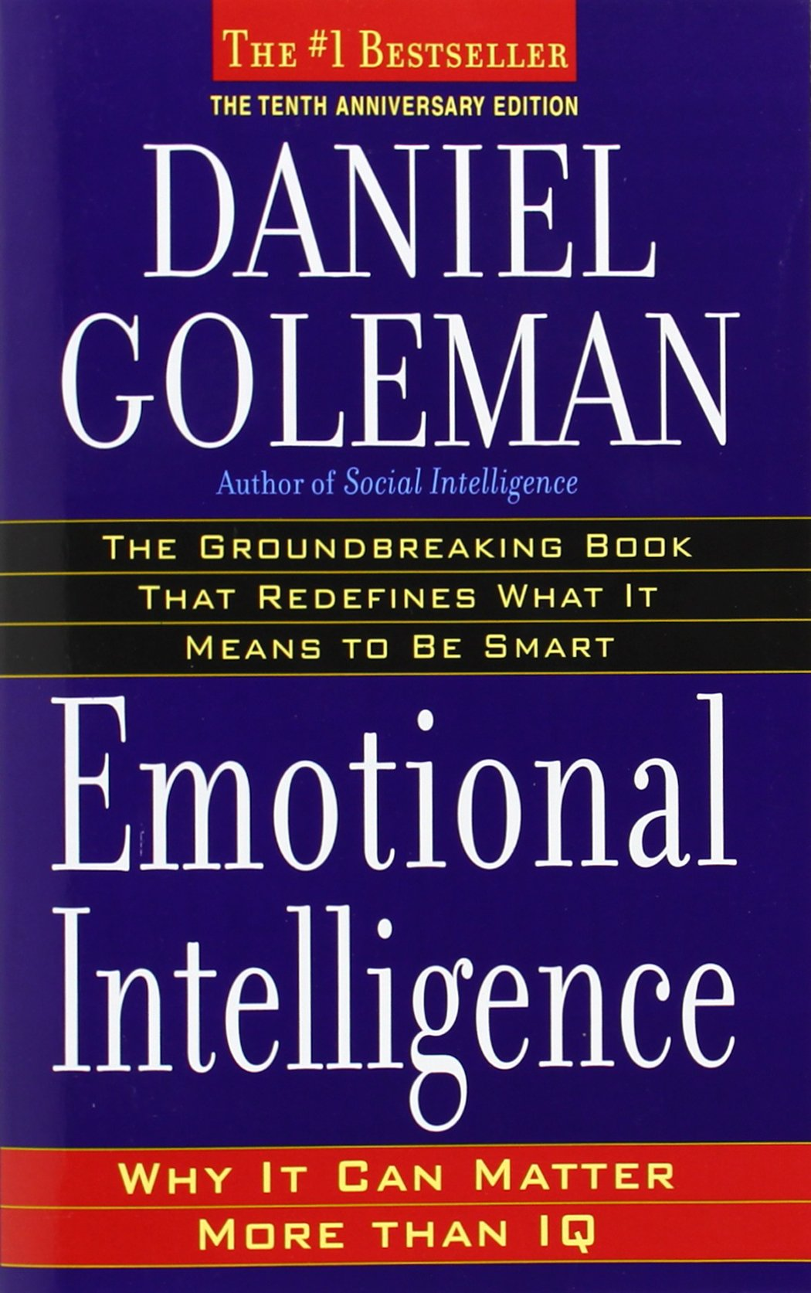
Additional Learning Resources
Access the LinkedIn Learning Paths at Leadership.cat.com:
Digital Body Language
Emotional Intelligence
Lean more at EAP.cat.com > EAP L&D > Emotional Intelligence, and Building a Stronger You
Reading:
Digital Body Language: How to Build Trust and Connection, No Matter the Distance by Erica Dhawan
Emotional Intelligence 2.0 by Travis Bradberry
EQ Applied by Justin Bariso
Emotional Intelligence by Daniel Goleman
EAP and additional 1:1 coaching or team session
36
Notes:
There are many books, website and articles about EQ. But there are two predominant resources on this topic and these materials have been drawn from both. The Bradberry book has an online assessment that comes with the book. General EI 2.0 is currently the most widely used. It is written in a very concise and direct manner. The book with the assessment is an outstanding resource to learn more about this topic.
Facilitator question: Have you seen these books or read material on EI? What did you learn?

Slide 37
Questions?
Dr. John Pompe
Global Manager, EAP and Employee Health Programs
pompejc@cat.com
37

