Slide 1
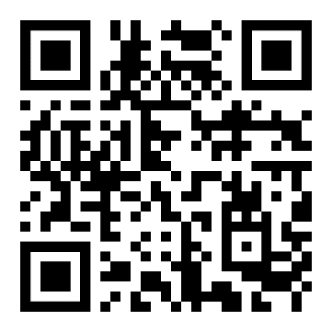
MAY IS
MENTAL HEALTH
AWARENESS MONTH
Most of us will experience a mental health concern in our lifetime.
Learn more about Mental Health, how to identify a problem, and how to access care at TotalHealth.cat.com.
Mental health conditions are:
Common.
High-impact.
Treatable.
And help is available.

