Slide 1
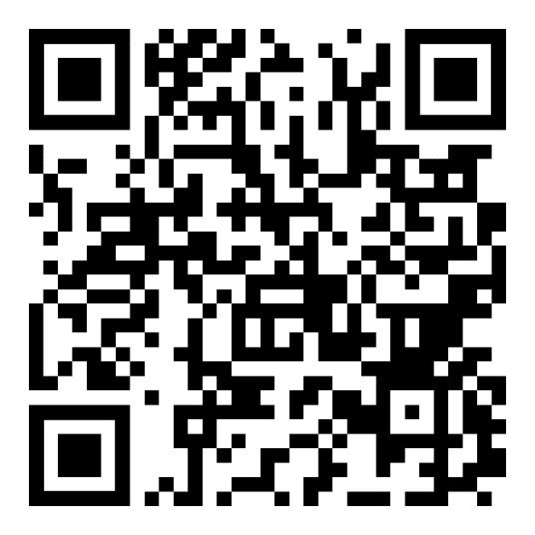
Employee Assistance Program (EAP)
Caterpillar’s EAP is a free, voluntary and completely confidential service provided to employees and eligible family members to help meet many challenges at home and work.
Access the EAP 24/7 by phone, Web, or the TELUS Health One app.
CaterpillarEAP.com
For global access numbers, scan QR code

Slide 2
Struggling with Addiction?
Resolving addiction problems can be one of life’s most difficult issues. Let us help. Using the Caterpillar Employee Assistance Program (EAP) is free and strictly confidential.
Access the EAP 24/7 by phone, Web, or the TELUS Health One app.
CaterpillarEAP.com
For global access numbers, scan QR code

Slide 3
Need Help with Budgeting and Finances?
Money management can be stressful. Let us help. Using the Caterpillar Employee Assistance Program (EAP) is free and strictly confidential.
Access the EAP 24/7 by phone, Web, or the TELUS Health One app.
CaterpillarEAP.com
For global access numbers, scan QR code

Slide 4
Struggling with Loneliness?
Are you feeling disconnected or lonely? These moments provide opportunities to talk about life’s challenges. Let us help. Using the Caterpillar Employee Assistance Program (EAP) is free and strictly confidential.
Access the EAP 24/7 by phone, Web, or the TELUS Health One app.
CaterpillarEAP.com
For global access numbers, scan QR code

Slide 5
Need Help with Parenting?
Looking for resources to assist with caring for your children? Let us help. Using the Caterpillar Employee Assistance Program (EAP) is free and strictly confidential.
Access the EAP 24/7 by phone, Web, or the TELUS Health One app.
CaterpillarEAP.com
For global access numbers, scan QR code

Slide 6
Feeling Stressed?
Learn how to make changes to your routine to decrease stress. Let us help. Using the Caterpillar Employee Assistance Program (EAP) is free and strictly confidential.
Access the EAP 24/7 by phone, Web, or the TELUS Health One app.
CaterpillarEAP.com
For global access numbers, scan QR code

Slide 7
Struggling to Maintain Work-Life Balance?
Achieve the right balance between work and home responsibilities. Let us help. Using the Caterpillar Employee Assistance Program (EAP) is free and strictly confidential.
Access the EAP 24/7 by phone, Web, or the TELUS Health One app.
CaterpillarEAP.com
For global access numbers, scan QR code

