Slide 1
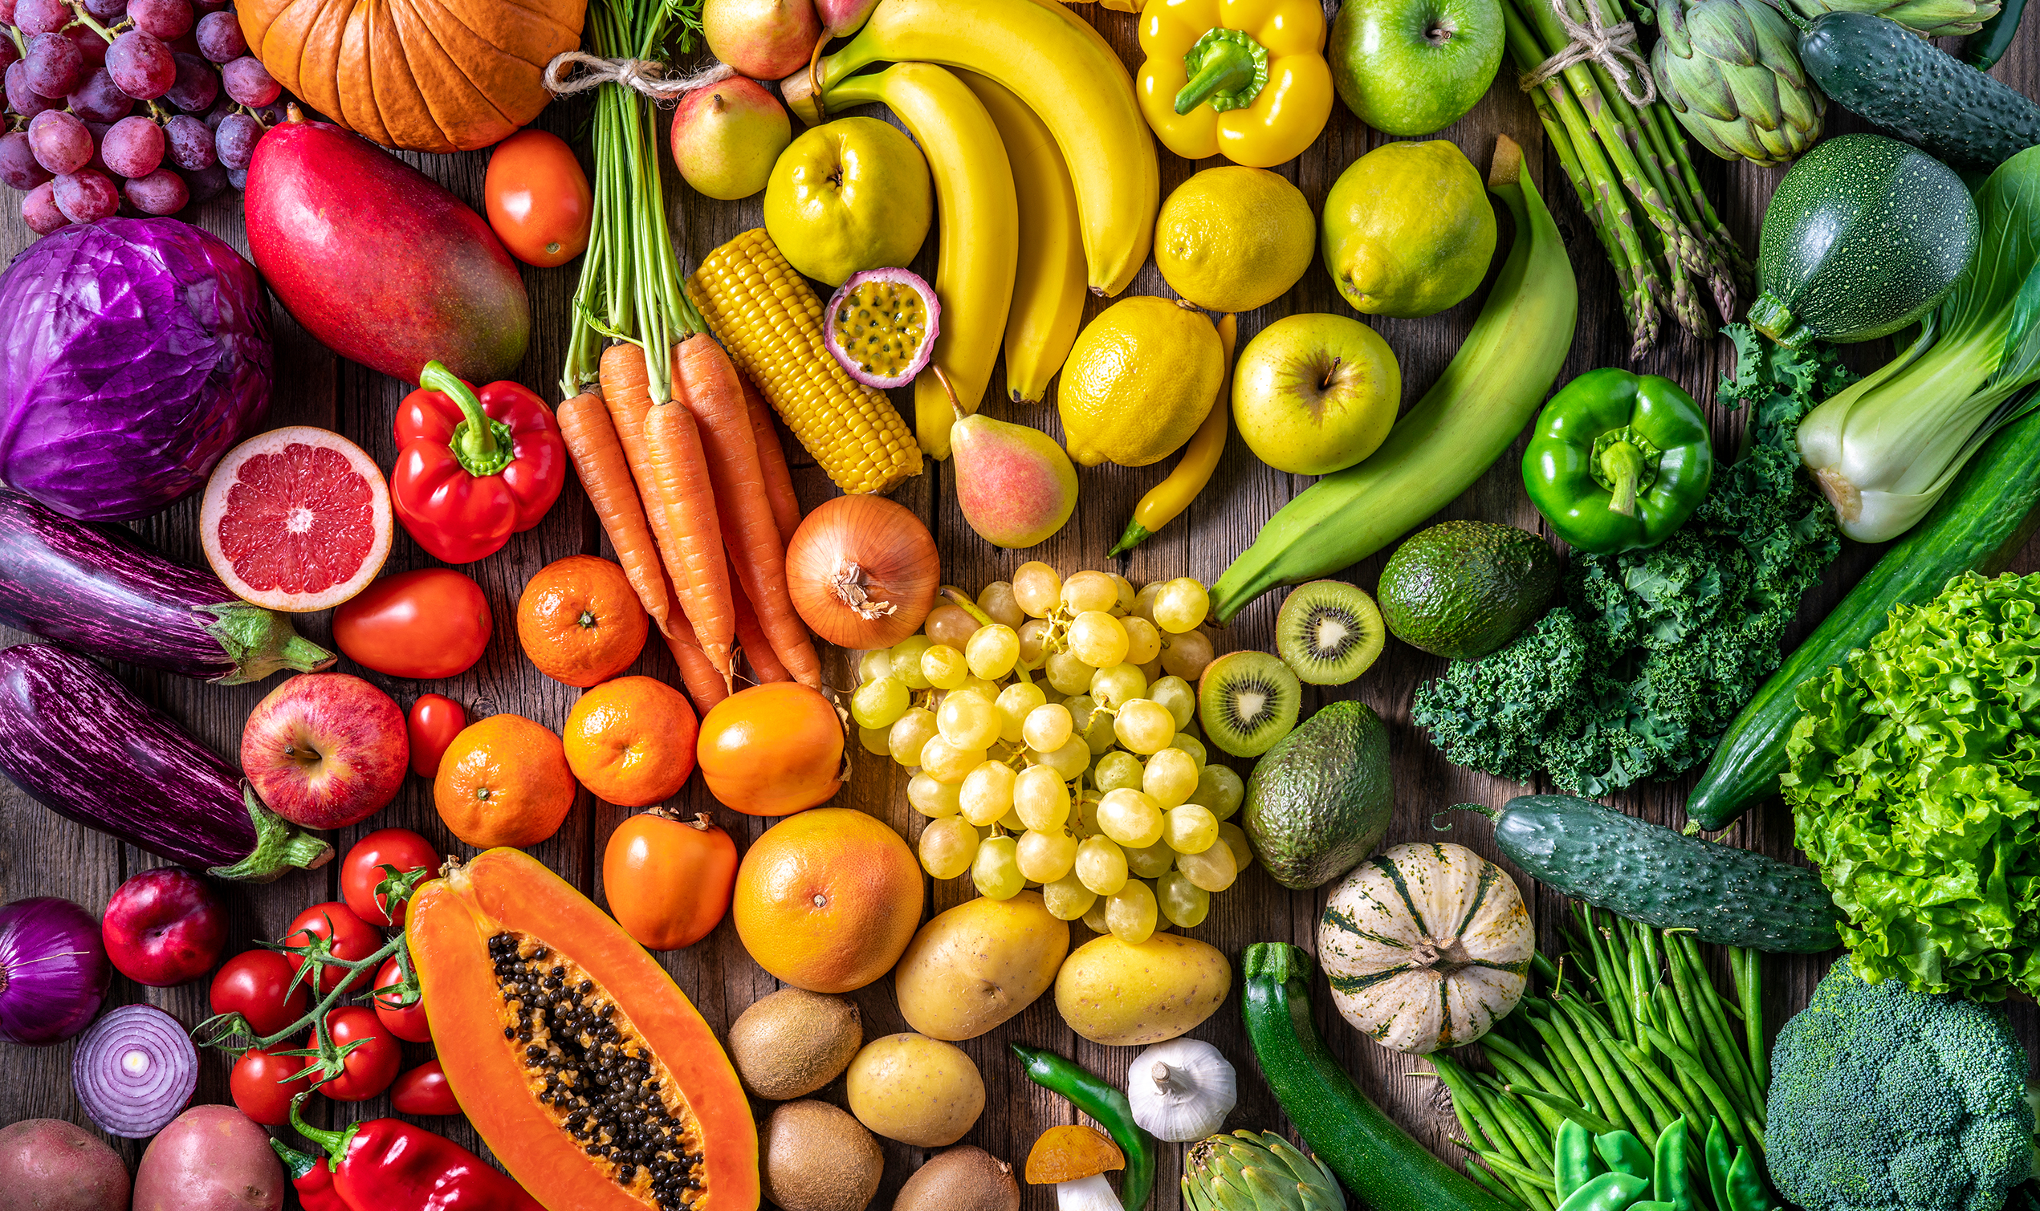
Healthy Eating
Healthy Eating
Healthy Eating
Healthy Eating

Slide 2
Good nutrition is about consistently choosing healthy foods and beverages. Try these quick healthy eating tips to get started:
Increase fiber – Found in fresh fruits and vegetables, whole grains, legumes, nuts, and seeds.
Increase calcium and vitamin D – Found in fortified dairy beverages and cereals as well as some fish.
Increase potassium – Found in a variety of fruits and veggies, including bananas, beet greens, lima beans, and 100% prune juice.
Limit added sugar – Avoid processed foods and replace sugary beverages with water or black coffee.
Limit sodium – Avoid processed foods and try seasoning with fresh herbs and spices instead of salt.
Hungry for more tips? Contact Haller_Rhonda_M@cat.com!
Good nutrition is about consistently choosing healthy foods and beverages. Try these quick healthy eating tips to get started:
Increase fiber – Found in fresh fruits and vegetables, whole grains, legumes, nuts, and seeds.
Increase calcium and vitamin D – Found in fortified dairy beverages and cereals as well as some fish.
Increase potassium – Found in a variety of fruits and veggies, including bananas, beet greens, lima beans, and 100% prune juice.
Limit added sugar – Avoid processed foods and replace sugary beverages with water or black coffee.
Limit sodium – Avoid processed foods and try seasoning with fresh herbs and spices instead of salt.
Hungry for more tips? Contact Haller_Rhonda_M@cat.com!
Good nutrition is about consistently choosing healthy foods and beverages. Try these quick healthy eating tips to get started:
Increase fiber – Found in fresh fruits and vegetables, whole grains, legumes, nuts, and seeds.
Increase calcium and vitamin D – Found in fortified dairy beverages and cereals as well as some fish.
Increase potassium – Found in a variety of fruits and veggies, including bananas, beet greens, lima beans, and 100% prune juice.
Limit added sugar – Avoid processed foods and replace sugary beverages with water or black coffee.
Limit sodium – Avoid processed foods and try seasoning with fresh herbs and spices instead of salt.
Hungry for more tips? Contact Haller_Rhonda_M@cat.com!
Good nutrition is about consistently choosing healthy foods and beverages. Try these quick healthy eating tips to get started:
Increase fiber – Found in fresh fruits and vegetables, whole grains, legumes, nuts, and seeds.
Increase calcium and vitamin D – Found in fortified dairy beverages and cereals as well as some fish.
Increase potassium – Found in a variety of fruits and veggies, including bananas, beet greens, lima beans, and 100% prune juice.
Limit added sugar – Avoid processed foods and replace sugary beverages with water or black coffee.
Limit sodium – Avoid processed foods and try seasoning with fresh herbs and spices instead of salt.
Hungry for more tips? Contact Haller_Rhonda_M@cat.com!

